Slide 1
‘Macbeth’ Context Recall
List 3 reasons to support that ‘Macbeth’ is a tragedy.
What is meant by the ‘Divine Right of Kings’?
Define tyranny / usurp / villainy

Slide 2

FEEDBACK
The play is a 5 act play / ends in death / tragic hero / hamartia / downfall / catharis / any structural overview comment
The belief that the monarch is selected by God and is only accountable to divine powers and not to any earthly powers.
As below:

Slide 3
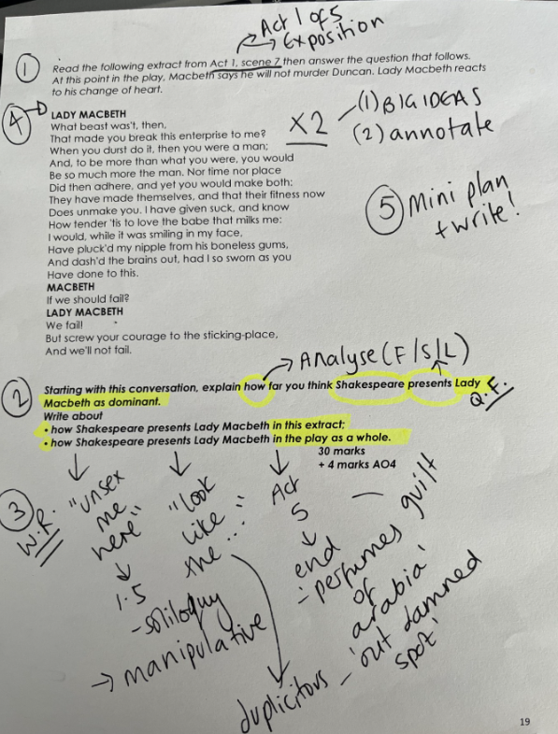
Planning: How far do you think Shakespeare presents Lady Macbeth as dominant?

Slide 4
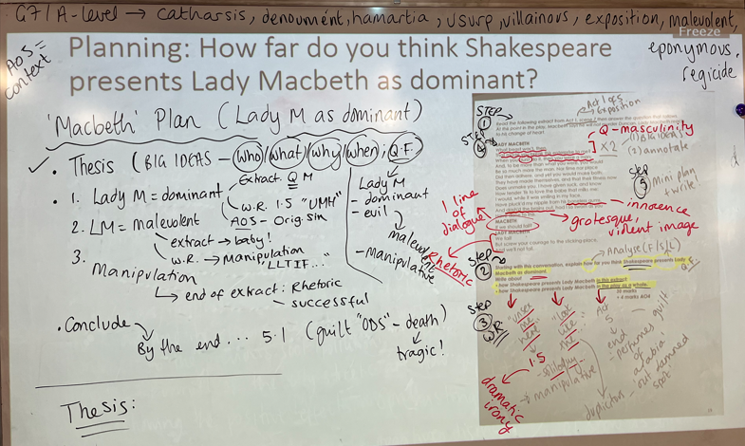
What we did (our plan):

Slide 5
‘Macbeth’ Getting Started …
Thesis: BIG IDEAS (who / what / when / why) / Q.F.
Shakespeare’s Jacobean morality play, ‘Macbeth’ conveys the downfall of its eponymous tragic hero as he is driven by the witches’ prophecies and ambition to become and remain King. Throughout this five act tragedy, the audience observe as Macbeth transcends from the valiant, heroic “brave Macbeth” to the tyrannical “dead butcher” by the end. Arguably, it is not only Macbeth’s hamartia (his ambition) that leads to this downfall but his complex relationship with his wife, Lady Macbeth …

