Slide 1


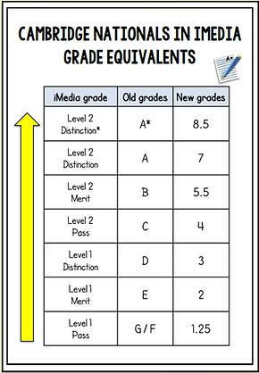
OOSHL Monday, Tuesday 3:10 – 4:15PM
Support from school and online
Revision Guides
https://amzn.eu/d/iTi8lD7
Seneca – D&T section
BBC Bitesize
Technology student
www.technologystudent.com
Google Classroom page where all lesson resources and assignments are posted.
Big Picture!
RO40 Coursework- 30% of qualification- Submitted in Year 10
R039 Coursework- 30% of qualification
R038 Exam- 40% of qualification
September to October half term = R039 L01 + L02 (12 lessons)
October half term to Xmas= R039 L03 (14 lessons)
Xmas to Easter= R039
1 lesson per fortnight till coursework is complete for theory lesson to prepare students for R038 exam.
Students will need to complete work at home to meet the coursework deadline.
Contact Mrs Asghar s.asghar@finhampark2.co.uk

Slide 2
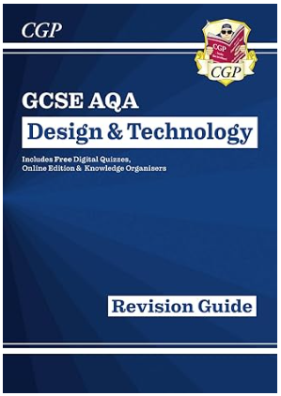

OOSHL Monday, Tuesday 3:10 – 4:15PM
AQA Design & Technology
Big Picture!
NEA 50% of qualification Exam 50% of qualification
September to October half term =(12 lessons)
NEA Section A (10 marks)
NEA Section B (10 Marks)
NEA Section C (20 Marks
October half term to Christmas = (14 lessons)
NEA Section C (20 Marks)
NEA Section D (20 Marks)
Christmas to Feb Half term= (10 lessons)
NEA Section D (20 Marks)
NEA Section E (20 Marks)
Feb half term to Easter= (14 lessons)
NEA Section E (20 Marks)
NEA Section F (20 Marks)
Students will need to complete work at home to meet coursework deadlines.
Support from school and online
Revision Guides
https://amzn.eu/d/9yttJWN
Revision flash cards
https://amzn.eu/d/0u2WHl3
Seneca – D&T section
BBC Bitesize – D&T AQA section
Technology student
www.technologystudent.com
Google Classroom page where all lesson resources and assignments are posted.
Contact Mrs Pawar v.negi@finhampark2.co.uk

