Slide 1

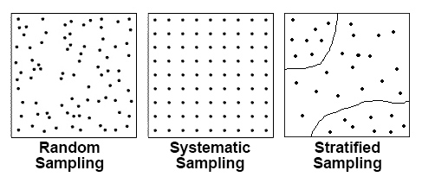
Deciding on Fieldwork Questions
Physical Fieldwork Questions
How do river characteristics change downstream? How does longshore drift affect beach profiles? What impact is erosion having at _________? Is flood management effective at _________? Does tourism has a positive impact on _________?
Human Fieldwork Questions
Has regeneration being successful in _________? How does environmental quality vary in ________? How is traffic managed in _________? Do science parks have a positive impact in _________? Is there economic inequality between _______ and ________?
Risk assessment
River currents | Risk of powerful water and risk of slipping over. | All wore wellies and were told not to go in deep parks of the river. Stay in groups.
Uneven ground | Danger of falling over due to uneven footpaths. | All wearing sensible footwear. Not running and walking carefully over large rocks.
Weather | Wet weather is dangerous due to slippery groynes etc. Hot weather also poses the risk of dehydration. | Students advised to bring plenty of water and sun cream if the weather forecast is hot. If the weather forecast is wet, students are advised to bring appropriate clothing and footwear.
Unfamiliar areas | Getting lost in new environments. | Staying in groups. Carrying a phone and a map in case you do get lost.
Traffic | Getting ran over by vehicles. | Use pedestrian crossings only when crossing the road.
Key Terms
Enquiry Question | The question we were trying to answer by doing the fieldwork.
Data collection methods | The way in which we collected the data. EG. Measuring width, depth and velocity.
Data presentation methods | The type of graphs we used to present the data. EG. Bar, scatter, maps etc.
Accurate conclusions | When data is collected in the correct way that make what we find to be trustworthy.
Reliable conclusions | When there is enough data collected in an accurate way so we can trust the results.
Types of data
 | Primary Data Data you collect yourself | Secondary Data Data collected by someone else
PHYS | River depth / width / velocity / discharge Pebble size / beach gradient / pebble roughness Photographs | Weather data Erosion rates OS maps – relief of the land / cliff locations
HUM | Environmental quality survey Questionnaires Interviews Traffic counts / Pedestrian counts Photographs | Census data House price data Crime statistics OS map – locations of services / houses / roads / buildings
Evaluating data collection methods
 | Advantages | Disadvantages
River Data | Data is easy to compare downstream | Current can make collection inaccurate
Pebble data | See impacts of erosion. | Bias in selecting pebbles to measure
Questionnaire | Understand people’s opinions | Timely to analyse People may lie
Env Quality Survey | Gain info on a wide variety of factors. Number is easy to compare scores. | Subjective – based on your opinion so can be bias.
Counts (Traffic / pedestrian) | Understand how busy / popular an area is. | Can easily miscount by mistake if an area is really busy
Paper 3 Section B
Unfamiliar Fieldwork (Paper 3)
Sampling Strategies
 | Advantages | Disadvantages
Random Sampling (Randomly choosing sites to collect data) | Not bias – each site has an equal chance of being picked. Can easily be done with a large area | Sites can get clustered together meaning data collection isn’t representative May lead to sites that are inaccessible
Systematic Sampling (picking sites every __ metres) | Gives a good representation of an area. Easier to do than random sampling | Can be time consuming Can be bias as not all sites have an equal chance of being selected. May lead to sites that are inaccessible
Stratified Sampling (picking sites by topic) | Flexible – fits with a lot of different enquiries Gives a good comparison of different areas. (Eg. Upper, middle and lower course) | Not suitable for something like a questionnaire Could lead to bias from the person picking the sites
Types of data
 | Quantitative Data Data that is statistical / numbers | Qualitative Data Data that is descriptive
PHYS | River depth / width / velocity / discharge Pebble size / beach gradient Weather data Erosion rates | Photographs Pebble roughness OS maps
HUM | Environmental quality survey Traffic counts Pedestrian counts House price data Crime statistics | Interviews Questionnaires OS maps Photographs
Improving data collection methods
Make it ACCURATE & RELIABLE (Enough data that we can trust what we find out) | Make it REPRESENTATIVE (Enquiry covers the whole area and not just a small part)
Collect more data and generate an average – reduce the risk of anomalies. Ask a wider variety of questions on a questionnaire. If something is opinion based, consulting with other people to reduce bias. Collect data at different times of day / year / weather conditions. | Collect data at more sites to cover a larger area – reduces the risk of anomalies. Ask a lots of different people for a questionnaire to cover all ages / genders / ethnicities etc. Collect data at different times of day / year / weather conditions.

Slide 2
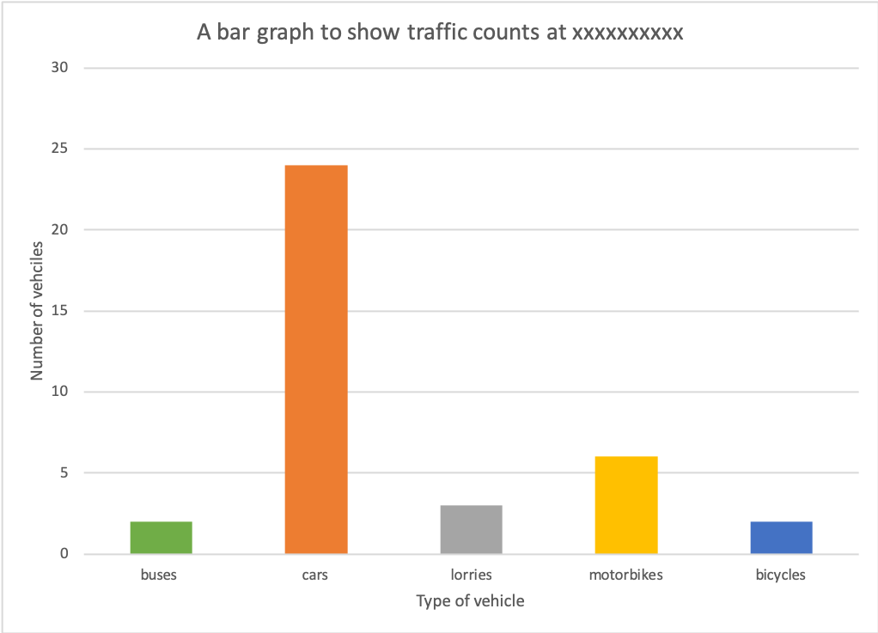
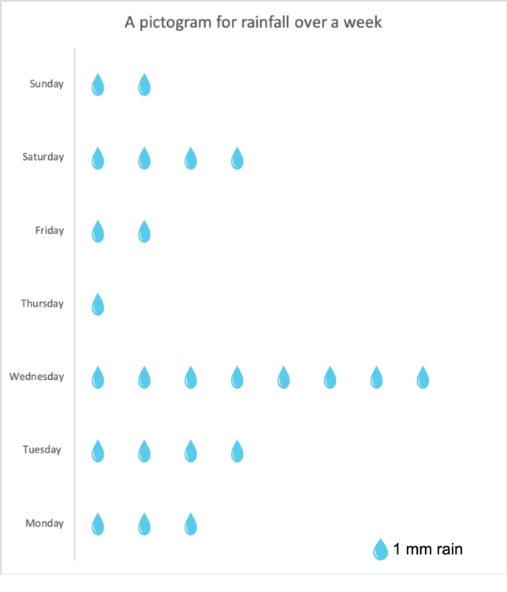
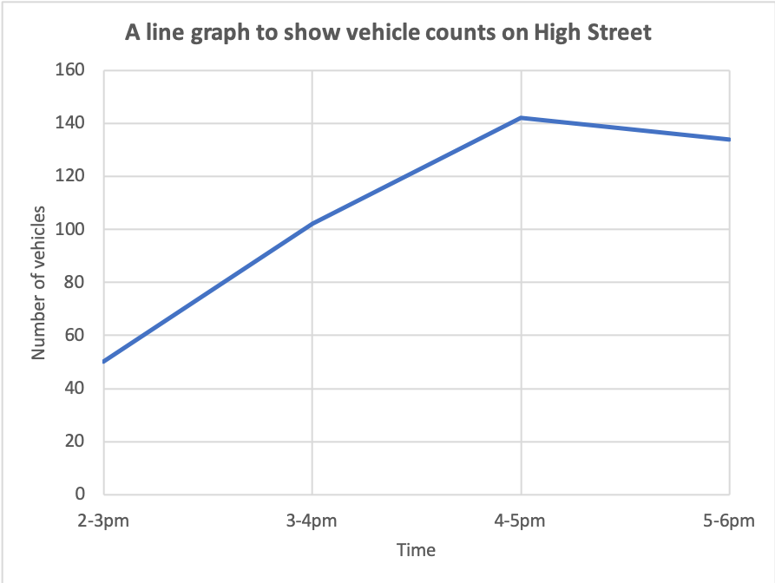
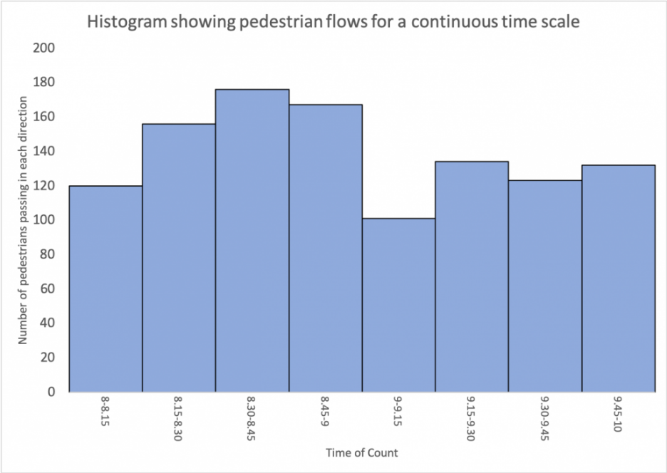
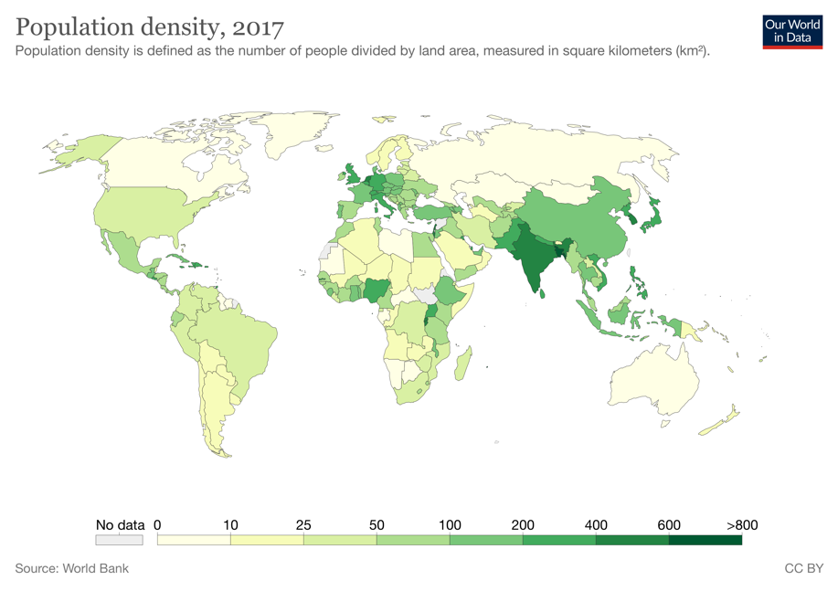
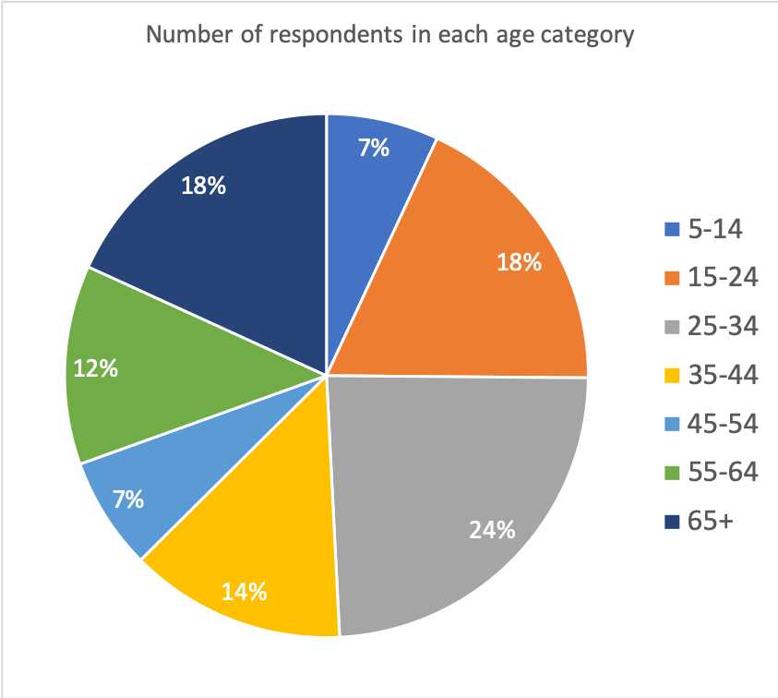
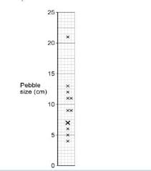
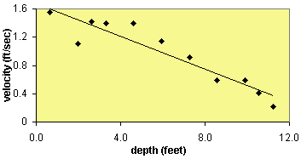
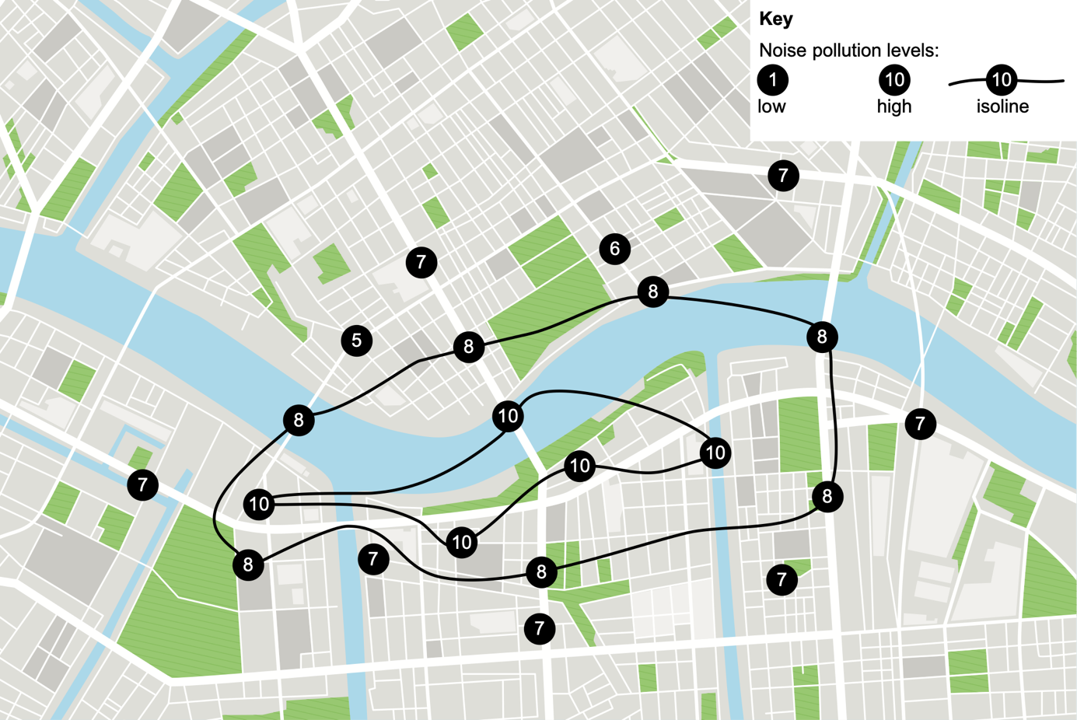
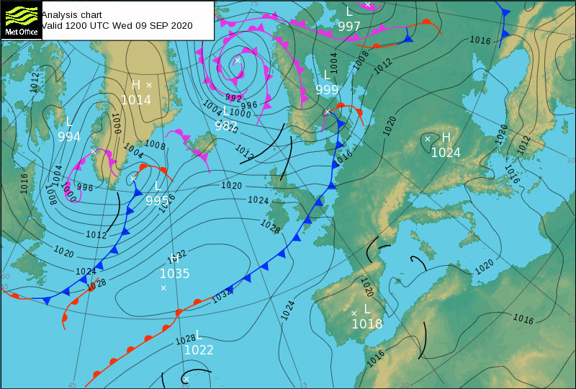
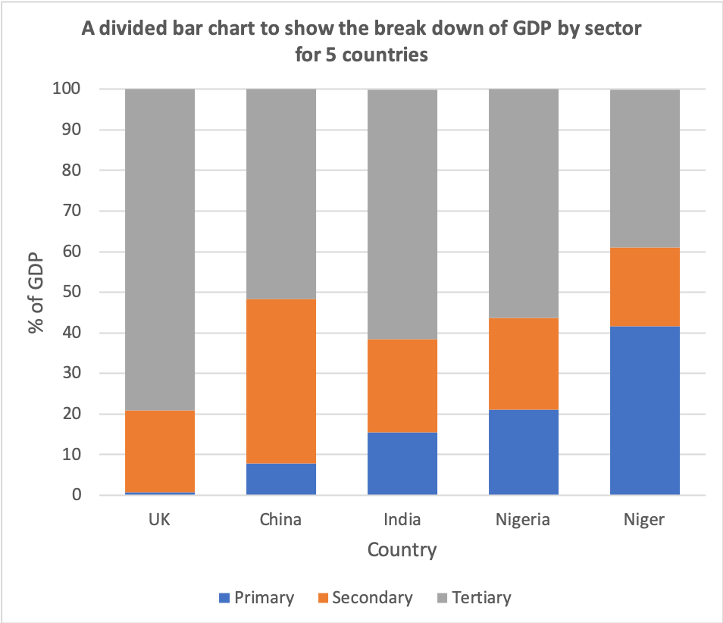
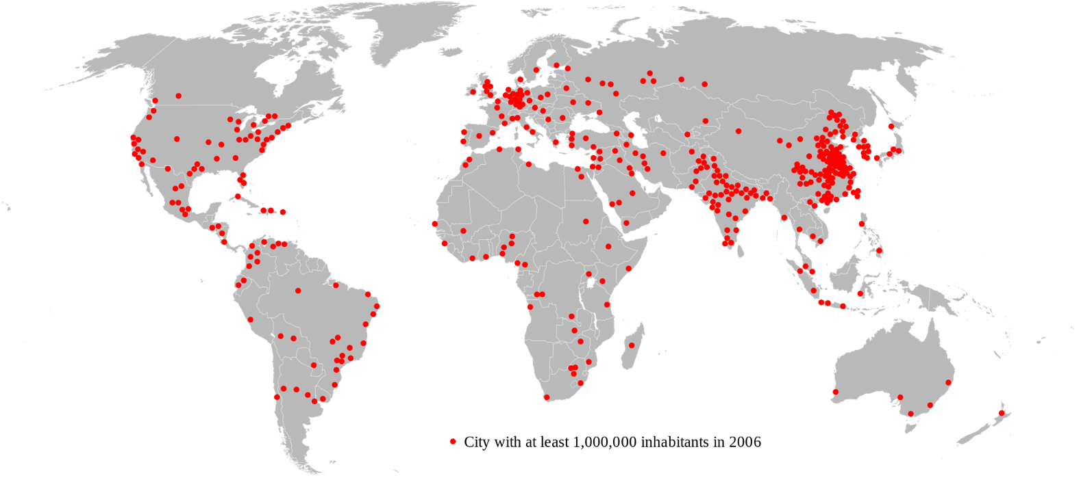
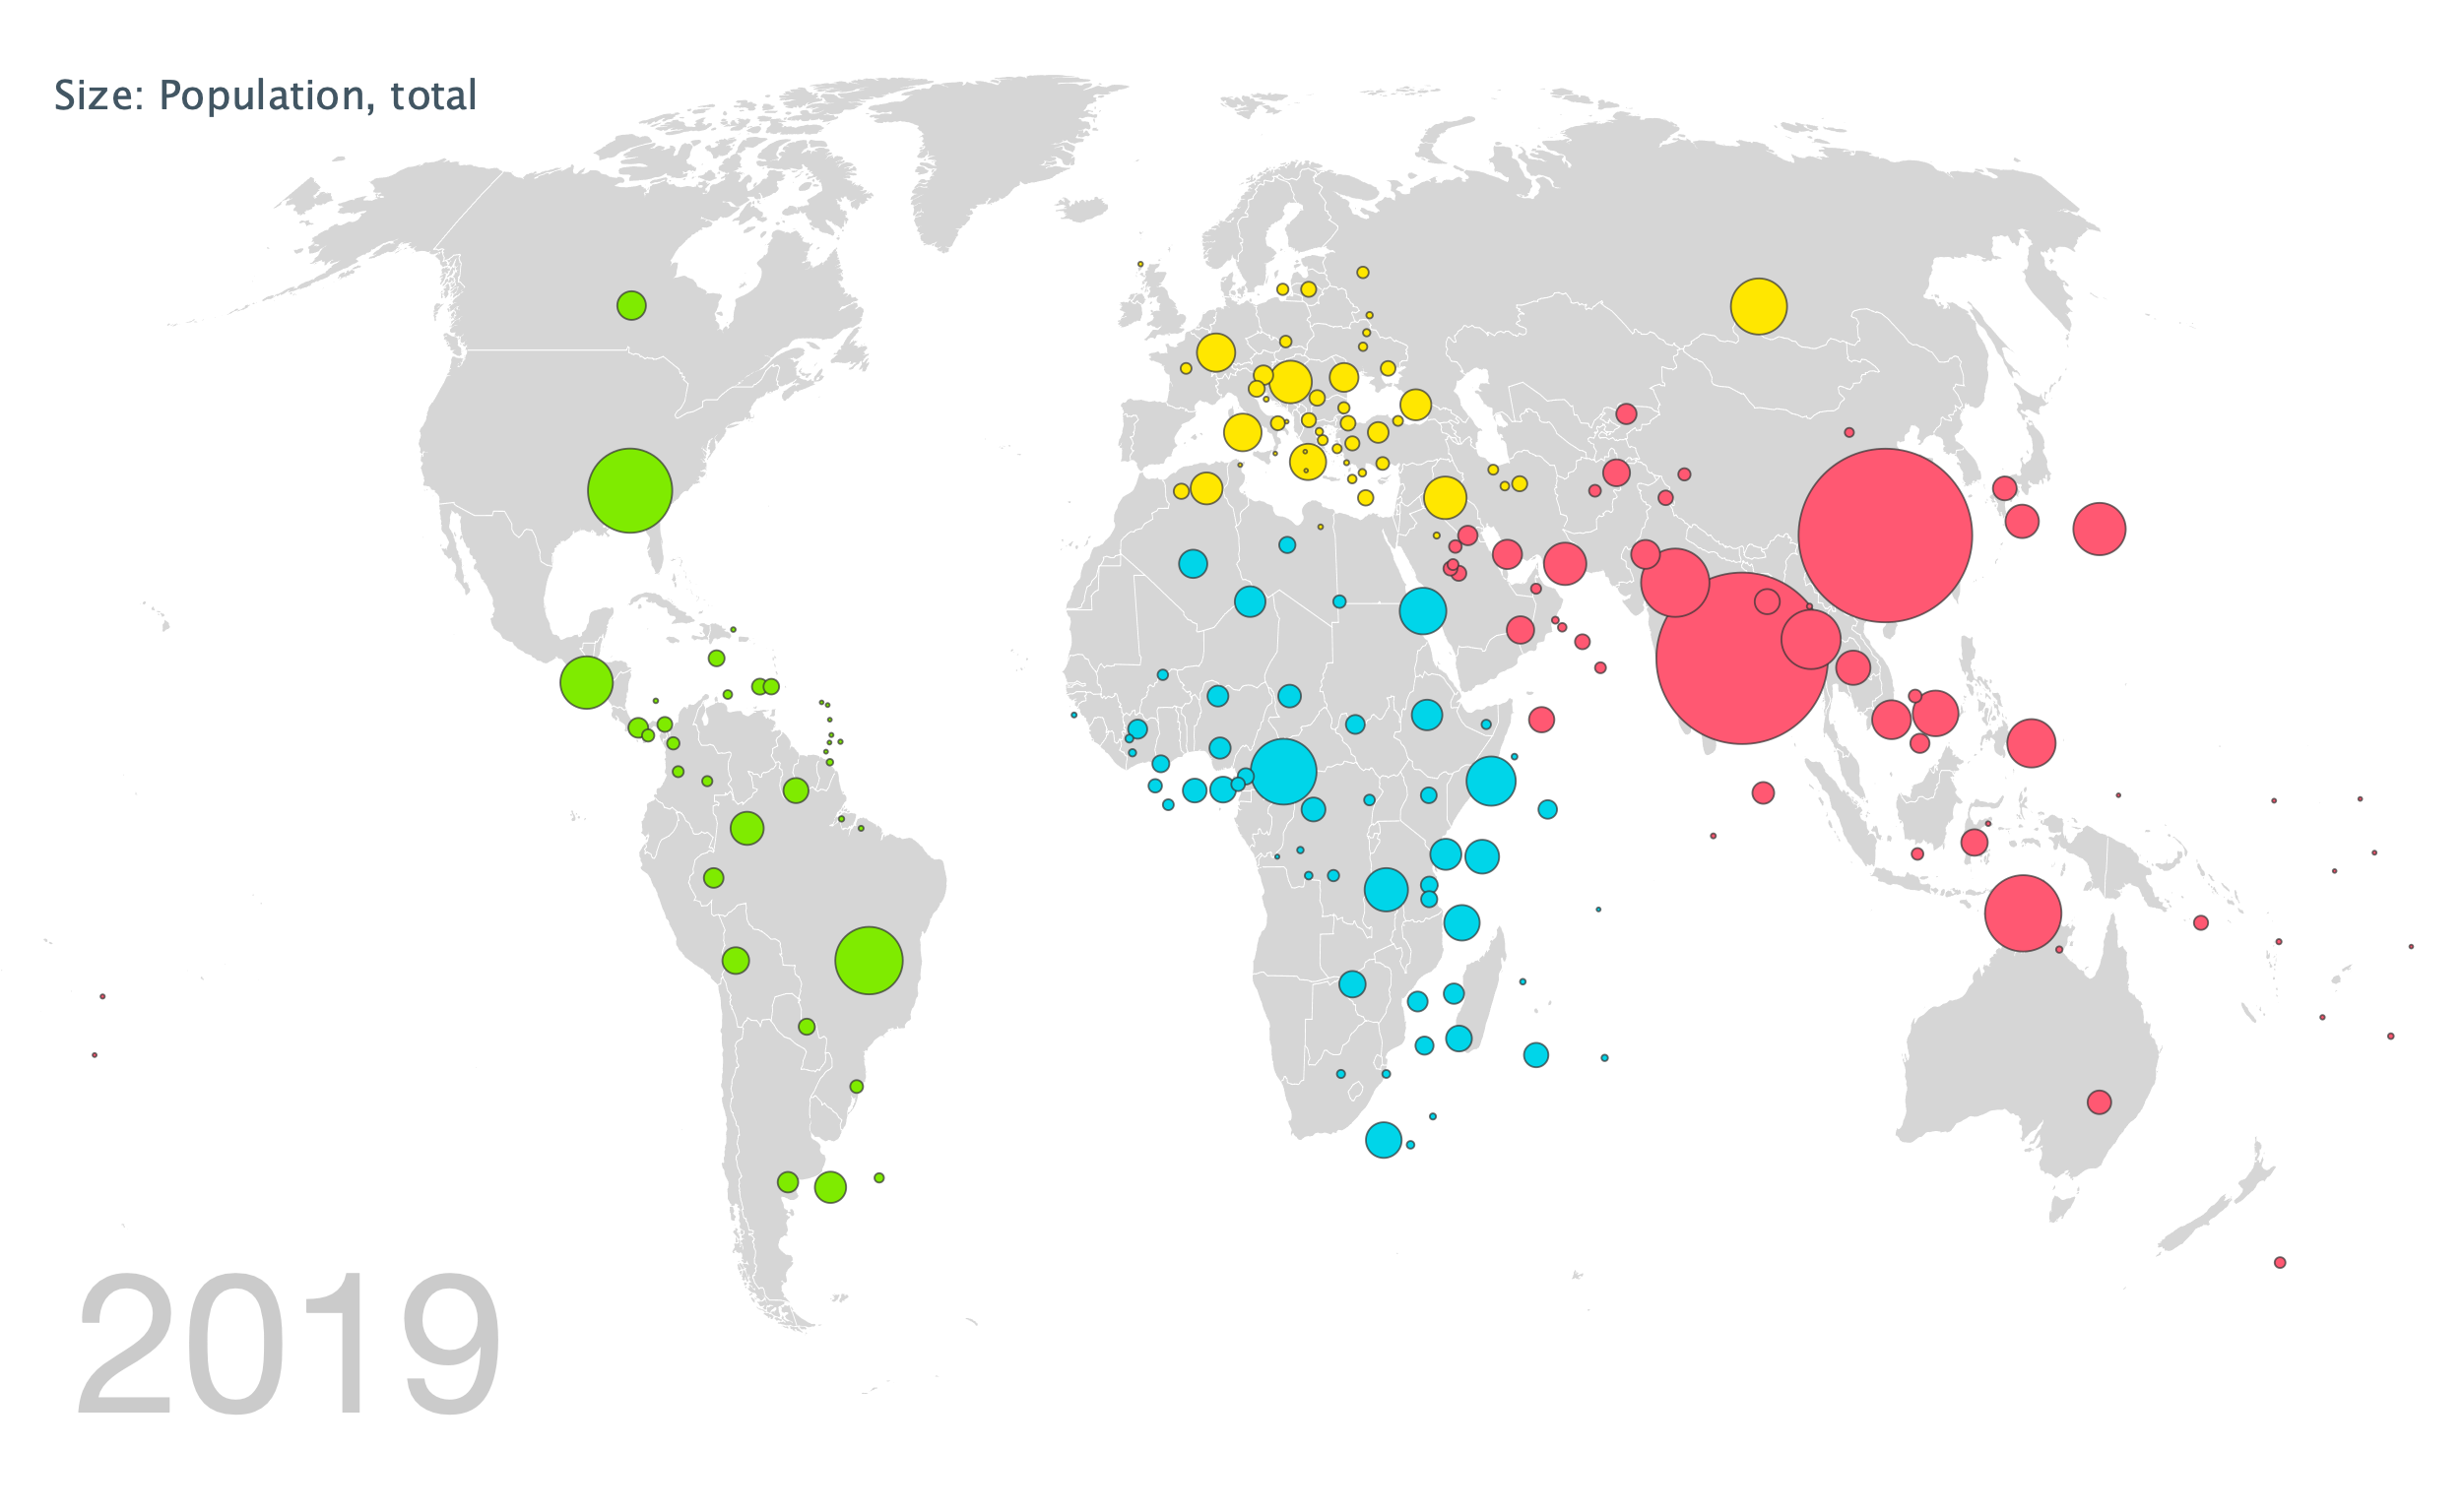
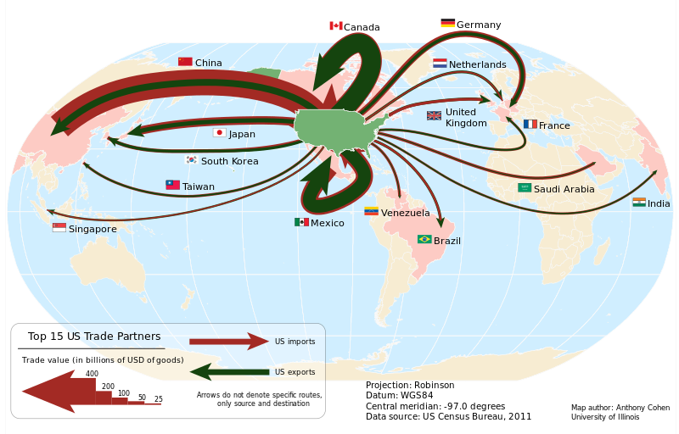
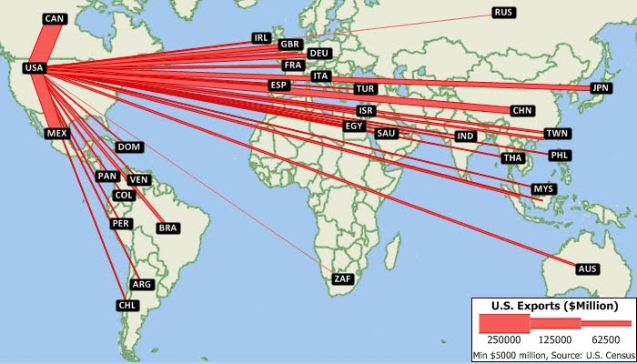
ANALYSING DATA
Mean | Add all data together and divide by the number of values.
Median | Put the data in numerical order and find the middle number.
Mode | Most common number.
Range | Highest number minus the smallest number.
Interquartile Range | Upper quartile value minus the lower quartile value. More accurate than the range as it removes the extreme values.
WHY? + Averages can remove the risk of anomalies skewing the data. + Easily see a general trend / what is most common in the data. + Easily compare changes between areas.
Bar Chart / Histograms
Bar charts show continuous data whereas histograms show continuous data. <- Bar chart Histogram ->
Advantages: Can see a clear comparison / trend. | Disadvantages: Does show the causes of trends.
Line Graph
Line graph shows continuous data to show changes over time. There is always a dependent (the variable that isn’t changed by other variables EG. time) and an independent variable (the variable that is changed by other variables (EG. The number of cars on the road).
Advantages: Can show multiple sets of data. | Disadvantages: If too much data is plotted – hard to read.
Pictogram
A way of presenting data using symbols.
Advantages: Easy to interpret / see trends. | Disadvantages: Not suitable for continuous data.
Pie Chart
Divided circle useful for presenting a quantity that can be divided in to parts.
Advantages: Good to display parts of a whole. | Disadvantages: Can not be used to show trends.
Choropleth Map
Uses different shades of colour / symbols to display different amounts.
Advantages: Easy to spot general trends. | Disadvantages: Not useful for showing total values
Paper 3 Section B
Unfamiliar Fieldwork (Paper 3)
Dispersion Graphs
Takes a set of data and allows you to see if the data is grouped together or very different.
Advantages: Can easily spot anomalies in data. | Disadvantages: Can be time consuming to analyse.
Scatter Graphs
Investigated a link between 2 sets of data.
Advantages: Can draw a LOBF to see if there is correlation. | Disadvantages: Analysis of the correlation can be subjective.
Isoline map
Lines that join up values of the same value. (EG. Contour lines)
Advantages: Can easily compare areas of equal value. | Disadvantages: Can be difficult to read if lines are close together.
Divided Bar Chart
Columns of bar charts are sub-divided based on the information being displayed.
Advantages: Easy to see trends in large sets of data. | Disadvantages: Requires additional explanation.
Dot Maps / Proportional Symbol Maps
Dot maps show 1 dot per value. Proportional symbols are circles / symbols drawn at different sizes to represent different values.
Advantages: Easy to interpret general trends. | Disadvantages: Clustering can make them hard to read.
Flow Line / Desire Line Maps
Flow lines show movement of something from one place to another. Desire lines shows a line to show how places are connected.
Advantages: Shows connections between places. | Disadvantages: Overlapping makes it hard to read.

