Slide 1
Separate Science: Chemistry Paper 2
Higher
Summary Sheets
Chemistry Paper 2
 |  | 1h 45min
Topics in the Paper:
C8 | Rates and Equilibrium
C9 | Crude Oil and Fuels
C10 | Organic Reactions
C11 | Polymers
C12 | Chemical Analysis
C13 | Earth’s Atmosphere
C14 | Earth’s Resources
C15 | Using Our Resources

Slide 2
C8: Rates and Equilibrium: Chemistry Specification
Calculating Rates of Reaction The rate of reaction is can be found by measuring the amount of reactant used or the amount of product formed over time. It can be calculated using: Rate of Reaction = Quantity of Reactant Used/Time Rate of Reaction = Quantity of Product Formed/Time The quantity can be measured by mass in grams and if so the units for rate of reaction will be g/s. The quantity can also be measured by volume in cm³, if so the unit for rate of reaction will be cm³/s. If the quantity is measured in moles then the units for rate of reaction will be mol/s. | Collision Theory and Activation Energy Chemical reactions can only occur when reacting particles collide with each other and with enough energy. | Factors Which Affect the Rates of Chemical Reactions There are different factors that affect rate of reaction including concentration of reactants, pressure of reacting gases, the surface area of solid reactants, the temperature and the presence of a catalyst.
 | Rate of Reaction and Temperature When temperature is increased the amount of collisions between reactants increases, and the collisions have more energy. This increases the rate of reaction.
 |  | Rate of Reaction and Pressure When the pressure of reacting gases is increased the amount of collisions between reactants increases and so the rate of reaction increases.
 | Rate of Reaction and Concentration When concentration is increased the amount of collisions between reactants increases and so this increases the rate of reaction. | Rate of Reaction and Surface Area When the surface area of reacting solids is increased the amount of collisions between reactants increases and so the rate of reaction increases.
Measuring Rate of Reaction To measure the rate of reaction you could add the reactants together and: Measure the decreasing mass at regular time intervals. This method works if one of your products is a gas. You will need a conical flask to put the chemicals in, a balance to measure the mass a stopwatch and cotton wool to bung the top of the flask to prevent any of the reactants being lost. Measure the volume of gas produced at regular time intervals. Again this method works if one of your products is a gas. You will need a conical flash connected to a gas syringe and a stopwatch. Measure the time it takes for a cross to disappear. This method works if one of your products is a solid.
 | Catalysts Catalysts increase the rate of reaction without being used up themselves. They do this by lowering the activation energy by providing an alternative pathway for the reaction to take place. Different reactions need different catalysts and enzymes are examples of biological catalysts. If a catalyst is involved with a chemical reaction it is not included in the chemical equation. When drawing a reaction profile to show a reaction with a catalyst, draw the activation energy for the reaction with the catalyst below the activation energy for the reaction without the catalyst.
 | Reversible Reactions In some reactions the products can react with each other to make the original products again. These are reversible reactions. They are represented by: A + B ⇌ C + D | Reversible Reactions and Energy Changes If a reversible reaction is exothermic in one direction then it will be endothermic in the opposite direction.
 |  | Equilibrium When a reversible reaction happens in a closed system in which reactants and products are unable to escape, equilibrium is reached. This is when the forward and reverse reaction happen at exactly the same rate. If a change is made to the conditions then the system will respond to counteract these changes. The effect of changing conditions can be predicted using Le Chatelier’s Principle.
Changing Concentration and Equilibrium If the concentration of a reactant is increased more products will be made. If the concentration of a product is decreased more reactants will react until equilibrium is reached again. | Changing Pressure and Equilibrium If pressure is increased the equilibrium will shift towards the side of the reaction with the smaller number of molecules. This can be determined from the symbol equation. If pressure is decreased the reaction will shift towards the side of the reaction with the larger number of molecules.
Changing Temperature and Equilibrium If the temperature is increased the endothermic reaction will happen at a faster rate and the products of this reaction will increase. There will be fewer products made for the exothermic reaction in the opposite direction. If the temperature is decreased the endothermic reaction will happen at a slower rate and the products of this reaction will decrease. There will be more products made for the exothermic reaction in the opposite direction.

Slide 3
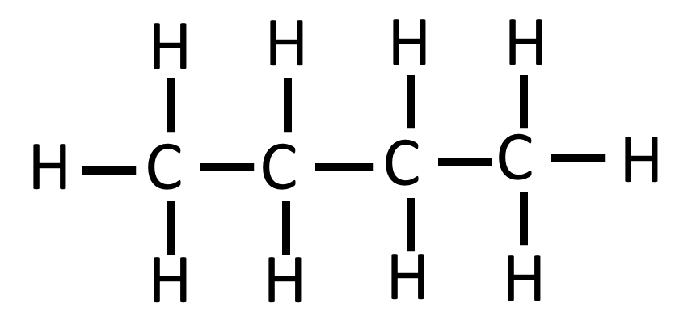
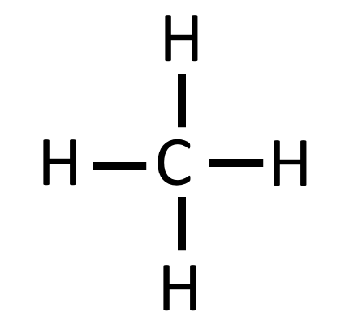
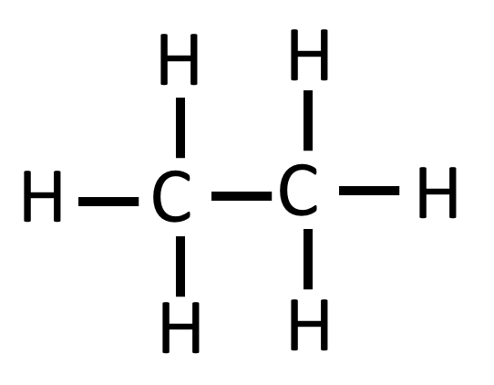
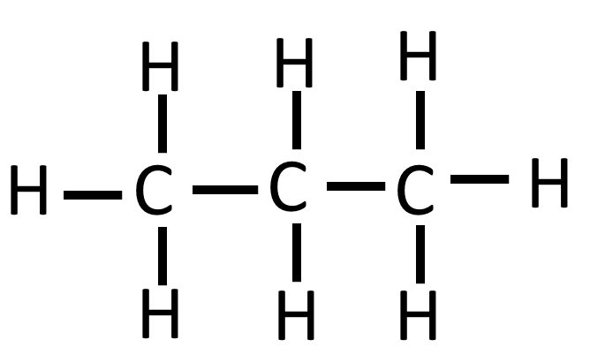
C9: Crude Oil: Chemistry Specification
Crude Oil
Crude oil is a finite resource found in rocks. It is the remains of an ancient biomass consisting mainly of plankton that was buried in mud. Crude oil is a mixture of a very large number of compounds. Most of the compounds in crude oil are hydrocarbons. Hydrocarbons are molecules made up of only hydrogen and carbon atoms. Most of the hydrocarbons found in crude oil are alkanes.
Butane
Butane is an alkane that contains 4 carbon atoms. It has the chemical formula C₄H₁₀ and can be represented using the structural formula below.
Properties of Hydrocarbons
Some properties of hydrocarbons depend on the size of their molecules, including boiling point, viscosity and flammability. As the size of alkanes increase the boiling point increases. This is because when the molecule is larger there are stronger intermolecular forces between the molecules. The longer the alkane chain the more viscous the alkane is also. As the alkane chain becomes longer the flammability of the alkane decreases. This means that methane is the most flammable of the alkanes. As short chain polymers are the most flammable this means that they are the most useful to use as fuels.
Fractional Distillation
The many hydrocarbons in crude oil may be separated into fractions, each of which contains molecules with a similar number of carbon atoms, by fractional distillation. In this process the crude oil is heated until most of it turns into gas. The gases enter a fractioning column which is cooler at the top and hotter at the bottom. The gases rise up the column and as they rise they cool and condense back into liquids. The longer hydrocarbons have higher boiling points and so condense into liquids lower down the column while the smaller hydrocarbons have lower boiling points and so condense further up the column. The end result is crude oil separated into different fractions. Each fraction contains hydrocarbons with a similar number of carbon atoms and so they all have similar boiling points.
Alkanes
Alkanes are compounds with the general formula C_{n}H_{2n+2} Examples of alkanes include methane, ethane, propane and butane.
Combustion
The combustion of hydrocarbon fuels releases energy. During combustion, the carbon and hydrogen in the fuels are oxidised. The complete combustion of a hydrocarbon produces carbon dioxide and water.
For example:
Methane + Oxygen → Carbon Dioxide + Water
CH₄ + 2O₂ → CO₂ + 2H₂O
Methane
Methane is an alkane that contains 1 carbon atom. It has the chemical formula CH₄ and can be represented using the structural formula to the right.
Cracking
Hydrocarbons can be broken down to produce smaller, more useful molecules. This process is called cracking. Cracking can be done in different ways including catalytic cracking and steam cracking. In cracking a long chain hydrocarbon is broken down into smaller alkane molecules and alkenes which are another kind of hydrocarbon.
Ethane
Ethane is an alkane that contains 2 carbon atoms. It has the chemical formula C₂H₆ and can be represented using the structural formula to the right.
Petrochemicals
Different fractions of crude oil have many uses including as fuels that we depend for our modern lifestyle. Fuels from crude oil include petrol, diesel oil, kerosene, heavy fuel oil and liquid petroleum gases. Crude oil is also important for modern lifestyles as many useful materials including solvents, lubricants, polymers and detergents are produced by the petrochemical industry from crude oil. There is a huge selection of natural and synthetic carbon compounds due to the ability of carbon atoms to form families of similar compounds.
Catalytic Cracking
In catalytic cracking the long chain hydrocarbons are heated to vaporise them. Then the vapour is passed over hot powdered aluminium oxide which is a catalyst. The long chain molecules split apart on the surface of the catalyst.
Propane
Propane is an alkane that contains 3 carbon atoms. It has the chemical formula C₃H₈ and can be represented using the structural formula below.
Steam Cracking
In steam cracking the long chain hydrocarbons are heated to vaporise them. Then the vapour is mixed with steam. The long chain molecules then split apart.
Testing For Alkenes
Alkenes are more reactive than alkanes and can react with bromine. This means that if an alkene is present the bromine will turn colourless.

Slide 4
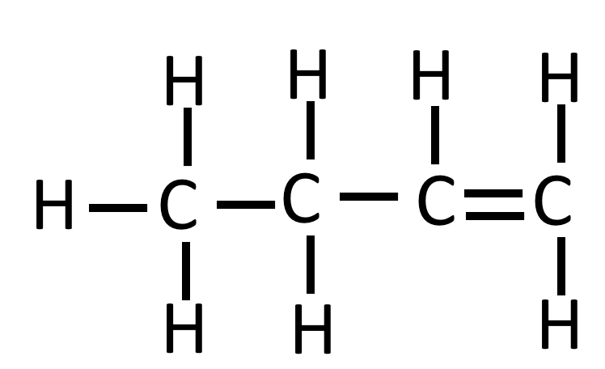
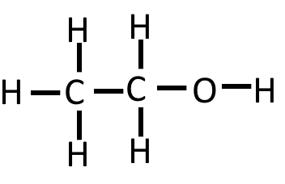
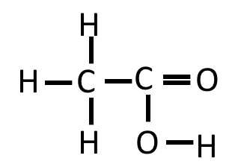
C10: Organic Reactions: Chemistry Specification
 | Alkenes |  |  | Alcohols |  |  | Carboxylic Acids
Functional Group | C=C |  |  | -OH |  |  | -COOH
First 4 members of the series | Ethene Propene Butene Pentene | C₂H₄ C₃H₆ C₄H₈ C₅H₁₀ | E.g. Butene | Methanol Ethanol Propanol Butanol | CH₃OH C₂H₅OH C₃H₇OH C₃H₉OH | E.g. Ethanol | Methanoic Acid Ethanoic Acid Propanoic Acid Butanoic Acid | COOH CH₃COOH C₂H₅COOH C₃H₇COOH | E.g. Ethanoic Acid
Reactions | Reaction with oxygen in combustion Alkenes react with oxygen during combustion but they tend to burn in air with smoky flames due to incomplete combustion. In general: Alkene + Oxygen → Carbon Dioxide + Water For example: Ethene Oxygen Carbon Dioxide Water C₂H₄ O₂ CO₂ H₂O Reaction with Hydrogen. In general: Alkene + Hydrogen → Alkane For example: Pentene Hydrogen Pentane C₅H₁₀ H₂ C₅H₁₂ This reaction takes place at 60°C in the presence of a nickel catalyst. Reaction with Water (Steam) In general: Alkene + Steam ⇌ Alcohol For example: Ethene Steam Ethanol C₂H₄ H₂O C₂H₄OH This reaction needs energy to heat the gases to a high temperature and a catalyst. Reaction with Halogens To identify a halogen you would use a halogen such as bromine. When it reacts with the alkane it turns colourless. This is because… Ethene Bromine Dibromoethane C₂H₄ Br₂ C₂H₄Br₂ Alkenes react with hydrogen, water and the halogens, by the addition of atoms across the carbon-carbon double bond so that the double bond becomes a single carbon-carbon bond. |  |  | Reaction with sodium In general: Sodium + Alcohol → Salt + Hydrogen For example: Sodium Ethanol Sodium Ethanoate Hydrogen Na C₂H₅OH C₂H₅ONa H₂ Reaction with oxygen in combustion In general: Alcohol + Oxygen → Carbon Dioxide + Water For example Ethanol Oxygen Carbon Dioxide Water C₂H₅OH O₂ CO₂ H₂O Alcohols in Water Small molecules of alcohol mix well with water and make neutral solutions. Reaction with an Oxidising Agent You can use oxidising agents such as potassium dichromate (V) to make carboxylic acids and water from alcohol. For example: Ethanol Oxygen from Ethanoic Acid Water oxidising agent C₂H₅OH O CH₃COOH H₂O |  |  | Reaction with carbonates In general: Acid + Carbonate → Salt + Water + Carbon Dioxide For example: Ethanoic Sodium Sodium Water Carbon Acid Carbonate Ethanoate Dioxide CH₃COOH NaCO₃ CH₃COONa H₂O CO₂ Reaction with alcohols In general: Alcohol + Carboxylic Acid ⇌ Ester + Water For example: Methanol Ethanoic Methyl Ethanoate Water Acid CH₃OH CH₃COOH CH₃COOCH₃ H₂O Dissolving in Water To show up their acidic properties acids must dissolve in water. This is because all acids ionise in water. Their molecules split up to form positive H⁺ ions and negative ions. Weak acids such as the carboxylic acids only partly ionise. When dissolving in water the following reaction can take place: Ethanoic Acid Ethanoate Ions Hydrogen Ions CH₃COOH CH₃COO⁻ H⁺ As carboxylic acids only partly ionise they have a higher pH than a strong acid and so there are slower reactions with metal carbonates.
 |  |  |  | Making Alcohols: Alcohol can be made in fermentation and can also be made by reacting ethene with water in the presence of a catalyst. Fermentation with yeast: Glucose → Ethanol + Carbon Dioxide
 |  |  |  | Uses Ethanol is the main ingredient in alcoholic drinks and alcohols can be used as solvents as they dissolve many other organic compounds. This means they are used in products such as perfumes, aftershaves and mouthwashes. |  |  | Esters have distinctive smells. Many smell sweet and fruity. This means that they are used in perfumes and food flavourings. Esters are also volatile which means they evaporate easily.
+ → +
+ → +
+ → + +
+ → +
+ → + +
+ → +
+ → +
+ → +
+ ⇌ +
+ →
+ →
+ ⇌ +
+ ⇌
+ → +
+ ⇌
+ → +
+ ⇌
+ ⇌
+ →
+ →

Slide 5
C11: Polymers: Chemistry Specification
Addition Polymerisation In addition polymerisation alkenes such as poly(ethene) and poly(propene) make polymers. In an addition polymerisation reaction lots of small molecules known as monomers make large molecules called polymers. No other molecules are made in the reaction. | DNA DNA is known as deoxyribonucleic acid and it is a large molecule that is needed for life. It codes for genetic instructions for the development and functioning of living organisms and viruses. DNA molecules are made of two polymer chains in a double helix. DNA contains four different monomers called nucleotides that react to form the polymer DNA. | Amino Acids Amino acids have two different functional groups and they react in condensation polymerisation to make a polypeptide. One of the functional groups is a basic group known as an amine –NH₂ while the other functional group is a acidic group –COOH. Different amino acids can be combined in the same chain to make make different proteins. Glycine has the formula H₂NCH₂COOH and when it polymerises it makes the polypeptide (-HNCH₂COO-)_{n} and n H₂O.
 |  | Naturally Occurring Polymers Natural occurring polymers important for life include DNA,, proteins which are made up of amino acids and starch and cellulose which are made of glucose monomers.
 | Condensation Polymerisation In condensation polymerisation monomers with two functional groups join together when they react. In this reaction water is made which is why they are called condensation polymers. A diol is a molecule that contain two alcohol –OH functional groups while a dicarboxylic acid contains two –COOH functional groups. When a diol and a dicarboxylic acid polymerise they make a polyester.
H H H H
I I I I
n C=C → - C- C -
I I I I
H H H H n

Slide 6
C12: Chemical Analysis: Chemistry Specification
Pure Substance In chemistry, a pure substance is a single element or compound, not mixed with any other substance. However, in everyday language, a pure substance can mean a substance that has had nothing added to it. We say it is unadulterated and in its natural state. An example of this is pure milk. In terms of chemistry this is a mixture, but in terms of everyday language it is a pure substance as no sugar etc. has been added to it. In chemistry you can tell if a substance is pure by melting or boiling it. This is because a pure element or compound melts and boils at specific temperatures. |  | Testing Gases |  |  | Flame Emission Spectroscopy This is an instrumental method used to analyse metal ions in solutions. The sample is put into a flame and the light given out is passed through a spectroscope. The output is a line spectrum that can then be analysed to identify the metal ions in the solution and measure their concentrations. It is accurate, sensitive and quick.
 |  | Testing Hydrogen The test for hydrogen uses a burning splint held at the open end of a test tube of the gas. Hydrogen burns quickly with a squeaky pop sound. | Test for Carbon Dioxide The test for carbon dioxide uses a solution of calcium hydroxide known as lime water. It turns cloudy when carbon dioxide is present.
 |  |  |  |  | Setting Up Chromatography Draw an origin line in pencil on the paper and put a spot of the sample on this along with other known pigments to be used used as a comparison. Place this in the solvent with the line kept above and leave for the solvent to rise up the paper. Remove when the solvent front is near the top and compare the position of your different samples.
 |  | Test for Oxygen The test for oxygen uses a glowing splint inserted into a test tube of the gas. The splint relights in oxygen. | Test for Chlorine Litmus paper is used to test chlorine uses litmus paper. Chlorine bleaches the litmus paper and turns it white.
Formulations A formulation is a mixture that has been designed as a useful product. They are made by mixing its different components in carefully measured amounts to make sure that the product has the properties that are wanted. Examples of formulations include fuels, cleaning agents, paints, medicines, alloys, fertilisers and foods.
 |  | Chromatography Chromatography can be used to separate mixtures and can be used to help identify substances. It involves a stationary phase (chromatography paper) and a mobile phase (solvent). Separation depends on the distribution of substances between the phases. If a substance is more soluble it will send more time dissolved in the solvent and so will move further up the paper while if a substance is less soluble it will spend more time on the stationary phase and will not move as far up. Different compounds have different Rf values in different solvents, which can be used to help identify the compounds. The Rf value is calculated using the formula: Rf = distance moved by substance / distance moved by solvent front. The Rf value is always a number less than 1. If a substance is a mixture if will separate into different spots depending but if the substance is pure will produce a single spot in all solvents. If a substance is insoluble it will not move from the origin line.
Testing Positive Ions
Flame Tests Flame tests can be used to identify some positive metal ions. You need to know the following: Lithium - Crimson flame Sodium - Yellow flame Potassium - Lilac flame Calcium - Orange-Red Copper - Green flame If there is a sample containing a mixture of ions the flame colour can be masked. Sodium in particular masks other colour. | Using Sodium Hydroxide When added to solutions of aluminium, calcium and magnesium ions a white precipitate is formed. Aluminium hydroxide will dissolve if an excess of sodium hydroxide is added. You need to know the following results: Copper(II) - Blue Precipitate Iron (II) - Green Precipitate Iron(III) - Brown Precipitate.
 |  | Testing Negative Ions |  |  |  |  | Instrumental Analysis Elements and compounds can be detected and identified using instrumental methods. These methods are accurate, sensitive and quick.
 |  | Carbonates They react with dilute acids to make carbon dioxide gas. This can be identified with with limewater turning cloudy. |  | Halides Add dilute nitric acid then silver nitrate. Chloride – White Precipitate Bromide – Cream Precipitate Iodide – Yellow Precipitate |  | Sulfates Add dilute hydrochloric acid and then barium chloride. Sulfates make a white precipitate.

Slide 7
C13: The Earths Atmosphere: Chemistry Specification
Gases in the Atmosphere For the last 200 million years the proportion of different gases in the Earth’s atmosphere have been around 80% nitrogen and 20% oxygen with small amounts of other gases including carbon dioxide, water vapour and noble gases. | Changes in Oxygen When plants and algae evolved they produced oxygen through photosynthesis. Carbon Dioxide + Water → Glucose + Oxygen CO₂ + H₂O → C₆H₁₂O₆ + O₂ Once oxygen increased in the atmosphere animals were able to evolve. | Carbon Footprint This is the total amount of carbon dioxide and other greenhouse gases emitted over the life cycle of a product, service or event. This can be reduced by reducing emissions of carbon dioxide and methane.
 |  | Pollutants The combustion of fuels is a huge source of pollutants. Many of these fuels contain carbon hydrogen and some sulfur. Pollutants include: Carbon Monoxide – this is made during the incomplete combustion of fuels. It is a toxic colourless and odourless and so not easily detected if it is around. This is a toxic gas. Sulfur Dioxide – this is made during the combustion of fuels. It can cause acidic rain when it dissolves in water and it can cause respiratory problems. Nitrogen Oxides – this is made when burning fossil fuels. The nitrogen in the air reacts with the oxygen in the air due to the high temperatures. It can cause acidic rain when it dissolves in water and it can cause respiratory problems. Soot – these are also called particulates and they can causes global dimming and health problems for humans.
Earth Atmosphere The theories about what the Earth’s early atmosphere was like and how it formed have changed over the years and evidence is very limited because of how long ago the atmosphere formed. It is thought that the Earth had lots of volcanic activity in the first billion years and this released gases such as water vapour and carbon dioxide. The atmosphere may have been like the atmosphere of Mars and Venus today. The volcanoes also made nitrogen which built up in the atmosphere and there may have been small amounts of methane and ammonia. As the Earth cooled the water vapour condensed and the oceans formed. The carbon dioxide dissolved into the water and the dissolved carbonates formed sediments.
 | Changes in Carbon Dioxide Firstly carbon dioxide dissolved into the oceans to make carbonate ions. Sedimentary rocks formed. Once plants evolved carbon dioxide was further removed from the atmosphere and over time the carbon became locked within fossil fuels.
 | Changes in Greenhouse Gases Human activity increase the amount of greenhouse gases in the atmosphere. The increased combustion of fuels and increased deforestation are causing an increase in carbon dioxide levels while the production of human waste, increase in agriculture and increase in rice fields is leading to the increase in methane.
Greenhouse Gases Greenhouse gases maintain temperatures on the Earth high enough to support life. Examples of greenhouse gases include water vapour, carbon dioxide and methane. The molecules of a greenhouse gas absorb the energy radiated by the Earth as it cools down at night. This increases the store of energy of the gases in the atmosphere and causes the Earth to warm up.
 | Climate Change It is difficult to model climate change due to the complex systems and this had led to oversimplified models causing onions to be formed that are biased. Due to peer reviewed evidence many scientists believe that human activities will cause an increase of the Earth’s atmosphere.
Climate Change An increase in average global temperature is a major cause of climate change and there are some serious consequences of it. These consequences include rising sea levels which is caused by melting ice caps and the expansion of warmer oceans. This has increased flooding and has caused coasts to erode. Also extreme weather is becoming more frequent and there are changes to rainfall. Dry areas will get dryer while wet areas will become wetter. Climate change has also been linked to changes in the distribution of animals. This means that some ecosystems will be put under stress and some animals may become extinct.

Slide 8
C14: The Earths Resources: Chemistry Specification
Using the Earths Resources Humans use the Earth’s resources to provide warmth, shelter, food and transport. There are some resources with are natural and others which are finite. | Waste Water Treatment Waste water is produced through urban lifestyles and industrial processes. This water needs treatment before it is released into the environment. Waste water will need the removal of organic matter and harmful microbes while industrial waste water may require removal of organic matter and harmful chemicals also. This is done by screening and grit removal followed by sedimentation. This makes sewage sludge (more solid) and effluent (liquid sewage). The sewage sludge is digested anaerobically (without oxygen) by bacteria and the effluent is digested aerobically (wit oxygen) by bacteria. | Extracting Metals (Alternative Methods) The Earth’s resources of metal ores are limited and copper ores in particular are becoming scarce and so new ways of extracting copper from low-grade ores are being developed and used. Methods to extract metal from low-grade ores include phytomining, and bioleaching. Both of these methods avoid traditional mining methods of digging, moving and disposing of large amounts of rock.
Potable Water Water that is safe to drink is called potable water. This water is essential for life. Drinking water needs low levels of dissolved salts and microbes in it. This water is not pure because it does still contain dissolved substances. In the UK, rain, which has low levels of dissolved substances collects in the ground, in lakes and rivers, and most potable water is produced from this by selecting an appropriate source of fresh water, passing it through filter beds and then sterilising it. Water can be sterilised using chlorine, ozone or UV light. If supplies of fresh water are limited, desalination of salty water or sea water will be done. Desalination can be done by distillation or by processes that use membranes such as reverse osmosis. These processes require large amounts of energy.
 |  | Phytomining In this process plants are used to absorb metal compounds from the earth that contain low grade ores. The plants are harvested and then burned to make ash. Sulfuric acid is added to this to make a solution of copper sulfate called leachate.
 | Life Cycle Assessment These assessments are carried out to assess the environmental impact of products when extracting and processing the raw materials, when manufacturing and packaging them and in their use and operation during its lifetime. The disposal at the end of its useful like including transport and distribution at each stage is also assessed. Within the assessments the use of water, resource, energy sources, production of waste and pollutants is all considered.
 |  | Bioleaching In this process bacteria feed on low-grade metal ores and they produce leachate solutions.
 |  | Finite Resources Finite resources from the Earth, oceans and atmosphere are processed to provide energy and materials. These are resources that are used up at a faster rate than they can be replaced. Examples of finite resources include metal ores and crude oil.
Electrolysis of Copper Sulfate Solution A circuit can be set up with a power supply and a cathode and an anode. These are put into a solution of copper sulfate. The anode can be made of impure copper while the cathode can be made of pure copper. The positive copper ions are attracted to the cathode (negative electrode) and over time the impure copper anode gets smaller and smaller. At the electrodes the following reactions take place: Anode (positive electrode made of impure copper) Cu (s) → Cu²⁺ (aq) + 2e⁻ Cathode (negative electrode made of pure copper) Cu²⁺ (aq) + 2e⁻→ Cu(s) | Sustainable Development This is development that meets the needs of current generations without compromising the ability of future generations to meet their own needs.
 |  | Natural Resources Natural resources are used to provide food timber, clothing and fuels. These natural resources can be supplemented by agriculture. Examples of natural resources include wool, cotton, silk, linseed oil, rubber and wood. Many of these resources are supplemented or replaced by agricultural and synthetic products. For example an alternative product to cotton is polyester, nylon is an alternative product to silk and PVC is an alternative product to wood.
 | Reducing Use of Resources Reducing the use of resources reduces the use of limited resources, use of energy sources, waste and environmental impacts. Materials such as metals, glass building materials, clay ceramics, plastics are all made using limited raw materials and use energy from limited resources also. Some products can be reused. For example, glass bottles can be crushed and melted to make other glassware. Other materials are recycled for a different used. For example, metals can be melted and recast into different products.

Slide 9
C15: Using Our Resources: Chemistry Specification
Corrosion Corrosion is the destruction of materials by chemical reactions with substances in the environment. Rusting is an example of corrosion. Both air and water are necessary for iron to rust. To prove this you could place an iron nail in a sealed test tube with some anhydrous calcium chloride to absorb water. The nail would not rust as there is no water. If you placed a nail in sealed test tube of boiled water (this means air has been removed) and placed a layer of oil on this to stop any air getting in the nail would not rust. However, if you placed a nail in an open test tube in a bit of water it would rust. | Composites Most are made of two materials: A matrix or binder surrounding Fibres or fragments of the other material Examples of composites include: Plywood – thin layers of wood glued together in layers running at right angles. MDF – woodchips, shavings of sawdust compressed together and bound together with resin. Concrete – cement, sand and gravel mixed with water. |  | Alloys Most metals in everyday use are alloys, they have desirable properties.. Alloys you need to know include: Bronze - an alloy of copper and tin. Brass - an alloy of copper and zinc. Gold used as jewellery is usually an alloy with silver, copper and zinc. The proportion of gold in the alloy is measured in carats. 24 carat being 100% (pure gold), and 18 carat being 75% gold. Steels are alloys of iron that contain certain amounts of carbon and other metals. High carbon steel is strong but brittle while low carbon steel is softer and more easily shaped. Steels containing chromium and nickel (these are known as stainless steels) are hard and resistant to corrosion. Aluminium alloys are low density.
Preventing Corrosion Corrosion can be prevented by applying a coating that acts as a barrier to water and air. This can be done by: Greasing Painting Electroplating. Aluminium has an oxide coating that protects the metal from further corrosion. Some coatings are reactive and contain a more reactive metal to provide what is known as sacrificial protection. For example zinc is used to galvanise iron. This works because zinc is more reactive than iron and so will react first and so “protect” the iron from reacting. | Ceramics These include pottery and bricks and are made by shaping wet clay and then heating it in a furnace.
 | Glass Most of the glass we use is soda-lime glass. This is made by heating a mixture of sand, sodium carbonate and limestone. There is another type of glass called borosilicate glass. This is made from sand and boron trioxide. It melts at higher temperatures than soda-lime glass and so is used in ovenware and test tubes. |  | Polymers These are made from monomers during polymerisation. The properties of the polymer depend partly on the monomer that you use. Polyethene can be low density or high density, but both are made from ethene monomers. Low density Polyethene has lots of branches and is made at high pressures in trace amounts of oxygen while high density Polyethene is made of monomer chains with no branches and packed closely together. This is done by making the polymer at a slightly raised temperature at 50°C in the presence of a catalyst.
NPK Fertilisers Compounds of nitrogen, phosphorus and potassium are used as fertilisers to improve agricultural productivity and NPK fertilisers contain compounds of all three elements. These fertilisers are formulations of different salts containing appropriate percentages of the elements. Ammonia can be used to make ammonium salts and nitric acid while potassium chloride, potassium sulfate and phosphate rock are obtained by mining. Phosphate rock cannot be used as a fertiliser but needs to be reacted with nitric acid or sulfuric acid to make soluble salts that can be used as fertilisers. | Thermosoftening Polymers These melt when they are heated. This is because they are made of a tangled chain of polymers that are tangled together and the bonds between them are weak. This means not much energy is needed to overcome this. | Thermosetting Polymers These do not melt when they are heated. This is because they are made of a chains of polymers that have strong covalent bonds linking them together. These crosslinks do not let them separate even when heated strongly.
 |  |  | Haber Process This is used to make ammonia, which can be used to make nitrogen-based fertilisers. The reaction is: Nitrogen + Hydrogen ⇌ Ammonia Nitrogen is obtained from the air while hydrogen is obtained from methane reacting with steam. In the Haber process the pure gases are passed over a catalyst of iron at a high temperature 450°C) and a high pressure (200 atmospheres). The ammonia mixture is cooled to around -34°C so that the liquid ammonia can be removed. The remaining hydrogen and nitrogen are recycled back into the reaction.

