Slide 1
Combined Science: Physics Paper 1
Summary
Sheets
Foundation
Physics Paper 1
 |  | 1h 15min
Topics in the Paper:
P1 | Conservation and Dissipation of Energy
P2 | Energy Transfer By Heating
P3 | Energy Resources
P4 | Electric Circuits
P5 | Electricity in the Home
P6 | Molecules and Matter
P7 | Radioactivity

Slide 2
P1: Conservation and Dissipation of Energy
Energy Stores and Systems
A system is an object or group of objects.
There are changes in the way energy is stored when a system changes. You need to be able to describe all the changes involved in the way energy is stored when a system changes, for common situations. For example:
An object projected upwards by a slingshot: Elastic potential energy is transferred to gravitational potential energy and kinetic energy.
A moving object hitting an obstacle: Kinetic energy is transferred to thermal energy and sound waves.
An object accelerated by a constant force: There will be an increase in kinetic energy.
A vehicle slowing down: There will be a decrease in kinetic energy.
Bringing water to a boil in an electric kettle: The current in the kettles heating element transfers energy to the thermal store of the water and kettle.
Kinetic Energy
Kinetic energy stores describe the energy that an object has because it is moving. It is calculated using the formula:
Kinetic Energy = 0.5 x mass x (speed)²
Quantity | Symbol | Unit
Kinetic Energy | E_{k} | J
Elastic Potential Energy | E_{e} | J
Gravitational Potential Energy | E_{p} | J
Change in Thermal Energy | 𝚫E | J
Energy Transferred | E | J
Work Done | W | J
Mass | m | Kg
Speed | v | m/s
Spring Constant | k | N/m
Extension | e | m
Height | h | m
Gravitational Field Strength | g | N/kg
Weight | w | N
Specific Heat Capacity | c | J/kg°C
Temperature Change | 𝚫θ | °C
Power | P | W
Time | t | s
Elastic Potential Energy
Elastic potential energy stores describe the energy that is stored in a springy object when you squash or stretch it. It is calculated using the formula:
Elastic Potential Energy = 0.5 x spring constant x (extension)²
This assumes the limit of proportionality has not been exceeded.
Gravitational Potential Energy
Gravitational potential energy stores describe the energy that is stored in an object because of its position above the ground. It is calculated using the formula:
g.p.e = Mass x Gravitational Field Strength x Height
Objects with mass have weight due to gravitational field strength. It can be calculated using the formula:
Weight = Mass x Gravitational Field Strength
This means that:
g.p.e = Weight x Height
Energy Transfers in a System
Energy can be transferred usefully, stored or dissipated, but cannot be created or destroyed. When there are energy transfers in a closed system, that there is no net change to the total energy. In all system changes energy is dissipated, so that it is stored in less useful ways. This energy is described as being ‘wasted’. For example, in a car engine chemical energy from the fuel is transferred to increase the kinetic energy of the car. However, the rest of the energy is wasted as the engine and surroundings heat up and some of the energy is transferred as sound waves created by the engine vibration. To reduce unwanted energy transfers in you could use lubrication to reduce the friction between moving parts, could tighten loose parts to reduce vibrations to reduce noise and you would streamline the shape of an object.
Change in Thermal Energy
Thermal energy stores describe the energy a substance has because of its temperature. It is calculated using the formula:
Change in Thermal Energy = Mass x Specific Heat Capacity x Temperature Change
The specific heat capacity of a substance is the amount of energy required to raise the temperature of 1kg of the substance by 1°C.
Efficiency
The energy efficiency for any energy transfer can be calculated using the equations:
Efficiency = useful output energy / total input energy
Efficiency = useful power output / total power input
Power
Power is the rate at which energy is transferred or the rate at which work is done. It is calculated using the formulas: Power = Energy Transferred / Time
Power = Work Done / Time
An energy transfer of 1 joule per second is equal to a power of 1 watt.

Slide 3
P2: Energy Transfer By Heating
Specific Heat Capacity The specific heat capacity of a substance is the amount of energy required to raise the temperature of one kilogram of the substance by 1°C. The amount of energy stored in or released from a system as its temperature changes can be calculated using the equation: Change in Thermal Energy = Mass × Specific Heat Capacity × Temperature Change |  |  | Determining Specific Heat Capacity Heat a metal block of a known mass. The mass can be measured using a balance. Record the temperature of the metal block before heating and then use an energy meter (or Joulemeter) to measure the energy supplied to the block. Measure the temperature again and use this to calculate the temperature change. To then find the specific heat capacity of the block use and rearrange the equation: Change in Thermal Energy = Mass × Specific Heat Capacity × Temperature Change | Conduction This is the process by which energy is transferred through a material. The higher the thermal conductivity of a material the higher the rate of energy transfer by conduction across the material. Metals are good conductors while non metals are poor conductors.
 |  |  |  | Insulators Materials that are poor conductors are known as insulators. The energy transferred through them is low. The energy transfer per second through a layer of insulating material depends on the temperature difference across the material, the thickness of the material and its them conductivity.
Quantity | Symbol | Unit
Change in Thermal Energy | 𝚫E | J
Mass | m | Kg
Specific Heat Capacity | c | J/kg°C
Temperature Change | 𝚫θ | °C
Insulating Buildings To reduce the energy transfers in buildings they can be insulated. Insulation can include: Loft insulation – this reduces energy transferred through the roof. The air between the fibres in the insulation also reduces the energy transferred even more. Cavity Wall Insulation - this reduces energy transferred through the walls. This in insulation placed between the outer wall and the bricks of the inner wall. Double Glazing -these are windows made of two glass panes with a space in-between. This can be a vacuum or filled with dry air. Both of these reduce the energy transferred through the window.

Slide 4
P3: Energy Resources
Renewable Energy This is a resource that is replenished at the same rate as it is used. |  |  | Non Renewable Energy This is a resource that is replenished slower than the rate as which is used.
Energy Resource | Description | Renewable/ Non Renewable | Way Used | Reliability | Environmental Impact
Fossil Fuel | Coal, oil and natural gas that are extracted from the Earth and burned. | Non-Renewable | Transport, electricity generation and heating. | Reliable | Produce greenhouse gases.
Nuclear Fuel | Energy from atoms. Uranium is a nuclear fuel and transfers energy when the nucleus splits in two. | Non-Renewable | Electricity generation. | Reliable | No greenhouse gases, but radioactive waste is made.
Biofuel | A fuel taken from living or recently living things. An example of a biofuel is animal waste. | Renewable | Transport, electricity generation and heating. | Reliable | It is carbon neutral.
Wind | The force of wind turns blades and a generator at the top of a narrow tower. | Renewable | Electricity generation. | Unreliable as when there is no wind they don’t work. | Unsightly and make a noise. Don’t produce greenhouse gases.
Hydroelectricity | Can be generated when rainwater collects behind a reservoir and flows downhill. This turns a turbine. | Renewable | Electricity generation. | Affected by droughts if the reservoirs dry up. | Large reservoirs of water needed and habitats can be flooded to do this. Don’t produce greenhouse gases.
Geothermal | Water is pumped under the Earth and turns to steam. This turns a turbine to turn a generator. | Renewable | Electricity generation and heating. | Reliable | Don’t produce greenhouse gases.
Tidal | Water is trapped from high tide behind a barrage and then released into the sea through turbines. | Renewable | Electricity generation. | Reliable | Affect river estuaries and the habitats of animals. Don’t produce greenhouse gases.
The Sun | Transfers energy from the Sun using solar panels. They can be used to generate electricity or heat water. | Renewable | Electricity generation and heating. | No energy produced at night and affected by windy weather. | Cover large areas to generate enough power. Don’t produce greenhouse gases.
Water Waves | The waves make a floating generator move up and down to generate electricity. | Renewable | Electricity generation. | Affected by storms and don’t make a constant supply of electricity. | Can spoil the coastline and affect habitats. Don’t produce greenhouse gases.

Slide 5

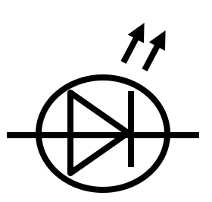
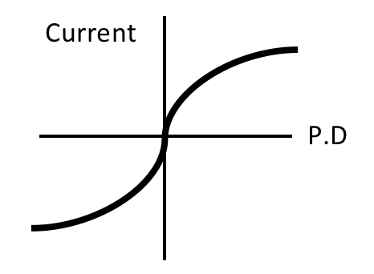


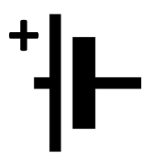
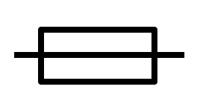
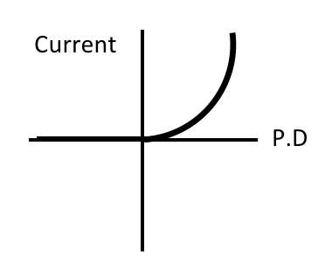
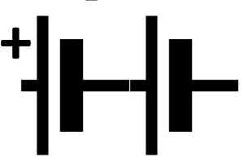
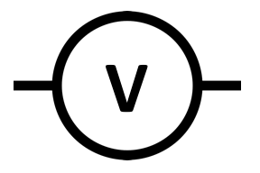

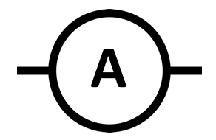

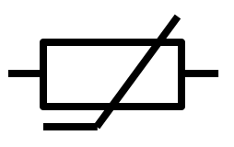
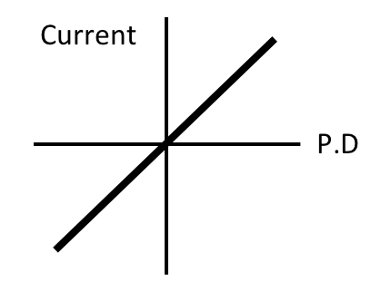
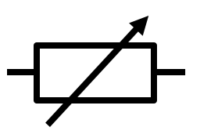
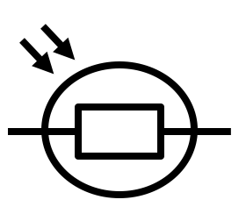
P4: Electric Circuits
Component | Symbol | Component | Symbol
Open Switch |  | LED
Closed Switch |  | Lamp
Cell |  | Fuse
Battery |  | Voltmeter
Diode |  | Ammeter
Resistor |  | Thermistor
Variable Resistor |  | LDR
Electric Fields
A charged object creates an electric field around itself. The electric field is strongest close to the charged object and when you move the object further away the field becomes weaker. If a second charged object placed in the field it experiences a force. The force gets weaker as the distance between the objects increases.
Static Charge
When some insulating materials are rubbed against each other they become charged. This is because electrons are rubbed off one material and on to the other. The material that gains electrons becomes negatively charged while the material that loses electrons is left with an equal positive charge. When two charged objects are brought close together they exert a force on each other. Two objects that have the same charge repel while objects that have opposite charges attract each other.
Filament Lamp
The resistance of a lament lamp increases as the temperature of the lament increases.
Diode
The current through a diode flows in one direction only. The diode has a very high resistance in the reverse direction.
Resistors
for some resistors, the value of R remains constant but that in others it can change as the current changes. The current through an ohmic conductor (at a constant
Current, Resistance and Potential Difference
The current through a component depends on the resistance of the component and the potential difference across the component. The greater the resistance of the component the smaller the current for a given potential difference across the component. They are linked with the equation:
Potential Difference = Current x Resistance
temperature) is directly proportional to the potential difference across the resistor. This means that the resistance remains constant as the current changes. The resistance of components such as lamps, diodes, thermistors and LDRs is not constant; it changes with the current through the component.
Series Circuits
For components connected in series there is the same current through each component and the total potential difference of the power supply is shared between the components. When in series the total resistance of two components is the sum of the resistance of each component: R total = R1 + R2
Parallel Circuits
For components connected in parallel the potential difference across each component is the same and the total current through the whole circuit is the sum of the currents through the separate components. In a parallel circuit the total resistance of two resistors is less than the resistance of the smallest individual resistor.
Thermistors and Light Dependent Resistors
The resistance of a thermistor decreases as the temperature increases. Thermistors can be used in thermostats. The resistance of an LDR decreases as light intensity increases. The application of LDRs in circuits includes switching lights on when it gets dark.
Electrical Charge and Current
For electrical charge to flow through a closed circuit the circuit must include a source of potential difference. Electric current is a flow of electrical charge. The size of the electric current is the rate of flow of electrical charge. Charge flow is calculated using the formula:
Charge Flow = Current × Time
Quantity | Symbol | Unit
Charge | Q | C
Current | I | A
Time | t | s
Potential Difference | V | V
Resistance | R | Ω

Slide 6
P5: Electricity in the Home
Direct and Alternating Potential Difference Mains electricity is an ac supply. In the United Kingdom the domestic electricity supply has a frequency of 50 Hz and is about 230 V. | Energy Transfers in Everyday Appliances Everyday appliances are designed to transfer energy. The amount of energy an appliance transfers depends on how long the appliance is switched on for and the power output of the appliance. The amount of energy transferred by an appliance can be calculated using the equations: Energy Transferred = Power x Time Energy Transferred = Charge x Potential Difference Often the power of a domestic appliance is measured in kW. There are 1000W in 1kW. | National Grid The National Grid is a system of cables and transformers that links power stations to consumers (homes, factories, schools, businesses). Electrical Power is transferred from power stations, where electricity is generated, using the National Grid. Step-up transformers increase the potential difference from the power station before reaching the transmission cables. Increasing the potential difference decreases the current, meaning less energy is wasted as heat in the wires. This increases the efficiency of the National Grid. The transmission cables have a low resistance, meaning less energy is wasted as heat. This increases the efficiency of the National Grid. Step-down transformers decrease the potential difference. This must happen before the supply reaches consumer for safety. For domestic homes the potential difference is decreased to 230V.
Mains electricity Most electrical appliances are connected to the mains using three-core cable. The insulation covering each wire is colour coded for easy identification: Live Wire – Brown Neutral Wire – Blue Earth Wire – Green and Yellow Stripes The live wire carries the alternating potential difference from the supply. The neutral wire completes the circuit. The earth wire is a safety wire to stop the appliance becoming live. The potential difference between the live wire and earth (0 V) is about 230 V. The neutral wire is at, or close to, earth potential (0 V). The earth wire is at 0 V, it only carries a current if there is a fault.
 |  | Power The rate of energy transfer (power) in any circuit is related to the potential difference across the circuit and the current through it. It can be calculated using the formulas: Power = Potential Difference x Current Power = (Current)² x Resistance
Quantity | Symbol | Unit
Energy Transferred | E | J
Power | P | W
Charge | Q | C
Potential Difference | V | V
Current | I | A
Resistance | R | Ω

Slide 7
P6: Molecules and Matter
Quantity | Symbol | Unit
Density | ⍴ | kg/m³
Mass | m | kg
Volume | V | m³
Change in Thermal Energy | 𝚫E | J
Specific Heat Capacity | c | J/kg°C
Temperature Change | 𝚫θ | °C
Energy | E | J
Specific Latent Heat | L | J/kg
Pressure | p | Pa
Volume | V | m³
Constant | constant
Internal Energy
Internal energy is the energy that is stored inside a system by the particles that make up the system. Internal energy is the total kinetic and potential energy of all the particles that make up a system. When you heat something the energy stored by the particles in the system increases. This will raise the temperature of the system or will cause a change in state.
Temperature Change
When the temperature of the system increases, how much it increases depends on the mass of the substance heated, the type of material and the energy input to the system.
Change in Thermal Energy = Mass x Specific Heat Capacity x Temperature Change
The specific heat capacity of a substance is the amount of energy required to raise the temperature of 1kg of the substance by 1°C.
Solids
Liquids
Gases
Changes in State
When substances change state mass is conserved. Changes of state are physical changes which are different from chemical changes because the material recovers its original properties if the change is reversed. Melting is when substances change from a solid to liquid while freezing is when a substance changes from a liquid to a solid. These changes take place at the substances melting point. Boiling is when a substance changes from a liquid to a gas while condensation is when a substance changes from a gas to a liquid. These changes take place at the boiling point.
Particle Motion in Gases
The molecules of a gas are constantly moving randomly. The temperature of the gas is related to the average kinetic energy of the molecules. Changing the temperature of a gas, held at constant volume, changes the pressure exerted by the gas. The pressure of a gas on a solid surface is caused by the impact of the gas particles with the surface. When a gas is heated the particles gain kinetic energy and so pressure increases.
Density
Density is the measure of the mass per unit volume of a substance. It is calculated using the formula: Density = Mass/Volume
Changes of Heat and Specific Latent Heat
The energy needed for a substance to change state is called latent heat. When a change of state occurs, the energy supplied changes the energy stored but not the temperature. The specific latent heat of a substance is the amount of energy required to change the state of one kilogram of the substance with no change in temperature. The formula to calculate this is:
energy for a change of state = mass × specific latent heat
Specific latent heat of fusion is the change of state from solid to liquid while specific latent heat of vaporisation is the change of state from liquid to vapour.
Particles in a Liquid
In a liquid there are weaker forces of attraction between the particles and so they are not held together in a regular structure, but the forces are strong enough to stop them moving away from each other completely. When heated, particles obtain enough energy to break away from other particles and they become a gas.
Measuring the Density of a Liquid
Use a measuring cylinder to measure the volume and measure the mass of the liquid by place a beaker on scales, set it to zero and add the liquid.
Particles in a Solid
In a solid particles are arranged in a regular structure. There are strong forces of attraction between the particles and they vibrate about fixed positions. When a solid is heated the particles energy increases and vibrate more. If the solid is heated up enough, it will melt.
Measuring the Density of a Solid Object
Measure the mass using a balance. If the object is a regular shape measure its dimensions and calculate the volume. For an irregular shaped object lower it on a thread into a measuring cylinder partly filled with water and record the displacement. This is the volume.

Slide 8



P7: Radioactivity
The Structure of an Atom Atoms are very small and they have a radius of about 1×10⁻¹⁰m. The basic structure of an atom is a positively charged nucleus made of protons and neutrons surrounded by negatively charged electrons. The radius of a nucleus is less than 1/10000 of the size of the radius of an atom. Most of the mass of an atom is concentrated in the nucleus. The electrons are arranged at different distances from the nucleus. The electron arrangements may change with the absorption of electromagnetic radiation. When they absorb radiation electrons move further from the nucleus to a higher energy. When electrons emit radiation they move closer to the nucleus to a lower energy level. |  |  |  | Radioactive Decay and Nuclear Radiation Some atomic nuclei are unstable. A nucleus can give out radiation in order to become more stable. This is a random process called radioactive decay. The nuclear radiation emitted can be in the form of alpha, beta or gamma radiation. |  |  | Contamination Contamination is the unwanted presence of materials containing radioactive atoms ending up on other materials. The hazard from contamination is due to the decay of the contaminating atoms. The type of radiation emitted affects the level of hazard. | Irradiation Irradiation is the process of exposing an object to nuclear radiation. The irradiated object does not become radioactive. Suitable precautions must be taken to protect against any hazard that the radioactive source used in the process of irradiation may present.
 |  |  |  | Half-Life The half-life of a radioactive isotope is the time it takes for the number of nuclei of the isotope in a sample to halve, or the time it takes for the count rate from a isotope sample to fall to half its start level. Different radioactive substances have different half lives. Those with longer half lives are more hazardous because they are radioactive for longer.
 |  |  |  |  |  |  | Background radiation Background radiation is around us all of the time. It comes from: Natural sources such as rocks and cosmic rays from space. Man-made sources such as the fallout from nuclear weapons testing and nuclear accidents. The level of background radiation and radiation dose may be affected by occupation and/or location.
Mass Number and Atomic Number In an atom the number of electrons is equal to the number of protons in the nucleus and atoms have no overall electrical charge. Atomic number is the number of protons in an atom while the atomic mass is the total number of protons and number of neutrons. |  |  |  | Alpha Decay An alpha particle (helium nucleus) is emitted from the nucleus. It can be represented by equations such as: The is the symbol for the alpha particle. Notice that the mass number and atomic number are balanced on each side.
Isotopes An isotope is an atom of the same element with a different number of neutrons. |  |  | Ions A positive ion can be created is an atom loses one or more electrons. | Beta Decay A beta particle (electron) is emitted from the nucleus when a neutron turns into a proton. It can be represented by equations such as: The is the symbol for the beta particle. Notice that the mass number and atomic number are balanced on each side. The element has mutated because it now has an extra proton. |  |  | Development of the Model of the Atom Dalton suggested that atoms were tiny spheres that could not be divided. JJ Thompson then discovered the electron. He also suggested the Plum Pudding Model. This was the idea that the atom was a ball of positive charge with negative electrons embedded in it. Then due to results from the alpha particle scattering experiment the nuclear model of the atom was suggested. Discovered the electron. Suggested the Plum Pudding Model. This was the idea that the atom was a ball of positive charge with negative electrons embedded in it. Niels Bohr then adapted this model by suggesting that electrons orbit the nucleus at specific distances and then James Chadwick proved the existence of neutrons.
Gamma Decay The emission of a gamma ray does not cause the mass or the charge of the nucleus to change.
Radiation | Symbol | Consists of.. |  | Blocked By.. | Range in Air | Ionising Power
Alpha | α | 2 neutrons and 2 protons |  | Paper | 5cm | High
Beta | β | High speed electron |  | Thin Aluminium | 1m | Medium
Gamma | γ | Electromagnetic Radiation |  | Thick Lead/Concrete | Infinite | Low

