Slide 1
Combined Science: Physics Paper 2
Summary Sheets
Foundation
Physics Paper 2
 |  | 1h 15min
Topics in the Paper:
P8 | Forces in Balance
P9 | Motion
P10 | Force and Motion
P12 | Wave Properties
P13 | Electromagnetic Waves
P15 | Electromagnetism

Slide 2
P8: Forces in Balance: Trilogy Specification: Foundation
Newtons First Law If the resultant force acting on an object is zero and the object is stationary, the object will stay stationary. However, if the object is moving, the object continues to move at the same speed and in the same direction. This means the object continues to move at the same velocity. The velocity of an object will only change if there is a resultant force acting on the object. | Scalar and Vector Quantities Scalar quantities have magnitude only while vector quantities have magnitude and an associated direction. Scalars include time and speed while vectors include velocity. A vector quantity may be represented by an arrow. The length of the arrow represents the magnitude, and the direction of the arrow the direction of the vector. |  | Distance Distance is how far an object moves. Distance does not involve direction. Distance is a scalar quantity. | Displacement Displacement includes both the distance an object moves, measured in a straight line from the start point to the finish point and the direction of that straight line. Displacement is a vector quantity.
 | Newtons Third Law Whenever two objects interact, the forces they exert on each other are equal and opposite. For example a man pushes on a wall with 100N and experiences a force of 100N in the opposite direction from the wall.
Contact and Non contact Forces A force is a push or pull that acts on an object due to the interaction with another object. All forces between objects are either contact forces in which the objects are physically touching or non-contact forces in which the objects are physically separated. Examples of contact forces include friction, air resistance, tension and normal contact force. Examples of non-contact forces are gravitational force, electrostatic force and magnetic force. Force is a vector quantity as it acts in a direction. |  |  | Determining Centre of Mass of a Symmetrical Object For a flat object that is symmetrical its centre of mass is along the axis of symmetry. If the object has more than one axis of symmetry than its centre of mass is at the point that these axis meet.
 | Resultant Force A single force that has the same effect as all the forces acting on the object. For example if there is a force of 100N to the right and 50N to the left then overall there will be a resultant force of 50N to the right. If forces are acting in the same direction add them together, if they are acting in opposite directions subtract them from each other.
Centre of Mass The weight of an object acts at a single single point called the centre of mass. This idea is very important for designers and engineers to make sure that they design something that wont tip over. The centre of mass of an object is the point at which its mass can be concentrated. If you suspend any object it will come to rest with its centre of mass directly below the point of suspension. | Friction A force that acts in the opposite direction of a moving object. Examples include air resistance and water resistance. |  | Determining Centre of Mass of an Irregular Shaped Piece of Card Put a hole in one corner of the card and suspend the card from a rod. Use a plumb line to draw a vertical line on the card from the rod. Repeat this again hanging the object from different corners. The point at which the lines meet is the centre of mass.

Slide 3
P9: Motion: Trilogy Specification: Foundation
Speed Speed is a scalar quantity as it does not involve direction. The speed of a moving object is normally changing and so is rarely constant. The speed a person travels at can depend on their age, terrain (is it hilly or flat) fitness and distance travelled. Typically people travel at 1.5m/s when walking, 3m/s when running and 6m/s when cycling. The speed of sound and of the wind may change also. Sound typically travels at 330m/s. The formula to calculate the speed of an object is: Distance Travelled = Speed x Time | Velocity The velocity of an object is its speed in a particular direction. This means velocity is a vector quantity. |  | Quantity | Symbol | Unit
 |  |  | Speed | v | m/s
 |  |  | Distance | s | m
 |  |  | Time | t | s
 |  |  | Change in Velocity | 𝚫v | m/s
 |  |  | Initial Velocity | u | m/s
Acceleration This is a measurement of the rate in which an objects velocity changes. If an object is slowing down than it is said to be decelerating. It can be calculated using the equation: Acceleration = change in velocity / time taken. Be careful when calculating change in velocity. For example if you are told an object from standing accelerates to 12m/s then the change in velocity is 12m/s. However if you are told that the object was moving at 5m/s and accelerates to 12m/s the change in velocity is now 7m/s. | Uniform Acceleration The following equation applies to uniform acceleration (you are given this one on your data sheet): (final velocity)² – (initial velocity)² = 2 x acceleration x distance Near the Earth’s surface any object falling freely under gravity has an acceleration of about 9.8m/s² |  | Final Velocity | v | m/s
 |  |  | Acceleration | a | m/s²
 |  |  | Velocity Time Graphs The acceleration of an object can be calculated from the gradient of a velocity–time graph.
Distance Time Graphs If an object moves along a straight line, the distance travelled can be represented by a distance–time graph. The speed of an object can be calculated from the gradient of its distance–time graph. If an object is accelerating, its speed at any particular time can be determined by drawing a tangent and measuring the gradient of the distance–time graph at that time.

Slide 4
P10: Force and Motion: Trilogy Specification: Foundation
Newtons Second Law This is the rule that the acceleration of an object is proportional to the resultant force acting on an object, and inversely proportional to the mass of the object. The equation for this is: Resultant Force = Mass x Acceleration | Changing Speed The velocity of an object increases if the resultant force is in the same direction as the velocity while an object will slow down if the resultant force acts in the opposite direction to its velocity. |  | Quantity | Symbol | Unit
 |  |  | Resultant Force | F | N
 |  |  | Mass | m | kg
 |  |  | Acceleration | a | m/s²
Forces and Elasticity To change the shape of an object (by stretching, bending or compressing), more than one force has to be applied. If an object is elastic it will return to its original shape when the forces deforming it re removed. | Hooke's Law The extension of a spring is directly proportional to the force applied as long as the limit of proportionality is not exceeded. Force Applied = Spring Constant x Extension |  | Weight | W | N
 |  |  | Gravitational Field Strength | g | N/kg
 |  |  | Spring Constant | k | N/m
 |  |  | Extension | e | m
Stopping Distance The stopping distance of a vehicle is the sum of the distance the vehicle travels during the driver’s reaction time (thinking distance) and the distance it travels under the braking force (braking distance). For a given braking force the greater the speed of the vehicle, the greater the stopping distance. | Reaction Times People have different reaction times. Typically people have a range between 0.2s and 0.9s. A persons reaction time can be affected by a persons tiredness and their use of drugs and alcohol. Distractions can also affect a drivers reaction time. To measure a persons reaction time in the science lab you could use a ruler. You would place the ruler just the finger and thumb of a friend and without warning drop the ruler. You would record the distance the ruler dropper before your friend caught it. You can then use this to find a reaction time. |  | Symbol for Proportionality ∝
Braking Braking distance of a vehicle can be affected by the road and weather conditions as well as the condition of the vehicle. Poor road conditions include wet or icy conditions while poor condition of the vehicle could include the brakes or tyres. of a vehicle, work done by the friction force between the brakes and the wheel reduces the kinetic energy of the vehicle and the temperature of the brakes increases. The greater the speed of a vehicle the greater the braking force needed to stop the vehicle in a certain distance. The greater the braking force the greater the deceleration of the vehicle. Large decelerations may lead to brakes overheating and/or loss of control. |  | Terminal Velocity An object falling through a fluid initially accelerates due to the force of gravity. Eventually the resultant force will be zero and the object will move at its terminal velocity. | Weight The weight of an object can be calculated using the equation: Weight = mass x gravitational field strength The weight of an object and the mass o an object are directly proportional and weight is measured using a calibrated spring-balance otherwise known as a newtonmeter.

Slide 5
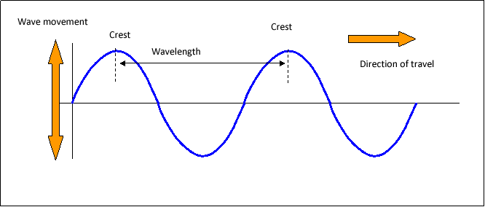
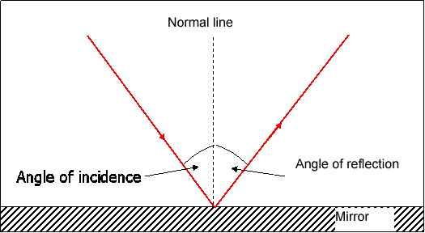
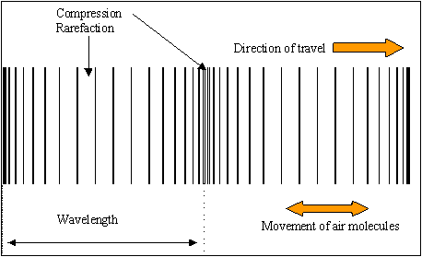
P12: Wave Properties: Trilogy Specification: Foundation
Transverse and Longitudinal Waves Waves can be either Transverse or Longitudinal. Transverse Waves. All waves transfer energy. In a transverse waves the particles oscillate perpendicular to the direction of energy transfer. Examples of transverse waves include water waves and electromagnetic waves. In a longitudinal wave the particles oscillate parallel to the direction of energy transfer. Examples of longitudinal waves include sound waves. | Reflection of waves Waves can be reflected at a boundary between two different materials. They could also be transmitted or absorbed at a boundary between two different materials. A ray diagram illustrates the reflection of a wave at a boundary. All ray diagrams should be drawn with a pencil and arrows clearly indicate the direction the light is travelling. These arrows must be included in all ray diagrams. | Sound Waves Sound waves can travel through solids causing vibrations in the solid. In the human ear, sound waves cause the ear drum to vibrate which allows us to detect sound. The conversion of sound waves to vibrations of solids only works over a limited frequency range. This restricts the range of human hearing. The range of human hearing is from 20Hz to 20kHz.
 |  | Waves for detection and exploration Ultrasound waves are waves that have a higher frequency than 20kHz. This is a wave with a frequency above the range of human hearing. Ultrasound waves are partially reflected when they meet a boundary between two different media. The time taken for an ultrasound detector to pick up these reflections can determine the distance of the boundary. This allows ultrasound waves to construct an image and they are used in medicine. Seismic waves are produced by Earthquakes. P-waves are longitudinal seismic waves. S-waves are transverse seismic waves. S waves cannot travel through a liquid. P-waves and S-waves both provide evidence for the structure and size of the Earth’s core. Echo Sounding uses high frequency sound waves to detect objects deep underwater and can also measure the depth of water.
Wave Properties The frequency of a wave is the number of waves passing through a fixed point each second. The amplitude of a wave is the maximum displacement of a point on a wave from its undisturbed position. The wavelength of a wave is the distance from a point on one wave to the equivalent point on the adjacent wave. The wave speed is the speed at which the wave moves through the medium. This is also the speed at which the energy is transferred through the medium. | Wave Equation Period = 1/frequency (you do not need to recall) Wave speed = frequency x wavelength
Quantity | Symbol | Unit
Frequency | f | Hz
Wave Speed | v | m/s
Wavelength | ƛ | m
period | T | s

Slide 6
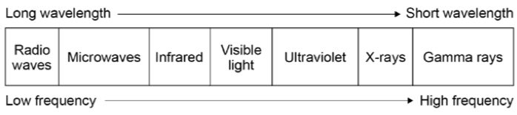
P13: Electromagnetic Waves: Trilogy Specification: Foundation
Types of Electromagnetic Waves Electromagnetic waves are transverse waves that transfer energy from the source to an absorber. All electromagnetic waves travel at the same speed, 3x10⁸m/s. Electromagnetic waves form a continuous spectrum . The spectrum is grouped by order of their wavelength and frequency. Humans can only detect the visible light part of the spectrum with their eyes. |  | Properties of Electromagnetic Waves Radio waves can be produced by oscillations in electric circuits. When radio waves are absorbed they can create an alternating current with the same frequency as the radio wave itself, so radio waves can themselves induce oscillations in an electrical circuit. Changes in atoms and the nuclei of atoms can result in electromagnetic waves being generated or absorbed over a wide frequency range. Gamma rays originate from changes in the nucleus of an atom. Ultraviolet waves, X-rays and gamma rays can have hazardous effects on human body tissue. The effects depend on the type of radiation and the size of the dose. Radiation dose is a measure of the risk of harm resulting from an exposure of the body to the radiation. Ultraviolet waves can cause skin to age prematurely and increase the risk of skin cancer. X-rays and gamma rays are ionising radiation that can cause the mutation of genes and cancer.
 | Properties of Electromagnetic Waves Electromagnetic Waves can be absorbed, transmit, refract or reflect. Refraction is due to the difference in velocity that the waves travel in the different substances. A ray diagram can be used to illustrate refraction. A wave front diagram can also be used to explain the change of speed that happens when the wave travels from one medium into another.
Component | Use
Radio Waves | Television and radio signal
Microwaves | Satellite communication, cooking food
Infrared | Electrical heaters, cooking food, infrared cameras
Visible Light | Fibre optic communication
Ultraviolet | Sun tanning, detecting forged notes
X-Rays | Medical imaging and treatment
Gamma Rays | Kill cancer cells, sterilization.

Slide 7
P15: Electromagnetism: Trilogy Specification: Foundation
Poles of a Magnet The poles of a magnet are the places where the magnetic forces are strongest. When two magnets are brought close together they exert a force on each other. Two like poles repel each other. Two unlike poles attract each other. Attraction and repulsion between two magnetic poles are examples of non-contact force. | Permanent Magnets A permanent magnet produces its own magnetic field. | Induced Magnets An induced magnet is a material that becomes a magnet when it is placed in a magnetic field. Induced magnetism always causes a force of attraction. When removed from the magnetic field an induced magnet loses most/all of its magnetism quickly. | Electromagnetism When a current flows through a conducting wire a magnetic field is produced around the wire. The strength of the magnetic field depends on the current through the wire and the distance from the wire. Shaping a wire to form a solenoid increases the strength of the magnetic field created by a current through the wire. The magnetic field inside a solenoid is strong and uniform. The magnetic field around a solenoid has a similar shape to that of a bar magnet. Adding an iron core increases the strength of the magnetic field of a solenoid. An electromagnet is a solenoid with an iron core.
Magnetic Fields The region around a magnet where a force acts on another magnet or on a magnetic material (iron, steel, cobalt and nickel) is called the magnetic field. The force between a magnet and a magnetic material is always one of attraction. The strength of the magnetic field depends on the distance from the magnet. The field is strongest at the poles of the magnet. The direction of the magnetic field at any point is given by the direction of the force that would act on another north pole placed at that point. The direction of a magnetic field line is from the north (seeking) pole of a magnet to the south(seeking) pole of the magnet. | Plotting a Magnetic Field Mark a dot near the north pole of a bar magnet and place the tail of the compass needle above the dot and mark a second dot at the tip of the needle. Repeat this with the tail of the next compass over the new dot until you reach the south pole. Repeat this with further lines.
 |  |  | Solenoids A solenoid is a long coil of insulating wire and they are used in lots of electrical devices where a strong magnetic field is needed. When a current is passed through the wire the magnetic field increases in strength if the current is increased and reverses in direction if the current is reversed.

