Slide 1
Separate Science: Physics Paper 2
Summary Sheets
Higher
Physics Paper 2
 |  | 1hr45
Topics in the Paper:
P8 | Forces in Balance
P9 | Motion
P10 | Force and Motion
P11 | Force and Pressure
P12 | Wave Properties
P13 | Electromagnetic Waves
P14 | Light
P15 | Electromagnetism
P16 | Space

Slide 2
P8: Forces in Balance: Physics Specification
Newtons First Law If the resultant force acting on an object is zero and the object is stationary, the object will stay stationary. However, if the object is moving, the object continues to move at the same speed and in the same direction. This means the object continues to move at the same velocity. The velocity of an object will only change if there is a resultant force acting on the object. The tendency of objects to continue in their state of rest or of uniform motion is called inertia. | Scalar and Vector Quantities Scalar quantities have magnitude only while vector quantities have magnitude and an associated direction. Scalars include time and speed while vectors include velocity. A vector quantity may be represented by an arrow. The length of the arrow represents the magnitude, and the direction of the arrow the direction of the vector. | Distance Distance is how far an object moves. Distance does not involve direction. Distance is a scalar quantity. | Displacement Displacement includes both the distance an object moves, measured in a straight line from the start point to the finish point and the direction of that straight line. Displacement is a vector quantity.
 | Newtons Third Law Whenever two objects interact, the forces they exert on each other are equal and opposite. For example a man pushes on a wall with 100N and experiences a force of 100N in the opposite direction from the wall.
Contact and Non contact Forces A force is a push or pull that acts on an object due to the interaction with another object. All forces between objects are either contact forces in which the objects are physically touching or non-contact forces in which the objects are physically separated. Examples of contact forces include friction, air resistance, tension and normal contact force. Examples of non-contact forces are gravitational force, electrostatic force and magnetic force. Force is a vector quantity as it acts in a direction. |  | Determining Centre of Mass of a Symmetrical Object For a flat object that is symmetrical its centre of mass is along the axis of symmetry. If the object has more than one axis of symmetry than its centre of mass is at the point that these axis meet.
 | Resultant Force A single force that has the same effect as all the forces acting on the object. For example if there is a force of 100N to the right and 50N to the left then overall there will be a resultant force of 50N to the right. If forces are acting in the same direction add them together, if they are acting in opposite directions subtract them from each other.
Centre of Mass The weight of an object acts at a single single point called the centre of mass. This idea is very important for designers and engineers to make sure that they design something that wont tip over. The centre of mass of an object is the point at which its mass can be concentrated. If you suspend any object it will come to rest with its centre of mass directly below the point of suspension. | Resolution of Forces You need to be able to draw vector diagrams to illustrate resolution of forces and determine the magnitude and direction of this force. You will need a protractor and a ruler. Use a ruler to draw the the forces to scale and use a protractor to measure the accurately the angle between these forces. Draw the resolving force line to complete the diagram. This should make a triangle. Measure the size of this line to measure the magnitude of this force. | Determining Centre of Mass of an Irregular Shaped Piece of Card Put a hole in one corner of the card and suspend the card from a rod. Use a plumb line to draw a vertical line on the card from the rod. Repeat this again hanging the object from different corners. The point at which the lines meet is the centre of mass.
Friction A force that acts in the opposite direction of a moving object. Examples include air resistance and water resistance.

Slide 3
P8: Forces in Balance: Physics Specification
Moments A force of a system of forces which may cause an object to rotate. The turning effect of a force is called the moment force and it can be calculated using the equation below: Moment of Force = Force x Distance Distance is the distance from the pivot to the line of action of the force. |  |  | Levers A simple lever and a simple gear system can both be used to transmit the rotational effects of forces. A spanner is an example of a lever. It can be used to produce a turning effect and unscrew a bolt. The weight of the object is called the load and the force that the person applies is called the effort. The point at which the object turns is called the pivot. To increase the moment of the force you could increase the size of the force or increase the distance between the effort and the pivot (use a spanner with a longer handle) | Gears Gears are like levers as they can multiply the effect of a turning force. When a car is in low gear a small gear wheel turns a larger gear wheel multiplying the turning effect of the engine force producing a bigger turning effect on the car wheels. Low Gear = Low Speed and a High Turning Effect When a car is in a high gear a large gear wheel turns a smaller gear wheel on the output shaft. This causes the output shaft to spin faster causing a higher speeds but the turning effect is lower. High Gear = High Speed and a Low Turning Effect.
Quantity | Symbol | Unit
Moment of Force | M | N/m
Force | F | N
Distance | d | m
Balanced Moments If an object is balanced the total clockwise moment about a pivot equals the total anticlockwise moment about the pivot. This means that: The sum of all of the clockwise moments about any point = the sum of all the anticlockwise moments about the point.

Slide 4
P9: Motion: Physics Specification
Speed Speed is a scalar quantity as it does not involve direction. The speed of a moving object is normally changing and so is rarely constant. The speed a person travels at can depend on their age, terrain (is it hilly or flat) fitness and distance travelled. Typically people travel at 1.5m/s when walking, 3m/s when running and 6m/s when cycling. The speed of sound and of the wind may change also. Sound typically travels at 330m/s. The formula to calculate the speed of an object is: Distance Travelled = Speed x Time |  | Velocity The velocity of an object is its speed in a particular direction. This means velocity is a vector quantity. If you are travelling around a roundabout (in a circle) your speed may be constant, but the velocity will be changing as you are constantly changing direction. |  | Quantity | Symbol | Unit
 |  |  |  | Speed | v | m/s
 |  |  |  | Distance | s | m
 |  |  |  | Time | t | s
 |  |  |  | Change in Velocity | 𝚫v | m/s
 |  |  |  | Initial Velocity | u | m/s
Acceleration This is a measurement of the rate in which an objects velocity changes. If an object is slowing down than it is said to be decelerating. It can be calculated using the equation: Acceleration = change in velocity / time taken. Be careful when calculating change in velocity. For example if you are told an object from standing accelerates to 12m/s then the change in velocity is 12m/s. However if you are told that the object was moving at 5m/s and accelerates to 12m/s the change in velocity is now 7m/s. |  | Uniform Acceleration The following equation applies to uniform acceleration (you are given this one on your data sheet): (final velocity)² – (initial velocity)² = 2 x acceleration x distance Near the Earth’s surface any object falling freely under gravity has an acceleration of about 9.8m/s² |  | Final Velocity | v | m/s
 |  |  |  | Acceleration | a | m/s²
 |  |  |  | Drawing a Tangent on a Point of Acceleration of a Distance Time Graph
Distance Time Graphs If an object moves along a straight line, the distance travelled can be represented by a distance–time graph. The speed of an object can be calculated from the gradient of its distance–time graph. If an object is accelerating, its speed at any particular time can be determined by drawing a tangent and measuring the gradient of the distance–time graph at that time. |  |  | Velocity Time Graphs The acceleration of an object can be calculated from the gradient of a velocity–time graph. The distance travelled by the object can be calculated by measuring the area underneath the line of a velocity time graph.

Slide 5
P10: Force and Motion: Physics Specification
Newtons Second Law This is the rule that the acceleration of an object is proportional to the resultant force acting on an object, and inversely proportional to the mass of the object. The equation for this is: Resultant Force = Mass x Acceleration Inertial mass is a measure of how difficult it is to change the velocity of an object and is defined as the ration of force over acceleration. | Changing Speed The velocity of an object increases if the resultant force is in the same direction as the velocity while an object will slow down if the resultant force acts in the opposite direction to its velocity. |  | Quantity | Symbol | Unit
 |  |  | Resultant Force | F | N
 |  |  | Mass | m | kg
 |  |  | Acceleration | a | m/s²
 | Terminal Velocity An object falling through a fluid initially accelerates due to the force of gravity. Eventually the resultant force will be zero and the object will move at its terminal velocity.
 |  |  | Weight | W | N
 |  |  | Gravitational Field Strength | g | N/kg
Stopping Distance The stopping distance of a vehicle is the sum of the distance the vehicle travels during the driver’s reaction time (thinking distance) and the distance it travels under the braking force (braking distance). For a given braking force the greater the speed of the vehicle, the greater the stopping distance. | Reaction Times People have different reaction times. Typically people have a range between 0.2s and 0.9s. A persons reaction time can be affected by a persons tiredness and their use of drugs and alcohol. Distractions can also affect a drivers reaction time. To measure a persons reaction time in the science lab you could use a ruler. You would place the ruler just the finger and thumb of a friend and without warning drop the ruler. You would record the distance the ruler dropper before your friend caught it. You can then use this to find a reaction time. |  | Velocity | v | m/s
 |  |  | Momentum | p | Kg m/s
 |  |  | Spring Constant | k | N/m
 |  |  | Extension | e | m
 |  |  | Hooke's Law The extension of a spring is directly proportional to the force applied as long as the limit of proportionality is not exceeded. Force Applied = Spring Constant x Extension
Momentum Momentum can be calculated using the equation: Momentum = Mass x Velocity In a closed system, the total momentum before an event is equal to the total momentum after the event. This is called conservation of momentum.
 | Symbol for Proportionality ∝
Braking Braking distance of a vehicle can be affected by the road and weather conditions as well as the condition of the vehicle. Poor road conditions include wet or icy conditions while poor condition of the vehicle could include the brakes or tyres. of a vehicle, work done by the friction force between the brakes and the wheel reduces the kinetic energy of the vehicle and the temperature of the brakes increases. The greater the speed of a vehicle the greater the braking force needed to stop the vehicle in a certain distance. The greater the braking force the greater the deceleration of the vehicle. Large decelerations may lead to brakes overheating and/or loss of control. |  | Forces and Elasticity To change the shape of an object (by stretching, bending or compressing), more than one force has to be applied. If an object is elastic it will return to its original shape when the forces deforming it re removed. | Weight The weight of an object can be calculated using the equation: Weight = mass x gravitational field strength The weight of an object and the mass o an object are directly proportional and weight is measured using a calibrated spring-balance otherwise known as a newtonmeter.

Slide 6
P11: Pressure and Surfaces: Physics Specification
Pressure in a Fluid A fluid can either be a liquid or a gas and the pressure in fluids causes a force normal (at right angles) to any surface. The pressure of a fluid can be calculating using the equation: Pressure = Force / Area The pressure due to a column of liquid can be calculated using the equation: Pressure = Height of Column x Density of Liquid x Gravitational Field Strength |  |  | Pressure of a Liquid Column The pressure due to a column of liquid can be calculated using the equation: Pressure = Height of Column x Density of Liquid x Gravitational Field Strength This equation shows that the pressure of a liquid depends on depth and also depends on the density of the liquid. The greater the height of fluid above a point the greater the pressure. This is because there is a greater mass of fluid above which means that there will be a greater weight of fluid exerting a force on that point. The greater the density of the fluid above a point the greater the pressure. This is because there is more mass per unit volume of fluid. | Upthrust A partially submerged object experiences a greater pressure on the bottom surface than on the top. This creases a resultant force acting upwards. This resultant force is called upthrust. This is also the case for objects that are fully submerged underwater.
 |  |  |  | Floating An object floats when its weight acting downwards is equal to the upthrust acting upwards. If you have a floating object loaded with additional mass it will float lower and lower in the water. More water will be displaced and so the upthrust will increase. The upthrust and weight will still be of equal sizes acting in opposite directions.
Quantity | Symbol | Unit | Atmospheric Pressure The atmosphere is a thin layer or air around the Earth and it gets less dense with increasing altitude. Atmospheric pressure occurs because air molecules collide with a surface. As the distance from the ground increases the number of air molecules decreases. This means that at a higher height there is always less air above a surface than there is at a lower height. This explains where atmospheric pressure decreases with an increase in height. | Sinking An object skins when its weight is greater than the upthrust. If you have a floating object and load on too much extra weight it will sink. This occurs because the object has displaced as much water as it cam and the upthrust can no longer support the total weight.
Pressure | p | Pa |  | Sinking An object skins when its weight is greater than the upthrust. If you have a floating object and load on too much extra weight it will sink. This occurs because the object has displaced as much water as it cam and the upthrust can no longer support the total weight.
Force | F | N
Area | A | m²
Height of Column | h | m
Density | ⍴ | kg/m³
Gravitational Field Strength | g | N/kg

Slide 7
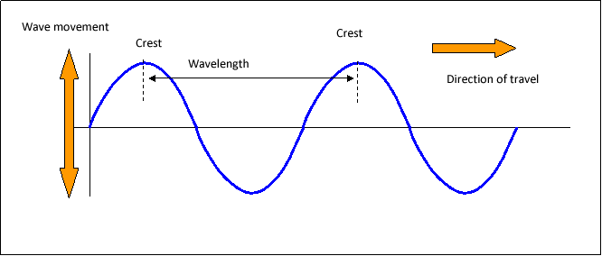
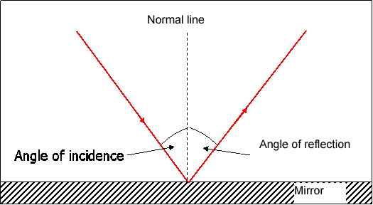
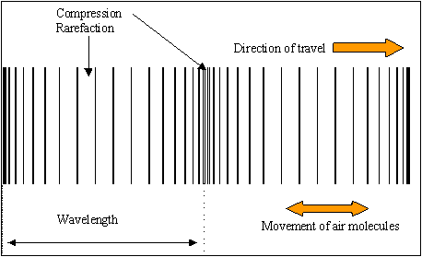
P12: Wave Properties: Physics Specification
Transverse and Longitudinal Waves Waves can be either Transverse or Longitudinal. Transverse Waves. All waves transfer energy. In a transverse waves the particles oscillate perpendicular to the direction of energy transfer. Examples of transverse waves include water waves and electromagnetic waves. In a longitudinal wave the particles oscillate parallel to the direction of energy transfer. Examples of longitudinal waves include sound waves. | Reflection of waves Waves can be reflected at a boundary between two different materials. They could also be transmitted or absorbed at a boundary between two different materials. A ray diagram illustrates the reflection of a wave at a boundary. All ray diagrams should be drawn with a pencil and arrows clearly indicate the direction the light is travelling. These arrows must be included in all ray diagrams. | Sound Waves Sound waves can travel through solids causing vibrations in the solid. In the human ear, sound waves cause the ear drum to vibrate which allows us to detect sound. The conversion of sound waves to vibrations of solids only works over a limited frequency range. This restricts the range of human hearing. The range of human hearing is from 20Hz to 20kHz.
 |  | Waves for detection and exploration Ultrasound waves are waves that have a higher frequency than 20kHz. This is a wave with a frequency above the range of human hearing. Ultrasound waves are partially reflected when they meet a boundary between two different media. The time taken for an ultrasound detector to pick up these reflections can determine the distance of the boundary. This allows ultrasound waves to construct an image and they are used in medicine. Seismic waves are produced by Earthquakes. P-waves are longitudinal seismic waves. S-waves are transverse seismic waves. S waves cannot travel through a liquid. P-waves and S-waves both provide evidence for the structure and size of the Earth’s core. Echo Sounding uses high frequency sound waves to detect objects deep underwater and can also measure the depth of water.
Wave Properties The frequency of a wave is the number of waves passing through a fixed point each second. The amplitude of a wave is the maximum displacement of a point on a wave from its undisturbed position. The wavelength of a wave is the distance from a point on one wave to the equivalent point on the adjacent wave. The wave speed is the speed at which the wave moves through the medium. This is also the speed at which the energy is transferred through the medium. | Wave Equation Period = 1/frequency (you do not need to recall) Wave speed = frequency x wavelength
Quantity | Symbol | Unit
Frequency | f | Hz
Wave Speed | v | m/s
Wavelength | ƛ | m
period | T | s

Slide 8
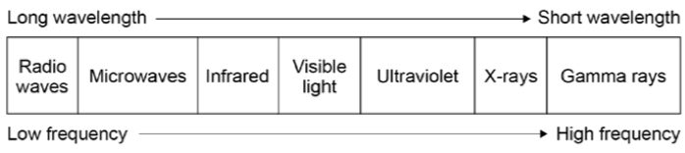
P13: Electromagnetic Waves: Physics Specification
Types of Electromagnetic Waves Electromagnetic waves are transverse waves that transfer energy from the source to an absorber. All electromagnetic waves travel at the same speed, 3x10⁸m/s. Electromagnetic waves form a continuous spectrum . The spectrum is grouped by order of their wavelength and frequency. Humans can only detect the visible light part of the spectrum with their eyes. |  | Properties of Electromagnetic Waves Radio waves can be produced by oscillations in electric circuits. When radio waves are absorbed they can create an alternating current with the same frequency as the radio wave itself, so radio waves can themselves induce oscillations in an electrical circuit. Changes in atoms and the nuclei of atoms can result in electromagnetic waves being generated or absorbed over a wide frequency range. Gamma rays originate from changes in the nucleus of an atom. Ultraviolet waves, X-rays and gamma rays can have hazardous effects on human body tissue. The effects depend on the type of radiation and the size of the dose. Radiation dose is a measure of the risk of harm resulting from an exposure of the body to the radiation. Ultraviolet waves can cause skin to age prematurely and increase the risk of skin cancer. X-rays and gamma rays are ionising radiation that can cause the mutation of genes and cancer.
 | Properties of Electromagnetic Waves Electromagnetic Waves can be absorbed, transmit, refract or reflect. Refraction is due to the difference in velocity that the waves travel in the different substances. A ray diagram can be used to illustrate refraction. A wave front diagram can also be used to explain the change of speed that happens when the wave travels from one medium into another.
Component | Use
Radio Waves | Television and radio signal
Microwaves | Satellite communication, cooking food
Infrared | Electrical heaters, cooking food, infrared cameras
Visible Light | Fibre optic communication
Ultraviolet | Sun tanning, detecting forged notes
X-Rays | Medical imaging and treatment
Gamma Rays | Kill cancer cells, sterilization.

Slide 9
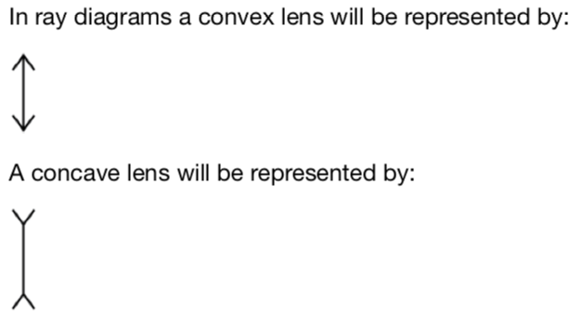
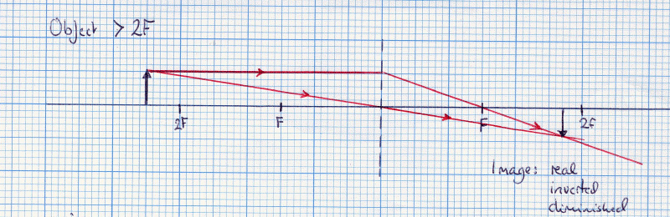
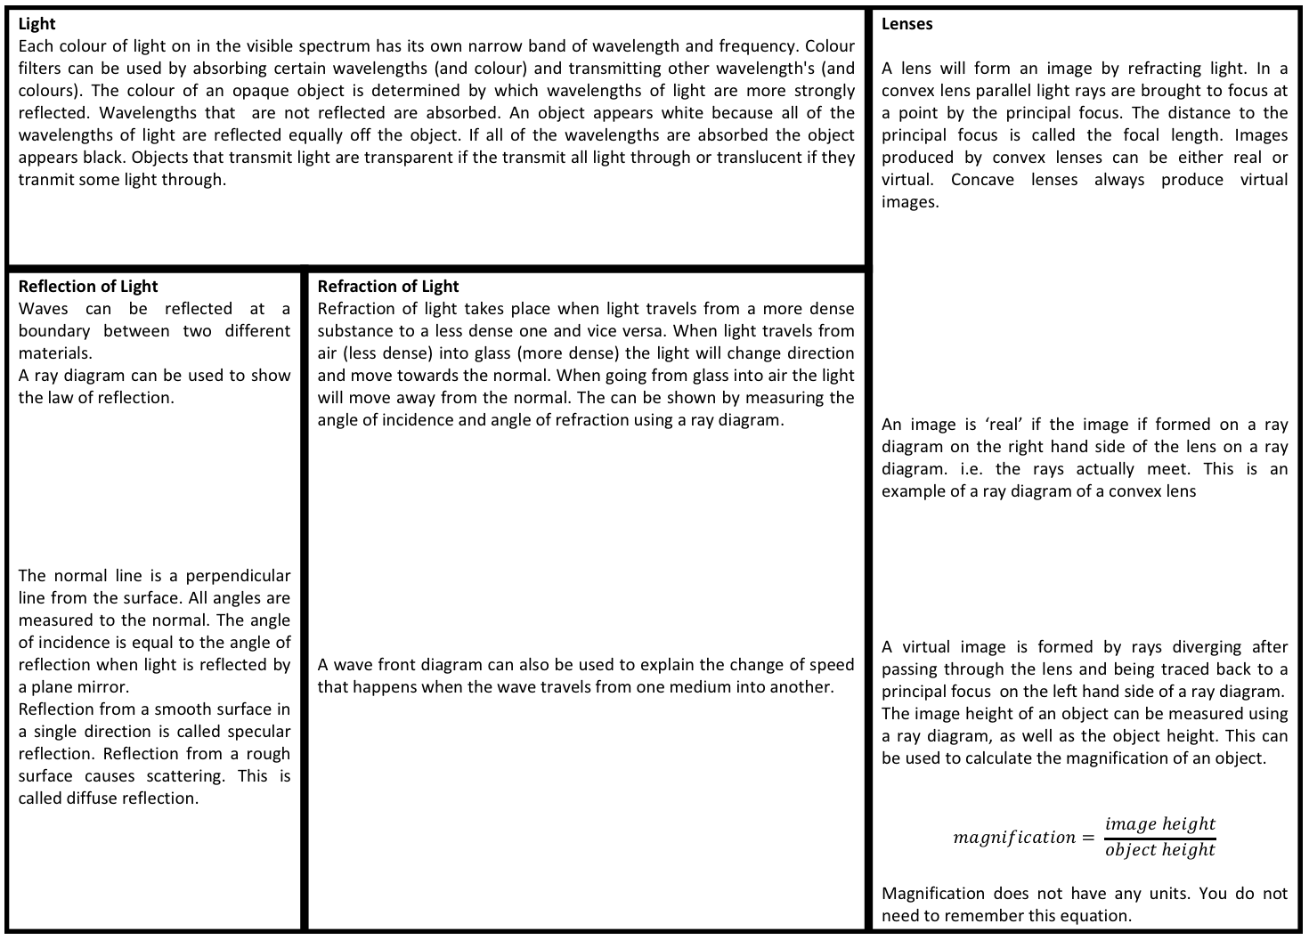
P14: Light: Physics Specification
Light Each colour of light on in the visible spectrum has its own narrow band of wavelength and frequency. Colour filters can be used by absorbing certain wavelengths (and colour) and transmitting other wavelength's (and colours). The colour of an opaque object is determined by which wavelengths of light are more strongly reflected. Wavelengths that are not reflected are absorbed. An object appears white because all of the wavelengths of light are reflected equally off the object. If all of the wavelengths are absorbed the object appears black. Objects that transmit light are transparent if the transmit all light through or translucent if they tranmit some light through. |  | Lenses A lens will form an image by refracting light. In a convex lens parallel light rays are brought to focus at a point by the principal focus. The distance to the principal focus is called the focal length. Images produced by convex lenses can be either real or virtual. Concave lenses always produce virtual images. An image is ‘real’ if the image if formed on a ray diagram on the right hand side of the lens on a ray diagram. i.e. the rays actually meet. This is an example of a ray diagram of a convex lens A virtual image is formed by rays diverging after passing through the lens and being traced back to a principal focus on the left hand side of a ray diagram. The image height of an object can be measured using a ray diagram, as well as the object height. This can be used to calculate the magnification of an object. $$magnification= \frac{image height}{object height}$$ Magnification does not have any units. You do not need to remember this equation.
Reflection of Light Waves can be reflected at a boundary between two different materials. A ray diagram can be used to show the law of reflection. The normal line is a perpendicular line from the surface. All angles are measured to the normal. The angle of incidence is equal to the angle of reflection when light is reflected by a plane mirror. Reflection from a smooth surface in a single direction is called specular reflection. Reflection from a rough surface causes scattering. This is called diffuse reflection. | Refraction of Light Refraction of light takes place when light travels from a more dense substance to a less dense one and vice versa. When light travels from air (less dense) into glass (more dense) the light will change direction and move towards the normal. When going from glass into air the light will move away from the normal. The can be shown by measuring the angle of incidence and angle of refraction using a ray diagram. A wave front diagram can also be used to explain the change of speed that happens when the wave travels from one medium into another.

Slide 10
P15: Electromagnetism: Physics Specification: Higher
Poles of a Magnet The poles of a magnet are the places where the magnetic forces are strongest. When two magnets are brought close together they exert a force on each other. Two like poles repel each other. Two unlike poles attract each other. Attraction and repulsion between two magnetic poles are examples of non-contact force. |  | Permanent Magnets A permanent magnet produces its own magnetic field. | Induced Magnets An induced magnet is a material that becomes a magnet when it is placed in a magnetic field. Induced magnetism always causes a force of attraction. When removed from the magnetic field an induced magnet loses most/all of its magnetism quickly. |  | Electromagnetism When a current flows through a conducting wire a magnetic field is produced around the wire. The strength of the magnetic field depends on the current through the wire and the distance from the wire. Shaping a wire to form a solenoid increases the strength of the magnetic field created by a current through the wire. The magnetic field inside a solenoid is strong and uniform. The magnetic field around a solenoid has a similar shape to that of a bar magnet. Adding an iron core increases the strength of the magnetic field of a solenoid. An electromagnet is a solenoid with an iron core.
Motors A coil of wire carrying a current in a magnetic field tends to rotate. This is the basis of an electric motor. The size of the force can be increased by increasing the current or using a stronger magnet. The size of the force depends on the angle between the wire and the magnetic field. The force is greatest when the wire is perpendicular to the magnetic field and zero when the wire is parallel.
Magnetic Fields The region around a magnet where a force acts on another magnet or on a magnetic material (iron, steel, cobalt and nickel) is called the magnetic field. The force between a magnet and a magnetic material is always one of attraction. The strength of the magnetic field depends on the distance from the magnet. The field is strongest at the poles of the magnet. The direction of the magnetic field at any point is given by the direction of the force that would act on another north pole placed at that point. The direction of a magnetic field line is from the north (seeking) pole of a magnet to the south(seeking) pole of the magnet. |  | Plotting a Magnetic Field Mark a dot near the north pole of a bar magnet and place the tail of the compass needle above the dot and mark a second dot at the tip of the needle. Repeat this with the tail of the next compass over the new dot until you reach the south pole. Repeat this with further lines. |  |  | Solenoids A solenoid is a long coil of insulating wire and they are used in lots of electrical devices where a strong magnetic field is needed. When a current is passed through the wire the magnetic field increases in strength if the current is increased and reverses in direction if the current is reversed.
 | Flemings Left Hand Rule When a conductor carrying a current is placed in a magnetic field the magnet producing the field and the conductor exert a force on each other. This is called the motor effect. You need to be d be able to show that Fleming’s left-hand rule represents the relative orientation of the force, the current in the conductor and the magnetic field. |  |  | Magnetic Flux Density For a conductor at right angles to a magnetic field and carrying a current: Force = Magnetic Flux Density x Current x Length | Quantity | Symbol | Unit
 |  |  |  |  | Force | F | N
 |  |  |  |  | Magnetic Flux Density | B | T
 |  |  |  |  | Current | I | A
 |  |  |  |  | Length | l | m

Slide 11
P15: Electromagnetism: Physics Specification: Higher
Uses of the Generator Effect The generator effect is used in an alternator to generate ac and in a dynamo to generate dc. | Loudspeakers Loudspeakers and headphones use the motor effect to convert variations in current in electrical circuits to the pressure variations in sound waves. | Loudspeakers Loudspeakers and headphones use the motor effect to convert variations in current in electrical circuits to the pressure variations in sound waves. | How Transformers Work Two coils of insulated wire are wound around an iron core. The primary coil is connected to ac and when the current passes through the primary coil potential difference is induced in the secondary coil. | Quantity | Symbol | Unit
 |  |  |  | Potential Difference Across Primary Coil | V_{p} | V
Efficiency of a Transformer. If transformers were 100% efficient the electrical power output would equal the electrical power input. This is represented by the equation: V x I = V x I
 |  |  |  | Potential Difference Across Secondary Coil | V_{s} | V
Induced Potential If an electrical conductor moves relative to a magnetic field or if there is a change in the magnetic field around a conductor, a potential difference is induced across the ends of the conductors. If the conductor is part of a complete circuit a current is induced in the conductor. This is called the generator effect. An induced current generates a magnetic field that opposes the original change, either the movement of the conductor o the change in magnetic field. The size of an induced potential current/potential difference is affected by the strength of a magnetic field, the speed at which the conductor crosses through the lines of the magnetic field. |  | Transformers A basic transformed is made up of a primary coil and a secondary coil wound on an iron core. Iron is used as the core as it is easily magnetised. For each of these coils they have a number of turns and a potential different across the coil. You can calculate the number of turns or potential difference for either of these coils using the equation: Potential Difference Number of Turns Across Primary Coil On Primary Coil = Potential Difference Number of Turns Across Secondary Coil On Secondary Coil In a step up transformed the voltage of the secondary coil is greater than the voltage of the primary coil while in a step down transformed the voltage of the secondary coil is less than the voltage of the primary coil.
 |  |  |  | Primary Coil Number of Turns | N_{p}
 |  |  |  | Secondary Coil Number of Turns | N_{s}
 |  |  |  | Primary Coil Current | I_{p} | A
 |  |  |  | Secondary Coil Current | I_{s} | A

Slide 12
P16: Space: Physics Specification
Fusion Fusion leads to the formation of new elements. In this process two nuclei fuse together releasing energy making a larger element. | Supernova A supernova is an explosion of a massive star and it distributes the elements throughout the universe. The explosion compresses the core of a star into a neutron star. |  | Birth of a Star Stars (including our Sun) are formed when a cloud of dust and gas called a nebula are pulled together by gravitational attraction. This causes fusion reactions. This fusion leads to an equilibrium between the gravitational collapse of the star and its expansion due to fusion energy. | Our Solar System In our solar system there is one star called the Sun. 8 planets and the dwarf planets orbit the Sun and each of these are orbited by Moons. Our solar system is mark of a galaxy called the Milky Way.
 |  |  |  | Red Shift There is an observed increase in the wavelength of light from most distant galaxies. The further away the galaxies, the faster they are moving and the bigger the observed increase in wavelength. This effect is called red-shift. This occurs because when a star or galaxy is moving away from you the light waves are stretched towards the red part of the spectrum. The observed red shift provides us with evidence that space is expanding and supports the Big Bang theory.
Big Bang This is a theory that suggests that the universe began from a very small region that was extremely hot and dense. Ref shift provides evidence for this theory. Cosmic microwave background radiation was first detected in 1965 and provides further evidence for the big bang. High energy gamma radiation would have been produced just after the Big Bang and this has stretched to microwave radiation due to red shift.
Life Cycle of a Star The life cycle is determined by the size of a star. Stars about the same size as our Sun will become red giants while stars much larger than our Sun will become Red super giants. |  | Circular Orbits Gravity provides the force that allows planets and satellites to maintain their circular orbits. The force of gravity on the planet from the Sun acts towards the centre of the Sun. This force is the resultant force on the planet because no other forces act on it. The force is a centripetal force because it acts towards the centre of a circle. For circular orbits the force of gravity can lead to changing velocity (as direction is changing), but unchanged speed. The speed does not change because the force acting on the object is at right angles to its direction of motion. This means that no work is done by the force on the planet so the kinetic energy and the speed of the planet does not change. For a stable orbit if the speed changes the radius must change also.
 |  |  |  | Dark Mass and Dark Energy There is still much of the universe that is not understood including dark mass and dark energy. Dark mass is mass in the universe that cant be seen while dark energy is energy in the universe that cant be seen.

