Slide 1
Triple Science: Chemistry Paper 1
Summary
Sheets
Higher
Chemistry Paper 2
 |  | 1h 45min
Topics in the Paper:
C8 | Rates and Equilibrium
C9 | Crude Oil and Fuels
C10 | Organic Reactions
C11 | Polymers
C12 | Chemical Analysis
C13 | Earth’s Atmosphere
C14 | Earth’s Resources
C15 | Using Our Resources

Slide 2
C8: Rates and Equilibrium
Calculating Rates of Reaction Describe how you can determine the rate of reaction. | Collision Theory and Activation Energy Define collision theory and activation energy. | Factors Which Affect the Rates of Chemical Reactions Identify factors which affect the rate of reaction.
 | Rate of Reaction and Temperature Describe the relationship between temperature and rate of reaction.
 |  | Rate of Reaction and Pressure Describe the relationship between pressure and rate of reaction.
 | Rate of Reaction and Concentration Describe the relationship between concentration and rate of reaction. | Rate of Reaction and Surface Area Describe the relationship between surface area and rate of reaction.
Measuring Rate of Reaction Describe how you could measure the rate of reaction.
 | Catalysts Define catalysts and explain why they are used.
 | Reversible Reactions Explain what reversible reactions are. | Reversible Reactions and Energy Changes Identify the energy changes involved in a reversible reaction.
 |  | Equilibrium Define equilibrium.
Changing Concentration and Equilibrium Explain how changing concentration could affect equilibrium. | Changing Pressure and Equilibrium Explain how changing pressure could affect equilibrium.
Changing Temperature and Equilibrium Explain how changing temperature could affect equilibrium.

Slide 3
C9: Crude Oil
Crude Oil
Describe what crude oil is.
Butane
Describe what butane is and construct a diagram.
Properties of Hydrocarbons
Describe the properties of hydrocarbons.
Fractional Distillation
Describe the process of fractional distillation.
Alkanes
Define alkanes
Combustion
Describe the process of combustion.
Construct word equations to model combustion.
Methane
Describe what methane is and construct a diagram.
Cracking
Describe the process of cracking.
Ethane
Describe what ethane is and construct a diagram.
Petrochemicals
Identify fuels we obtain from crude oil.
Identify uses we have for different fractions of crude oil.
Catalytic Cracking
Describe the process of catalytic cracking.
Propane
Describe what propane is and construct a diagram.
Steam Cracking
Describe the process of steam cracking.
Testing For Alkenes
Describe how to test for alkenes.

Slide 4
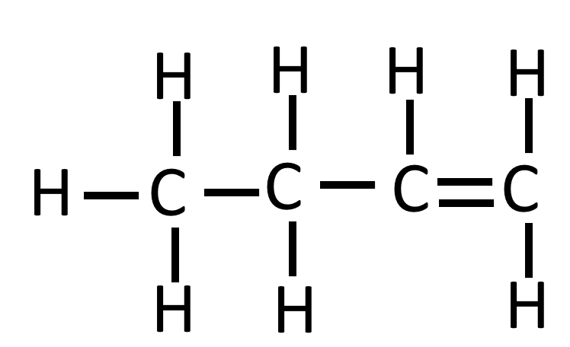
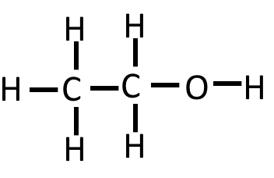
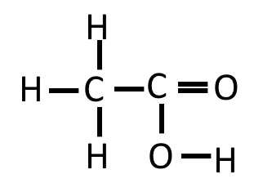
C10: Organic Reactions
 | Alkenes |  |  | Alcohols |  |  | Carboxylic Acids
Functional Group
First 4 members of the series | Ethene Propene Butene Pentene | C₂H₄ C₃H₆ C₄H₈ C₅H₁₀ | E.g. Butene | Methanol Ethanol Propanol Butanol | CH₃OH C₂H₅OH C₃H₇OH C₃H₉OH | E.g. Ethanol | Methanoic Acid Ethanoic Acid Propanoic Acid Butanoic Acid | COOH CH₃COOH C₂H₅COOH C₃H₇COOH | E.g. Ethanoic Acid
Reactions | Reaction with oxygen in combustion Alkenes react with oxygen during combustion but they tend to burn in air with smoky flames due to incomplete combustion. In general: Alkene + Oxygen → Carbon Dioxide + Water For example: Ethene Oxygen Carbon Dioxide Water C₂H₄ O₂ CO₂ H₂O Reaction with Hydrogen. In general: Alkene + Hydrogen → Alkane For example: Pentene Hydrogen Pentane C₅H₁₀ H₂ C₅H₁₂ This reaction takes place at 60°C in the presence of a nickel catalyst. Reaction with Water (Steam) In general: Alkene + Steam ⇌ Alcohol For example: Ethene Steam Ethanol C₂H₄ H₂O C₂H₄OH This reaction needs energy to heat the gases to a high temperature and a catalyst. Reaction with Halogens To identify a halogen you would use a halogen such as bromine. When it reacts with the alkane it turns colourless. This is because… Ethene Bromine Dibromoethane C₂H₄ Br₂ C₂H₄Br₂ Alkenes react with hydrogen, water and the halogens, by the addition of atoms across the carbon-carbon double bond so that the double bond becomes a single carbon-carbon bond. |  |  | Reaction with sodium In general: Sodium + Alcohol → Salt + Hydrogen For example: Sodium Ethanol Sodium Ethanoate Hydrogen Na C₂H₅OH C₂H₅ONa H₂ Reaction with oxygen in combustion In general: Alcohol + Oxygen → Carbon Dioxide + Water For example Ethanol Oxygen Carbon Dioxide Water C₂H₅OH O₂ CO₂ H₂O Alcohols in Water Small molecules of alcohol mix well with water and make neutral solutions. Reaction with an Oxidising Agent You can use oxidising agents such as potassium dichromate (V) to make carboxylic acids and water from alcohol. For example: Ethanol Oxygen from Ethanoic Acid Water oxidising agent C₂H₅OH O CH₃COOH H₂O |  |  | Reaction with carbonates In general: Acid + Carbonate → Salt + Water + Carbon Dioxide For example: Ethanoic Sodium Sodium Water Carbon Acid Carbonate Ethanoate Dioxide CH₃COOH NaCO₃ CH₃COONa H₂O CO₂ Reaction with alcohols In general: Alcohol + Carboxylic Acid ⇌ Ester + Water For example: Methanol Ethanoic Methyl Ethanoate Water Acid CH₃OH CH₃COOH CH₃COOCH₃ H₂O Dissolving in Water To show up their acidic properties acids must dissolve in water. This is because all acids ionise in water. Their molecules split up to form positive H⁺ ions and negative ions. Weak acids such as the carboxylic acids only partly ionise. When dissolving in water the following reaction can take place: Ethanoic Acid Ethanoate Ions Hydrogen Ions CH₃COOH CH₃COO⁻ H⁺ As carboxylic acids only partly ionise they have a higher pH than a strong acid and so there are slower reactions with metal carbonates.
 |  |  |  | Making Alcohols:
 |  |  |  | Uses |  |  | Uses

Slide 5
C11: Polymers
Addition Polymerisation Describe the process of addition polymerisation. | DNA Describe the structure of DNA. | Amino Acids Describe how amino acids form.
 |  | Naturally Occurring Polymers Identify examples of naturally occurring polymers.
 | Condensation Polymerisation Describe the process of condensation polymerisation.
H H H H
I I I I
n C=C → - C- C -
I I I I
H H H H n

Slide 6
C12: Chemical Analysis
Pure Substance Define a pure substance in chemistry Define a pure substance in everyday language. |  | Testing Gases |  |  | Flame Emission Spectroscopy Describe what flame emission spectroscopy is.
 |  | Testing Hydrogen Describe how to test for hydrogen. | Test for Carbon Dioxide Describe how to test for carbon dioxide.
 |  |  |  |  | Setting Up Chromatography Describe how to set up a chromatogram.
 |  | Test for Oxygen Describe how to test for oxygen. | Test for Chlorine Describe how to test for chlorine.
Formulations Define formulation. Identify examples of formulations.
 |  | Chromatography Describe the process of chromatography.
Testing Positive Ions
Flame Tests Describe how flame tests can be used to test for ions. | Using Sodium Hydroxide Describe how sodium hydroxide can be used to test for ions.
 |  | Testing Negative Ions |  |  |  |  | Instrumental Analysis Identify the advantages of instrumental analysis methods.
 |  | Carbonates Describe how to test for carbonates. |  | Halides Describe how to test for halides. |  | Sulfates Describe how to test for sulfates.

Slide 7
C13: The Earths Atmosphere
Gases in the Atmosphere Describe the composition of the Earth’s atmosphere. | Changes in Oxygen Explain why the amount of oxygen in the atmosphere has increased. | Carbon Footprint Define carbon footprint
 |  | Pollutants Identify different pollutants and describe the harm that they cause.
Earth Atmosphere Describe how we think the Earth’s early atmosphere may have formed.
 | Changes in Carbon Dioxide Describe why the amount of carbon dioxide has decreased compared to the Earth’s early atmosphere
 | Changes in Greenhouse Gases Describe how changes to the amount of greenhouse gases in the air is changing
Greenhouse Gases Describe how greenhouse gases causes the earths temperature to increase.
 | Climate Change Explain why climate change is hard to model
Climate Change Define climate change and explain the problems that can occur.

Slide 8
C14: The Earths Resources
Using the Earths Resources Describe how humans use the Earth’s resources | Waste Water Treatment Describe how waste water is treated. | Extracting Metals (Alternative Methods) Describe how metals can be extracted from low grade ores.
Potable Water Define potable water. Explain how potable water can be obtained.
 |  | Phytomining Describe what phytomining involves.
 | Life Cycle Assessment Identify what is considered during a LCA.
 |  | Bioleaching Describe what bioleaching is.
 |  | Finite Resources Define finite resource Identify examples.
Electrolysis of Copper Sulfate Solution Describe what happens during the electrolysis of copper sulfate solution | Sustainable Development Define sustainable development
 |  | Natural Resources Explain what natural resources are and identify examples.
 | Reducing Use of Resources Describe how we can reduce our use of resources.

Slide 9
C15: Using Our Resources
Corrosion Define corrosion and explain when it occurs. | Composites Explain what composites are and identify examples. |  | Alloys Define alloy and identify some examples.
Preventing Corrosion Describe some different ways that corrosion can be prevented. | Ceramics Identify examples of ceramics.
 | Glass Explain what borosilicate glass is. |  | Polymers Explain what polymers are. Compare low density and high density polyethene.
NPK Fertilisers Identify what NPK fertilisers contain. Describe how the different salts in NPK fertilisers can be produced. | Thermosoftening Polymers Explain the properties of thermosoftening polymers. | Thermosetting Polymers Explain the properties of thermosetting polymers.
 |  |  | Haber Process Describe and explain the conditions of the Haber process.

