Slide 1
Revising for English Literature GCSEs
English Literature
Google classroom OOSHL – 2y2nr6m

Slide 2
Literature Paper 1: Shakespeare and the 19th C novel (1h 45mins)
Section A: MACBETH
MARKS: 34 (inc. 4 SPaG)
TIME: 50 MINS
You will get one question only
You will be given an extract to refer to – make sure you refer to it in detail with language analysis
Use the bullet points to help structure your answer
Your response doesn’t have to be balanced between the whole text and the extract, but you do need to refer to the wider text
REMEMBER:
You will get an extract for this question but you will also need to remember quotes from the rest of play
AO3 CONTEXT IS ASSESSED – DON’T FORGET TO USE THE TERM “ELIZABETHAN”
Section B: A CHRISTMAS CAROL
MARKS: 30
TIME: 50 MINS
You will get one question only
You will be given an extract to refer to – make sure you refer to it in detail with language analysis
Use the bullet points to help structure your answer
Your response doesn’t have to be balanced between the whole text and the extract, but you do need to refer to the wider text
REMEMBER:
You will get an extract for this question but you will also need to remember quotes from the rest of play
AO3 CONTEXT IS ASSESSED – DON’T FORGET TO USE THE TERM “VICTORIAN”

Slide 3
Literature Paper 2: Modern Texts and Poetry (2h 15mins)
HANDY HINT: Remember that the title of a story/poem can be the basis of a PEEZ paragraph if it relates to the topic in the question (also good back-up if you can’t remember lots of quotes)
Section A: MODERN PROSE (An Inspector Calls)
MARKS: 34 (inc. 4 SPaG)
TIME: 45 MINS
You will get a choice of two questions but make sure you only answer one question
You must respond to the theme/topic given in the question
REMEMBER:
You will NOT get an extract for this question. All quotes will have to be from memory.
Section B: POETRY
MARKS: 30
TIME: 45 MINS
You will get one question only
You must compare the named poem in the question with one other anthology
You must respond to the theme/topic given in the question
REMEMBER:
You must try to compare the way the poems reflect the theme, not just what happens
You will have the named poem in full and a list of the other poems from the cluster
Section C: UNSEEN POETRY
MARKS: 24 (Q1), 8 (Q2)
TIME: 45 MINS (30 + 15)
Q1: Explain how a theme or topic is presented in the unseen poem given to you
PEEZ paragraphs
Q2: Compare the attitudes/feelings presented in the first unseen poem and the second unseen poem
REMEMBER:
The unseen poems have nothing to do with the poems we studied in class
There is no right/wrong answer as long as you support your ideas with evidence and explanation so BE BRAVE!

Slide 4
Assessment Objectives
AO1: Read, understand and respond to texts. Students should be able to:
  maintain a critical style and develop an informed personal response
  use textual references, including quotations, to support and illustrate interpretations.
AO2: Analyse the language, form and structure used by a writer to create meanings and effects, using relevant subject terminology where appropriate.
AO3: Show understanding of the relationships between texts and the contexts in which they were written.
AO4: Use a range of vocabulary and sentence structures for clarity, purpose and effect, with accurate spelling and punctuation.
You are only marked on AO1 and AO2 for unseen poetry.
Simplified
AO1 – how well do they know the text?
AO2 – have they been able to discuss the writers choices and what impact these have?
AO3 – do they consider why the writer has made the choices they have?
AO4 – SPAG

Slide 5
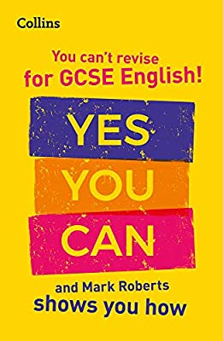
Understanding Effective Revision
Mark Robert’s book helps identify a variety of ways students can make their English revision much more effective for themselves. Maybe you fall into the ‘you can’t revise English’ category or maybe you are just unsure where to start. Hopefully you will find the following helpful in understanding the ways in which you can get revising English.

Slide 6
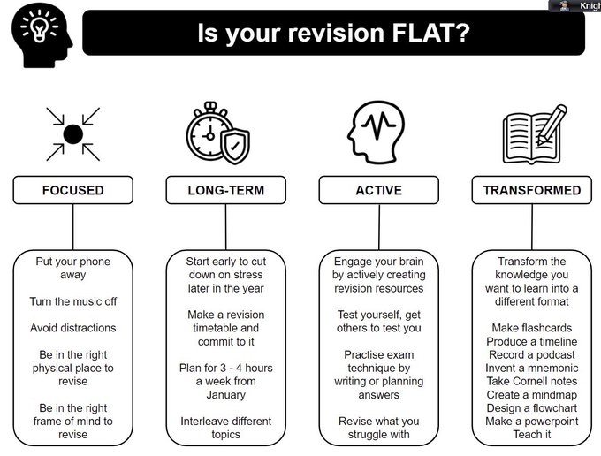

Slide 7
Retrieval and Flashcards
Retrieval practice – this is the recalling of information. This is best to do without your notes. It will form better bonds and connections to your long term memory helping you retrieve key information much quicker in exams.
One way to do this is by using flashcards. Include a question on one side and the answers on another. Test yourself frequently. For this to be more effective you must resist the temptation to turn your card over if you cannot retrieve the information immediately. The more challenging you find this task the better it is working for you.
Notes:
Think about the memory model

Slide 8
Flashcard examples
You could have a character one side and quotations about them / from them on the reverse.
You could do this with scenes / acts / themes …
Feel free to copy / print our examples.
Macbeth
‘Brave Macbeth’
‘Will all great Neptune’s ocean wash this blood
Clean from my hand?’
Front
Back

Slide 9
Flashcard examples
Macbeth
‘Brave Macbeth’
‘Will all great Neptune’s ocean wash this blood
Clean from my hand?’
Witches
‘fair is foul and foul is fair’
‘thou shalt be king hereafter’
Lady Macbeth
‘look like the innocent flower but be the serpent under it’
‘Out damn spot’
‘unsex me here’
Banquo
‘I fear thou played’st most foully for it’ (Macbeth)
‘oh treachery, fly good Fleance, fly!’
Duncan
‘valiant cousin, worthy gentleman’ (Macbeth)
“silver skin laced with his golden blood”
Macduff
‘bleed, bleed poor country’
‘tyrant, show thy face’
‘All my pretty ones? Did you say all?’

Slide 10
Scrooge Stave 1
‘Solitary as an oyster… hard and sharp as flint.’
‘squeezing, wrenching, grasping…old sinner.’
‘…decrease the surplus population.’
Scrooge Stave 4
‘I hope to live to be another man from what I was’
‘Ah, poor Tiny Tim!’
‘Hear me! I am not the man I was.’
Scrooge Stave 2
‘A solitary child, neglected by his friends, is left here still’
‘His heart and soul were in the scene’
‘Quite alone in the world’
Scrooge Stave 5
‘I am as light as a feather…happy as an angel…merry as a schoolboy’
‘a great many back payments are included in it’
Scrooge Stave 3
‘a strange voice… bade him enter. He obeyed.’
‘Tell me if Tiny Tim will live’
‘Have they no refuge or resource?’
Pathetic Fallacy
‘The fog came pouring in t every chink and keyhole’
‘No fog, no mist; clear, bright.’

Slide 11
Bob Crachit
‘In a dismal little cell’
‘Mr Scrooge, the founder of the feast’
‘I’ll raise your salary, and endeavour to assist your struggling family’
Fred
‘His face was ruddy handsome; his eyes sparkled’
‘I couldn’t be angry with him if I tried’
The Cratchit Family
‘then up rose Mrs Cratchit, brave in ribbons’
‘There never was such a goose… a meagre feast’
Business Men
‘I don’t mind going if lunch is provided’
‘It’s likely to be a very cheap funeral’
Tiny Tim
‘As good as gold and better’
‘My child, my little child!’
‘God bless us, every one!’
Mrs Dilber
‘Every person has a right to take care of themselves. He always did’
‘Why wasn’t he natural in his lifetime?’

Slide 12
Jacob Marley
‘I forged it link by link and yard by yard’
‘Mankind was my business’
Ghost of Christmas Yet to Come
‘The Phantom slowly, gravely, silently, approached.’
‘shrouded in a deep black garment, which concealed … its face’
Ghost of Christmas Past
‘like a child, yet… like an old man’
‘[from] its head there sprung a bright clear jet of light’
‘the light…streamed from under it…an unbroken flood’
Fezziwig
‘oily, rich, fat, jovial voice’
‘he has the power to render us happy or unhappy’
Ghost of Christmas Present
‘Jolly giant’
‘an antique scabbard…eaten up with rust’
‘This boy is ignorance, this girl is want’
Belle
‘Another idol has replaced me… a golden one’
‘Our contract is an old one’
‘I release you’

Slide 13
Mr Birling
“A man has to make his own way – has to look after himself – and his family too, of course.”
Sheila
“But these girls aren’t cheap labour, they’re people.”
Mr Birling
“unsinkable, absolutely unsinkable.”
Sheila
“I have been so happy tonight, I wish you hadn’t told me.”
Mr Birling
“Now look at the pair of them – the famous younger generation who know it all.”
Sheila
“If all that’s come out tonight is true, then it doesn’t much matter who made us confess.”

Slide 14
Eric
“Why shouldn’t they try for higher wages? We try for the highest possible prices.”
Gerald
‘you were the wonderful fairy prince’ (Sheila)
Eric
“My God – I’m not likely to forget.”
Gerald
‘I’m rather more upset than I appear to be’
Eric
“Half shy, half assertive.”
Gerald
‘I don’t come in to this suicide business’

Slide 15
Mrs Birling
“as if a girl of that sort would ever refuse money”
‘her husband’s social superior’
‘that was one of the things that prejudiced me against her case’
Inspector Goole
‘public men have responsibilities as well as privileges’
Mrs Birling
‘her husband’s social superior’
Inspector Goole
‘they will be taught it in fire and blood and anguish’
Mrs Birling
‘that was one of the things that prejudiced me against her case’
Inspector Goole
‘creates an impression of massiveness, solidity and purposefulness’

Slide 16
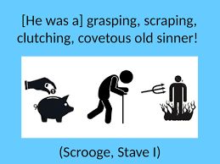
Turn key quotations into pictograms if you wish (instead of words use images to represent the quotation).
Test yourself by seeing the image / images and trying to write down what the quote is.

Slide 17
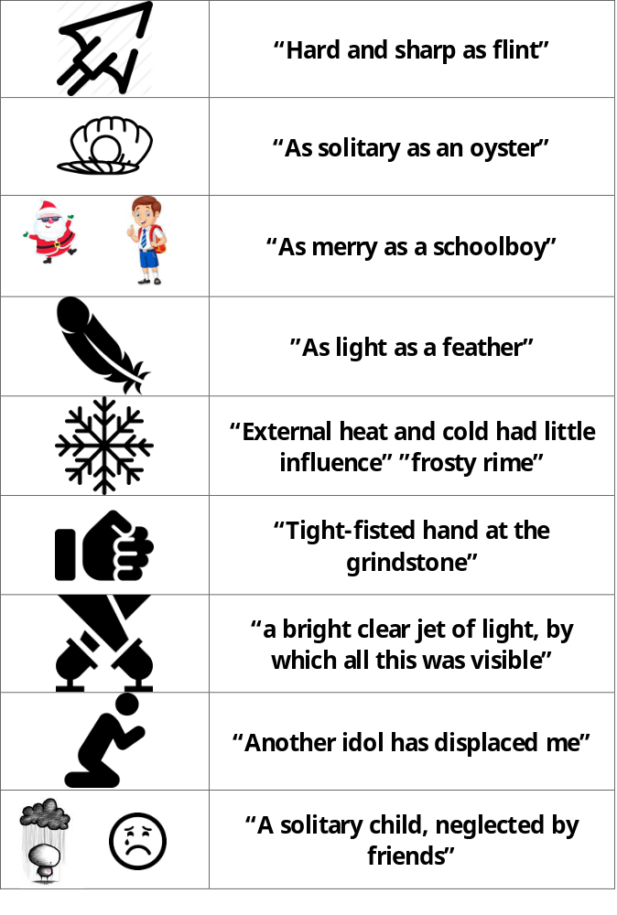
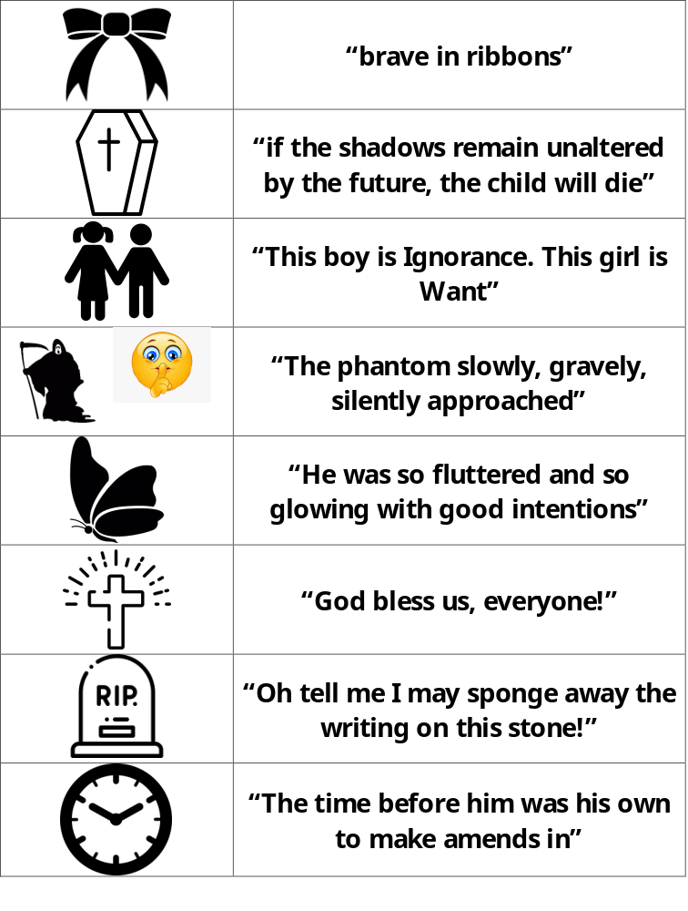

Slide 18





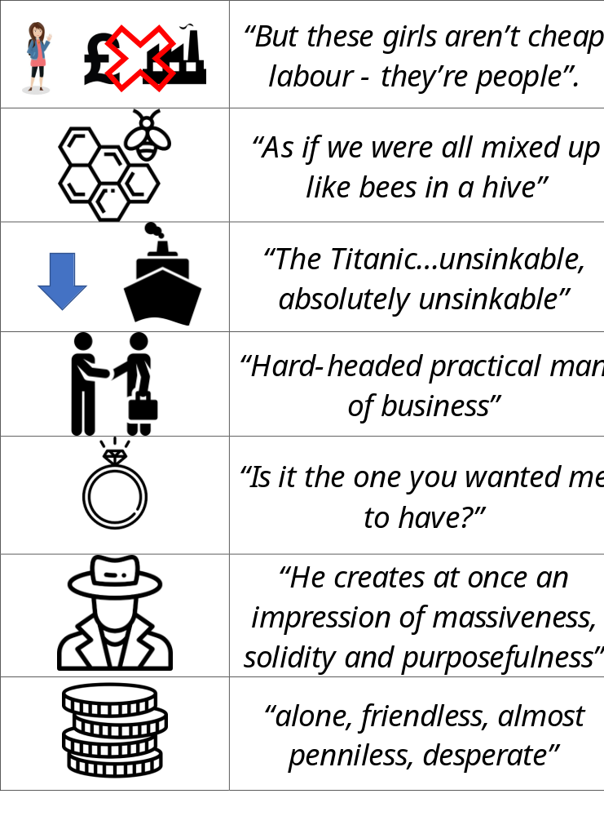
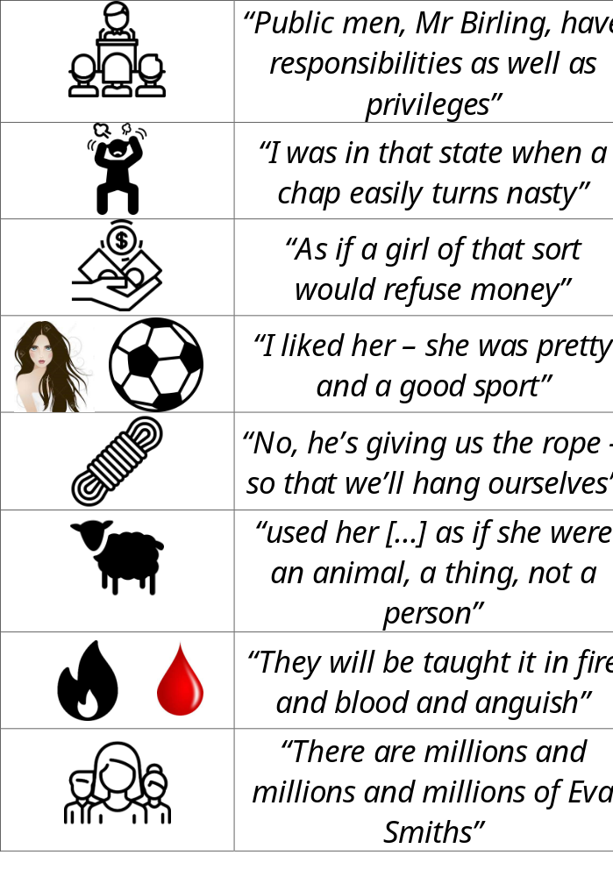

Slide 19
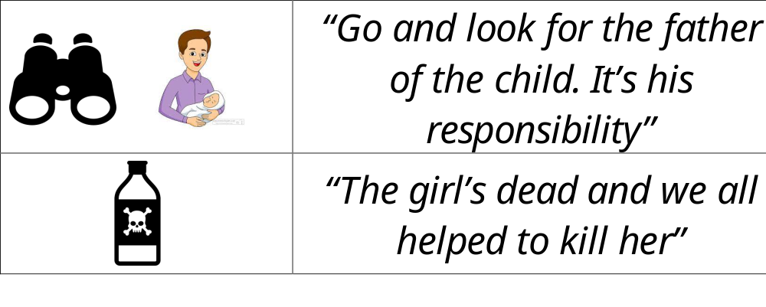

Slide 20
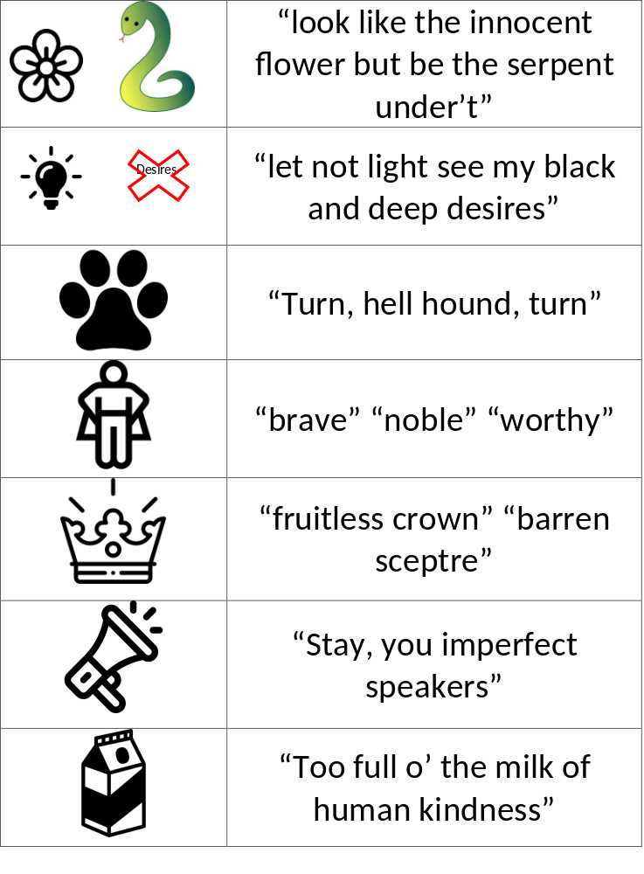
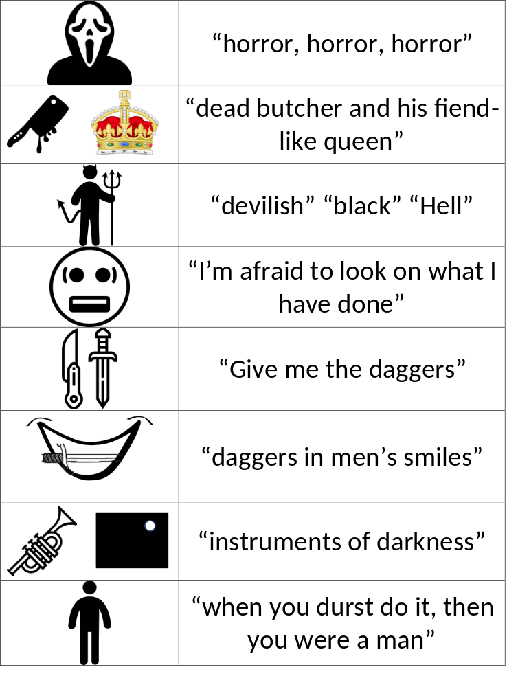

Slide 21
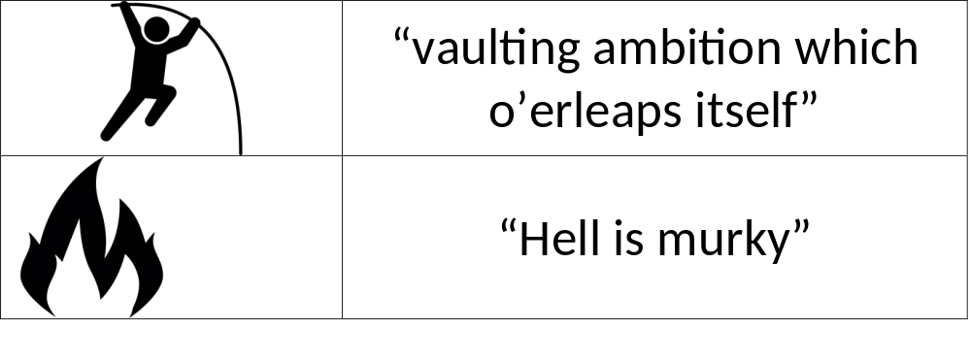

Slide 22
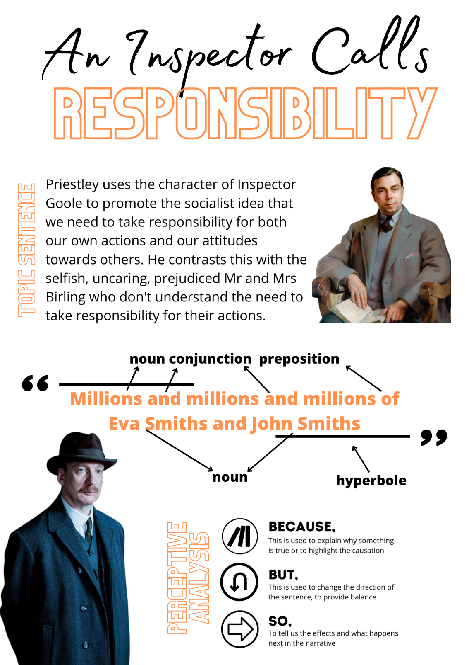
When picking quotations to remember, you must ensure you have something to say about them. Does it allow you to introduce a key theme / piece of context? Is it structurally significant? Is there a particular word / technique you could expand on?

Slide 23
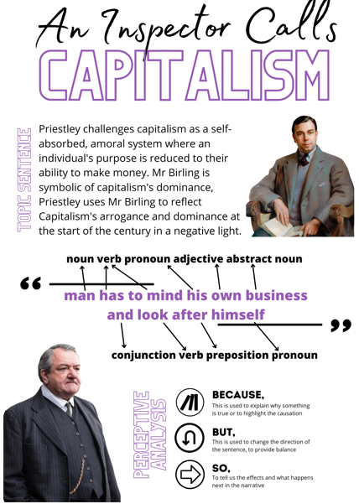
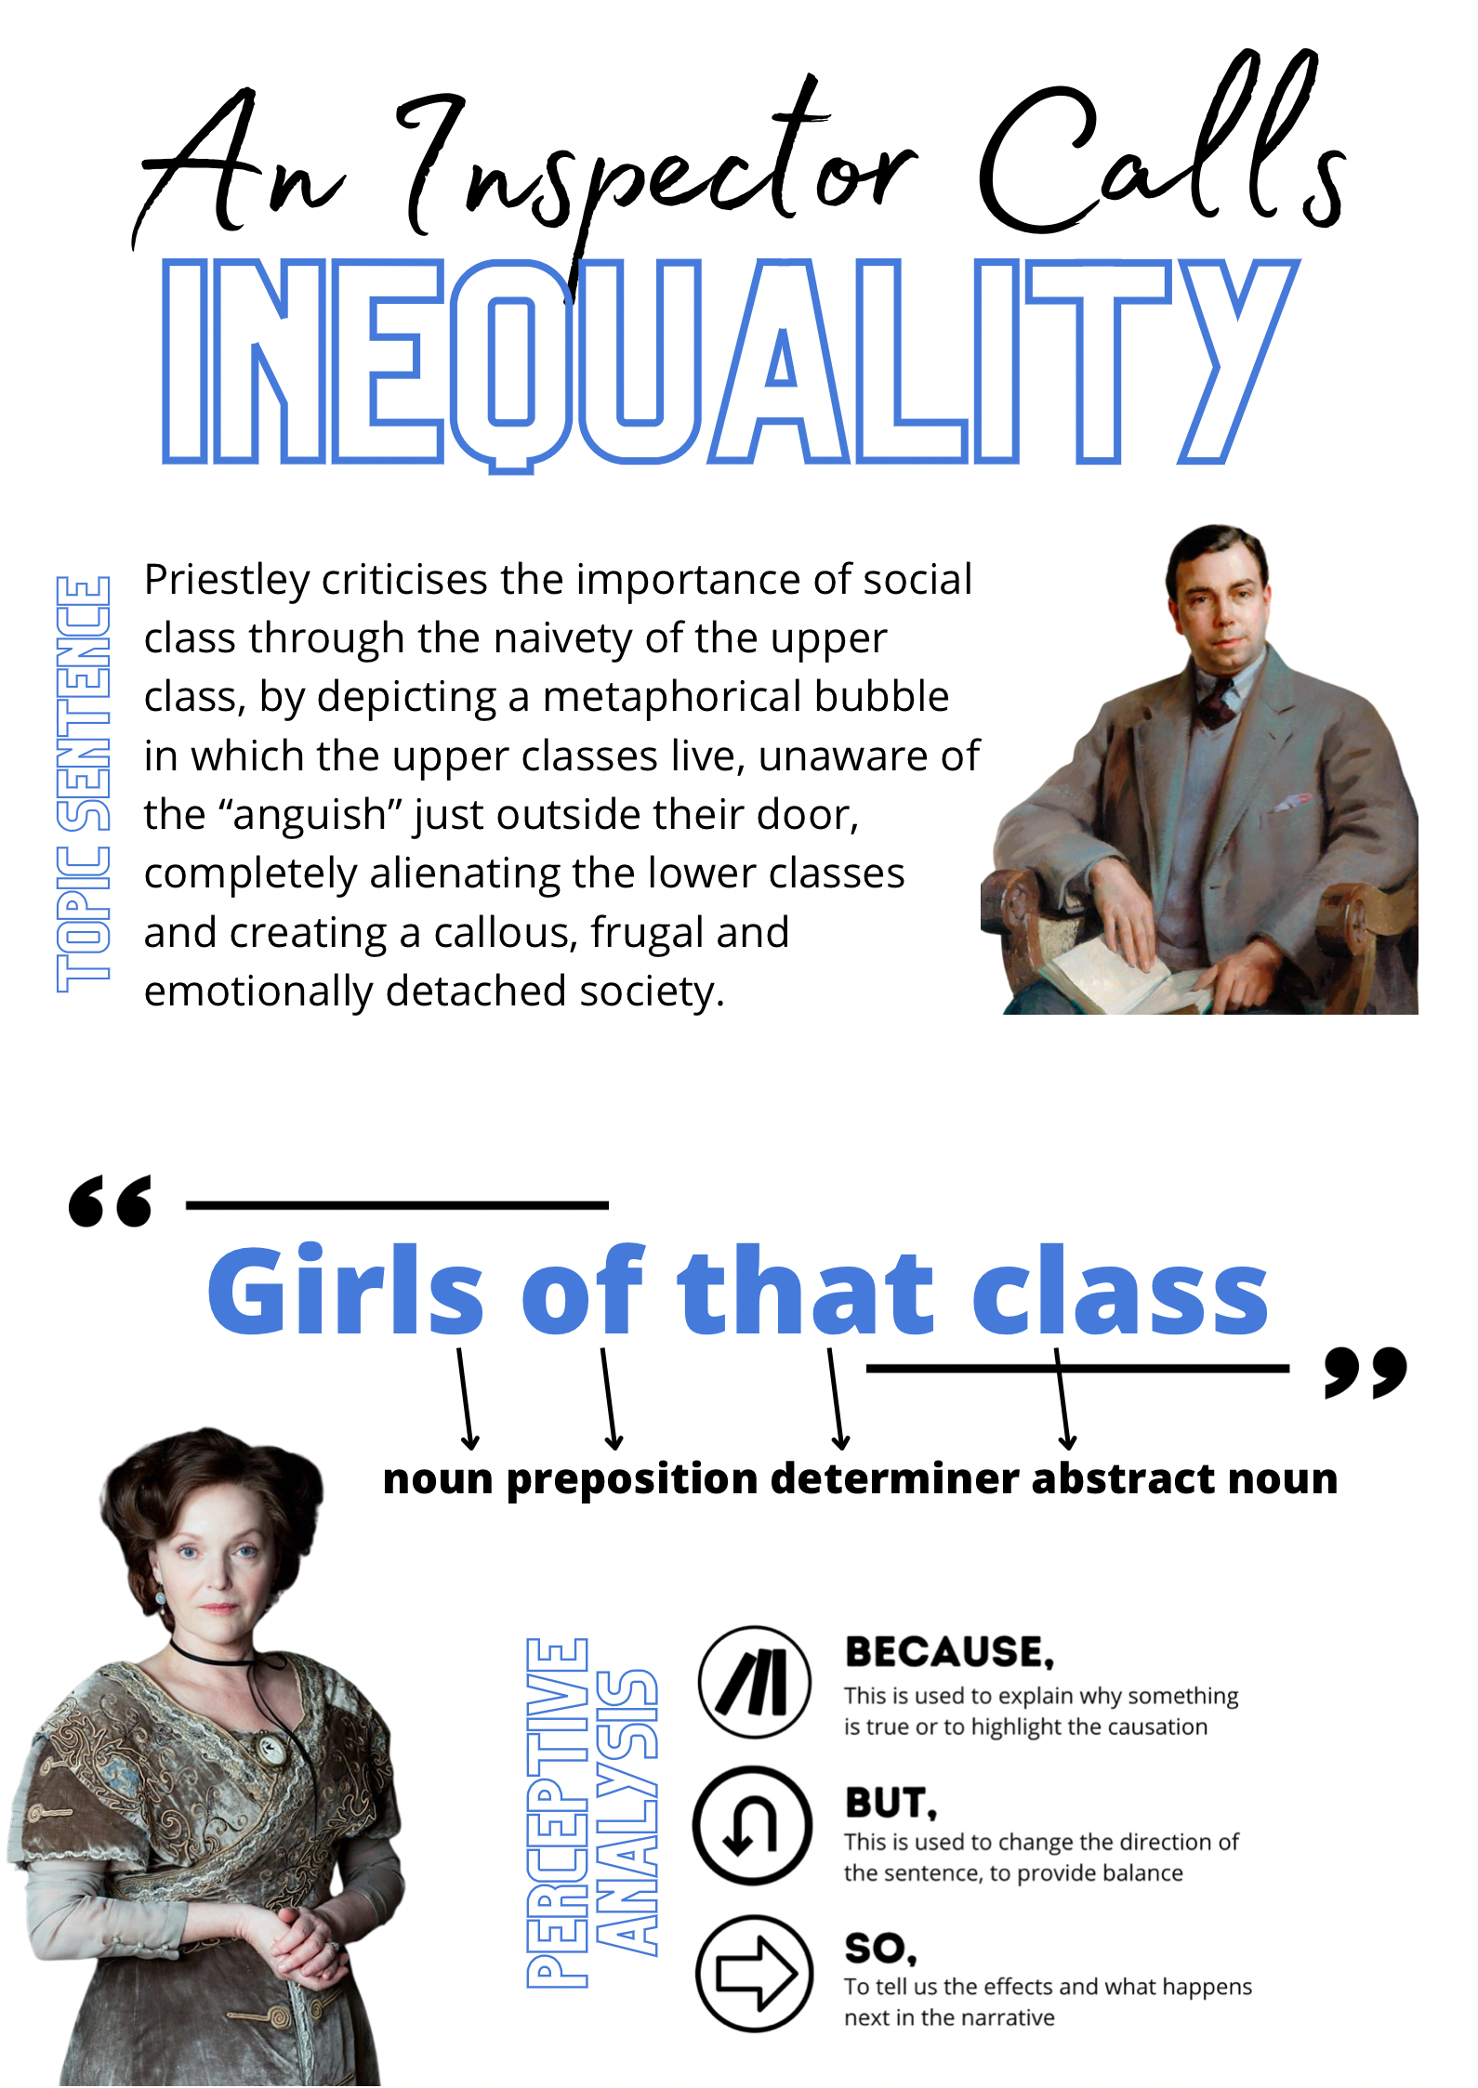

Slide 24
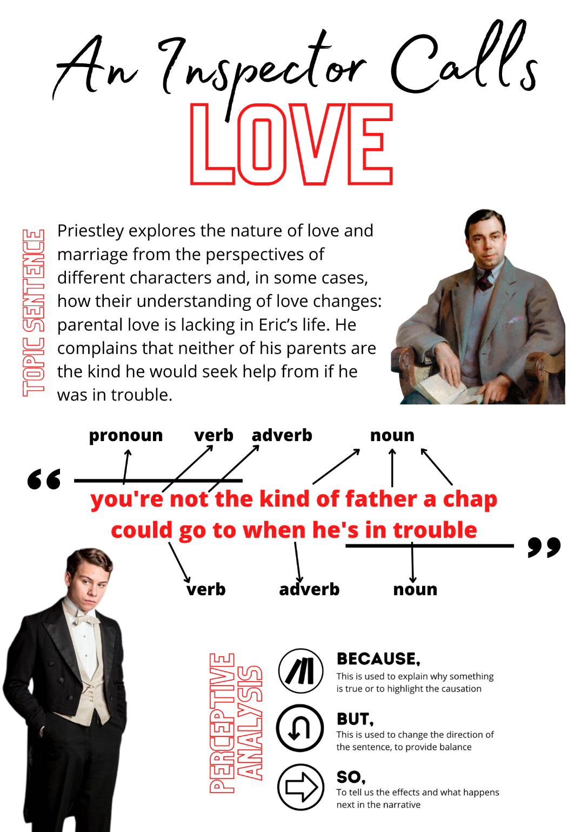
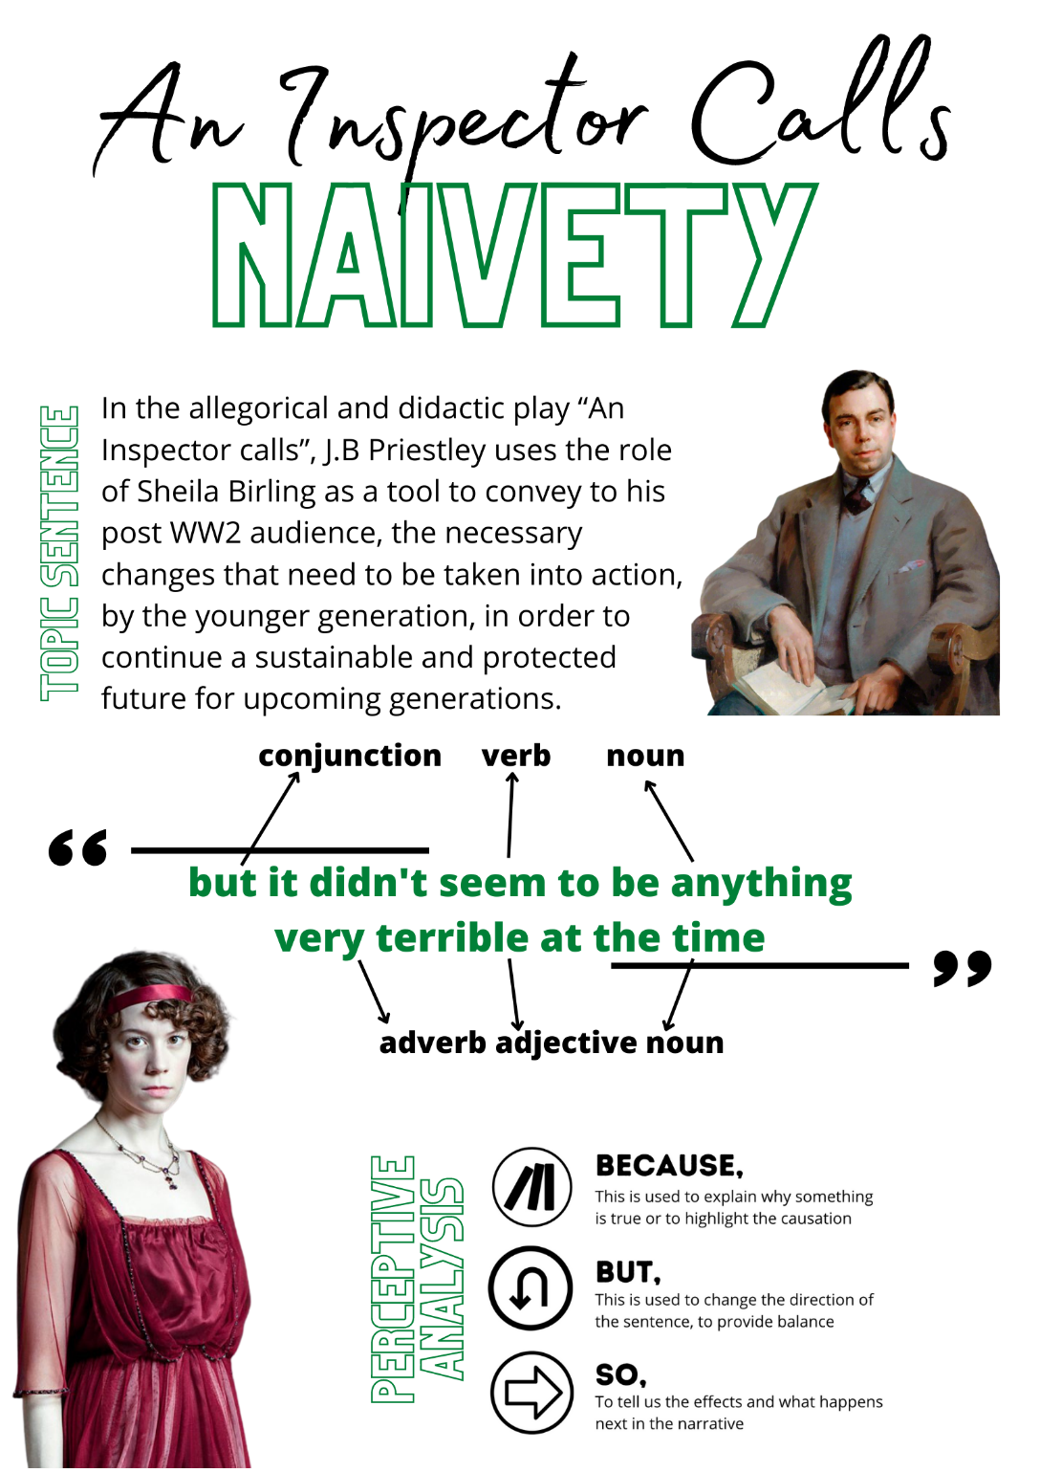

Slide 25
Exploding and Killer Quotes
Exploding
Killer
As teachers we encourage you to do this all the time.
Take your key quotations and explode them – consider inferences of each word, links to themes / characters / context and any techniques. FIT.
Consider synonyms – why did the writer use the word bleak instead of miserable? You can then use these words to help discuss – instead of repeating the word bleak I could use miserable / austere / unwelcoming to make your analysis more impressive.
Identify quotations that grab your attention – when rereading the texts / looking over class notes.
Identify commonly occurring quotations – do they crop up for a range of themes / do discuss a range of characters?
Can they / do they match with any other key quotations?

Slide 26
Quotations
You do not necessarily have to remember long chunks of quotations. Think about single words. These may be words that start with the same letter or words that go across more than one text or grouped into a particular theme.
Practise embedding quotations into your sentences. This means the sentence makes sense whether it is a quotation or not.

Slide 27
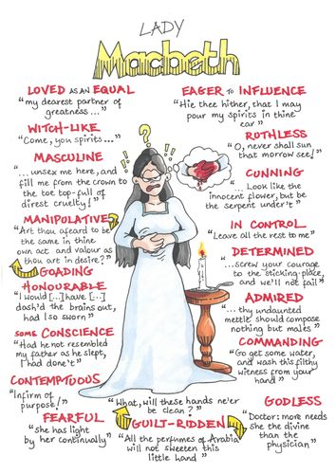
Create roles on the wall for each of the characters.
Include their thoughts and feelings, how the audience view them, how other characters view them … then use quotations to support your ideas.
Stick them all over your room / house. Remind yourself of them wherever you go then.
Here’s the Macbeth ones to get you started – and remember you can always use a gingerbread man outline to get you started.

Slide 28
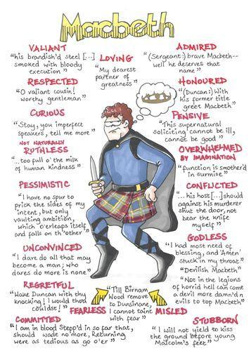
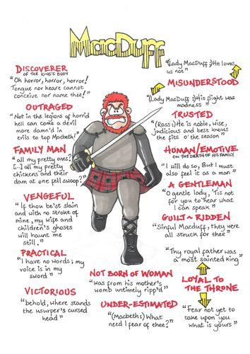

Slide 29
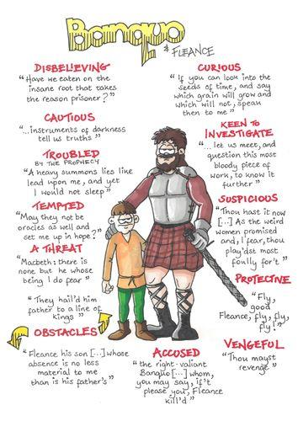
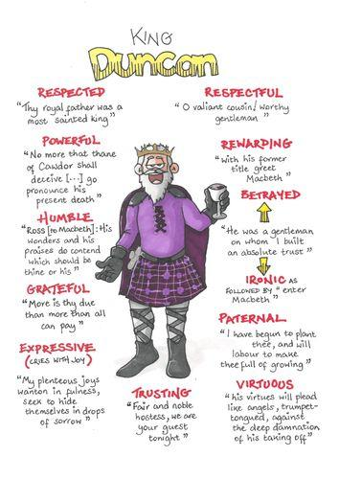

Slide 30
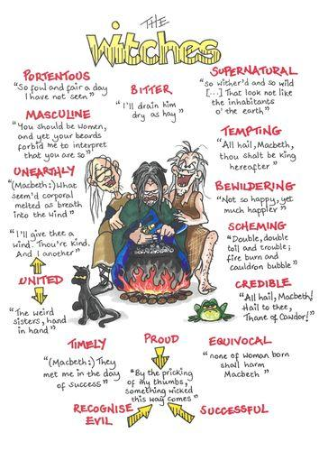

Slide 31

An Inspector Calls
Inspector Goole
Mr Birling
Mrs Birling
Sheila
Eric
Gerald Croft
Edna
Eva Smith / Daisy Renton
A Christmas Carol
Scrooge
Jacob Marley
Ghost of Christmas Past
Ghost of Christmas Present
Ghost of Christmas Yet To Come
Bob Cratchit
Fred
Tiny Tim

Slide 32
Context – AO3
5 tips to thrive
As part of your revision, consider the types of context you can use (author, time period…)
Consider what context will be relevant to which questions
Balance – not too much and not too little
Improve your knowledge of time periods, genre tropes, authors / poets … this can help you avoid making vague or incorrect statements
Practise writing paragraphs – blending your context into your analysis
Macbeth Context Topics:
William Shakespeare
Shakespearean era
Witchcraft
James I Scotland
Tragedy
Shakespearian women
You do not need to comment on context in the unseen poetry part of the paper.

Slide 33
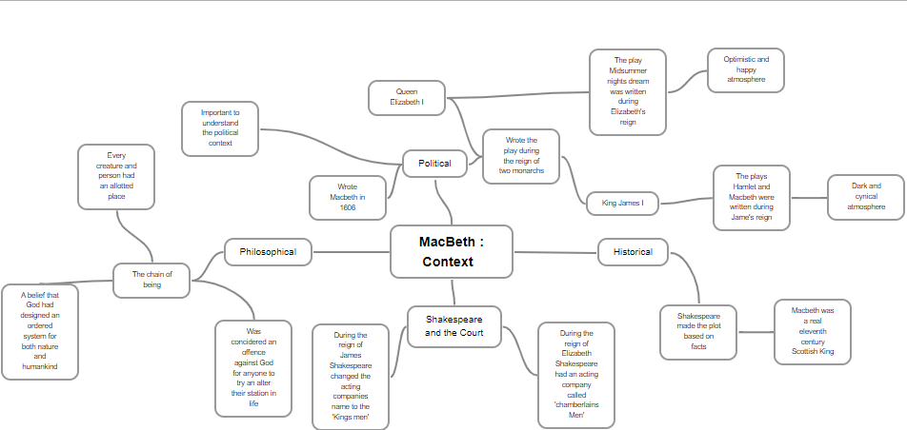

Slide 34
Unseen
Unseen poetry – you can still revise for something you won’t see until the day!
Revise language and structure techniques. (There are lots of resources on the internet and BBC Bitesize) https://www.bbc.co.uk/bitesize/guides/zs4rg82/revision/2
Look at a variety of poetic forms.
Read a variety of poems and practise using our approaching unseen poetry strategy.
Complete past papers. https://www.aqa.org.uk/subjects/english/gcse/english-literature-8702/assessment-resources

Slide 35
Moving
Moving in, I think I thought
that here was a house
in which our troubled souls
might one day come to rest.
Nothing in the street seemed planned,
each house a blueprint of the grand.
But there were omens from the start.
Our hired van came late –
Stock full of toys, your clothes, our books,
the tired ten year wedding gifts which
symbolized our disappointment.
Walking for milk to lace our tea
I passed another scene of change.
in a front room behind a bay she stood alone
contemplating a vacancy.
Her parents and her kids standing at the door,
the cases lined like gravestones in the hall.
When it came, the day I left that place,
I thought of this, how she’d watch me pass,
her empty eyes, the rawness of her face,
how it seemed to stand for something
pre-determined, a truth about life,
each of us alone, an empty space.
John Pownall
In ‘Moving’, how does the poet present the speaker’s feelings about what it means to move home? (24 marks)
Strategy for Approaching Poetry
Look at the title; what inferences can we make about the poem from this? What connotations might there be of the title?
Read the poem – note down any feelings / thoughts you have as you read.
Read the poem again and annotate methods (language / structure). What is the message of the poem? How has that been communicated?
Identify 3 key quotes that you would want to focus on – try to make one of these about structure (think about what the question has asked you to focus on).

Slide 36
Abandoned Farmhouse
He was a big man, says the size of his shoes
on a pile of broken dishes by the house;
a tall man too, says the length of the bed
in an upstairs room; and a good, God-fearing man,
says the Bible with a broken back
on the floor below the window, dusty with sun;
but not a man for farming, say the fields
cluttered with boulders and the leaky barn.
A woman lived with him, says the bedroom wall
papered with lilacs and the kitchen shelves
covered with oilcloth, and they had a child,
says the sandbox made from a tractor tire.
Money was scarce, say the jars of plum preserves
and canned tomatoes sealed in the cellar hole.
And the winters cold, say the rags in the window frames.
It was lonely here, says the narrow country road.
Something went wrong, says the empty house
in the weed-choked yard. Stones in the fields
say he was not a farmer; the still-sealed jars
in the cellar say she left in a nervous haste.
And the child? Its toys are strewn in the yard
like branches after a storm—a rubber cow,
a rusty tractor with a broken plow,
a doll in overalls. Something went wrong, they say.
Ted Kooser
In both ‘Moving’ and ‘Abandoned Farmhouse’ the speakers describe feelings about empty or abandoned homes. What are the similarities and/or differences between the ways the poets present those feelings? (8 marks)
Strategy for Approaching Poetry
Look at the title; what inferences can we make about the poem from this? What connotations might there be of the title?
Read the poem – note down any feelings / thoughts you have as you read.
Read the poem again and annotate methods (language / structure). What is the message of the poem? How has that been communicated?
Identify 3 key quotes that you would want to focus on – try to make one of these about structure (think about what the question has asked you to focus on).

Slide 37
Helpful Vocabulary
Develop your essays with the following vocabulary:
Analytical Verbs: helps make clear what you think the writer is doing and why.
Instead of writing ‘Shakespeare’ uses the quote / word …’
Consider using ‘phrase’ or ‘line’ or identify the language feature ‘use of irony / simile’ or describe the sentence function ‘Shakespeare’ uses the exclamatory’
Amplifies | Emphasises by adding extra impact
Conveys | Gets across a message / idea / theory
Demonstrates | Provides a clear explanation / example
Emphasises | Draws attention to something
Evokes | Brings a strong feeling or idea
Foreshadows | Hints at subsequent events / themes
Highlights | Draws clear attention to make it stand out
Reiterates | Repeats or supports the same point / idea
Reveals | Makes clear something previously unclear
Symbolises | Uses something to represent an idea or theme

Slide 38
Alliteration
This is where the first letter of a word is repeated in words that follow. For example, the cold, crisp, crust of clean, clear ice.
Assonance
This is where the same vowel sound is repeated but the consonants are different. For example, he passed her a sharp, dark glance, she shot a cool, foolish look across the room.
Colloquial language
This is language used in speech with an informal meaning. For example, chill, out of this world, take a rain check
Dialect
This is a version of a language spoken by people in a particular geographical area.
Dialogue
This is a conversation between two or more people - sometimes an imagined conversation between the narrator and the reader. Dialogue is important in drama and can show conflict through a series of statements and challenges, or intimacy where characters mirror the content and style of each other's speech. It can also be found in the conversational style of a poem.
Dissonance
This is discordant combinations of sounds. For example, the clash, spew and slow pang of grinding waves against the quay.
Enjambment
This is device used in poetry where a sentence continues beyond the end of the line or verse. This technique is often used to maintain a sense of continuation from one stanza to another.
Hyperbole
This is exaggerating for a purpose – it is not meant to be taken literally. For example, we gorged on the banquet of beans on toast.
Imagery
This is where strong pictures or ideas are created in the mind of the reader. Similes, metaphors and personification can all be used to achieve this - they all compare something 'real' with something 'imagined'.
Irony
This is where words or ideas are used humorously or sarcastically, to imply the opposite of what they mean.
Metaphor
This is where a word or phrase is used to imply figurative resemblance, not a literal or 'actual' one. For example, he flew into the room.
Monologue
An uninterrupted monologue can show a character's importance or state of mind. Monologue can be in speech form, delivered in front of other characters and having great thematic importance, or as a soliloquy where we see the character laying bare their soul and thinking aloud.

Slide 39
Onomatopoeia
This is a word that sounds like the noise it is describing. For example, splash, bang, pop, hiss.
Oxymoron
This is where two words normally not associated are brought together. For example, cold heat, bitter sweet.
Pathos
This is language that evokes feelings of pity or sorrow.
Personification
This is where a human quality is attributed to a thing or idea. For example, the moon calls me to her darkened world.
Repetition
This is where a word or phrase is repeated to achieve a particular effect.
Rhyme
Poems often have a fixed rhyme scheme. For example, sonnets have 14 lines with the fixed rhyme scheme ABAB CDCD EFEF GG. Try to comment on what contribution the rhyme scheme is making to the text as a whole. Why do you think the poet has chosen it? Does it add control or perhaps imitate the ideas in the poem in some way?
Rhythm
Many poems contain a repetitive beat or metre. Tennyson's poem The Lady of Shalott uses a strong internal rhythm to build up the sense of unrelenting monotony in the poem.
There she weaves by night and day/A magic web with colours gay./She has heard a whisper say,/A curse is on her if she stay
Simile
This is where a phrase establishes similarity between two things. Similes usually involve the words 'like' or 'as'- he is as quick as an arrow in flight, as white as snow, like a burning star.
Symbolism
Objects, colours, sounds and places may work as symbols. They can sometimes give us an insight into the themes. So, snakes are often symbols of temptation as in the story of Adam and Eve, white usually symbolises innocence and a ringing bell can be a symbol for impending doom.
Tone
Tone is the creation of mood in a text, such as sadness, gloom, celebration, joy, anxiety, dissatisfaction, regret or anger. Different elements of writing can help to create these moods. For example, long sentences or verses, with assonance, tend to create a sad, melancholic mood. But short syllabic, alliterative lines can create an upbeat and pacy atmosphere.
Word choice
This can also be referred to as 'register'. It refers to an author's choice of language. Authors may use words commonly associated with a certain subject, experience or state of mind.

Slide 40
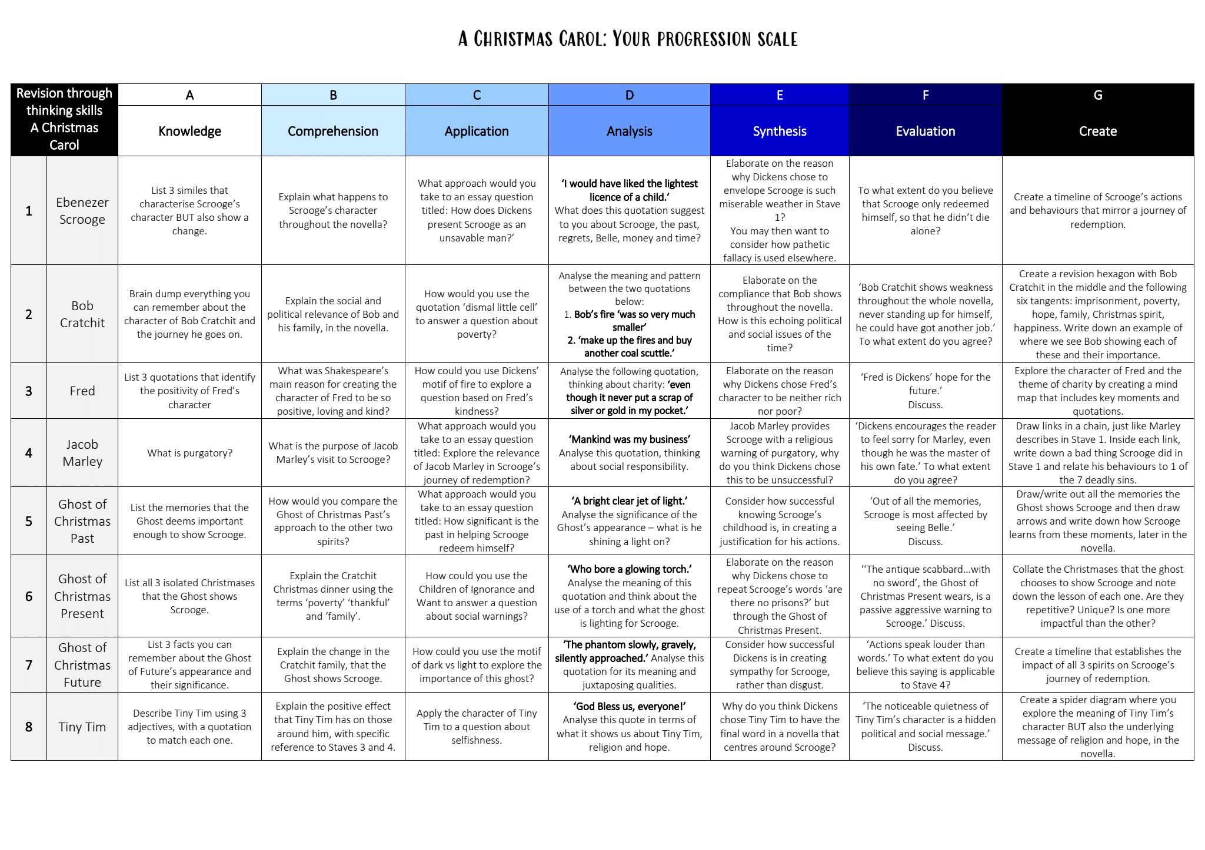

Slide 41
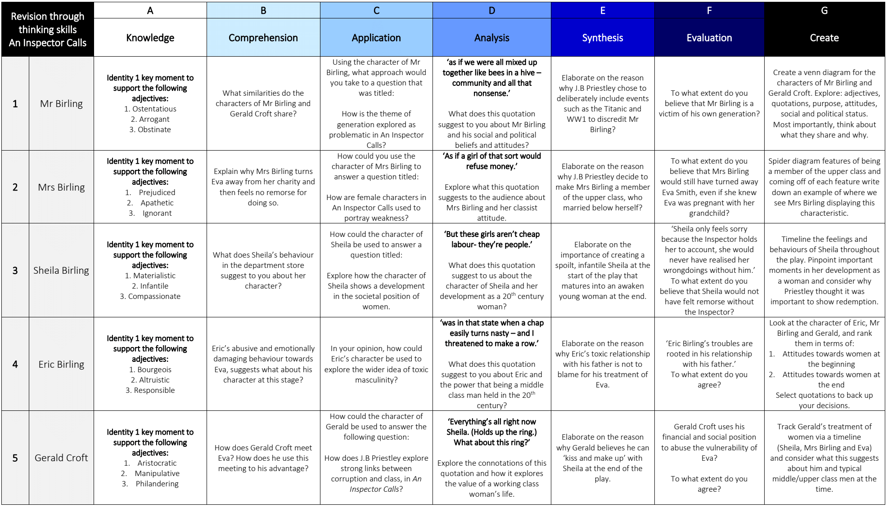

Slide 42
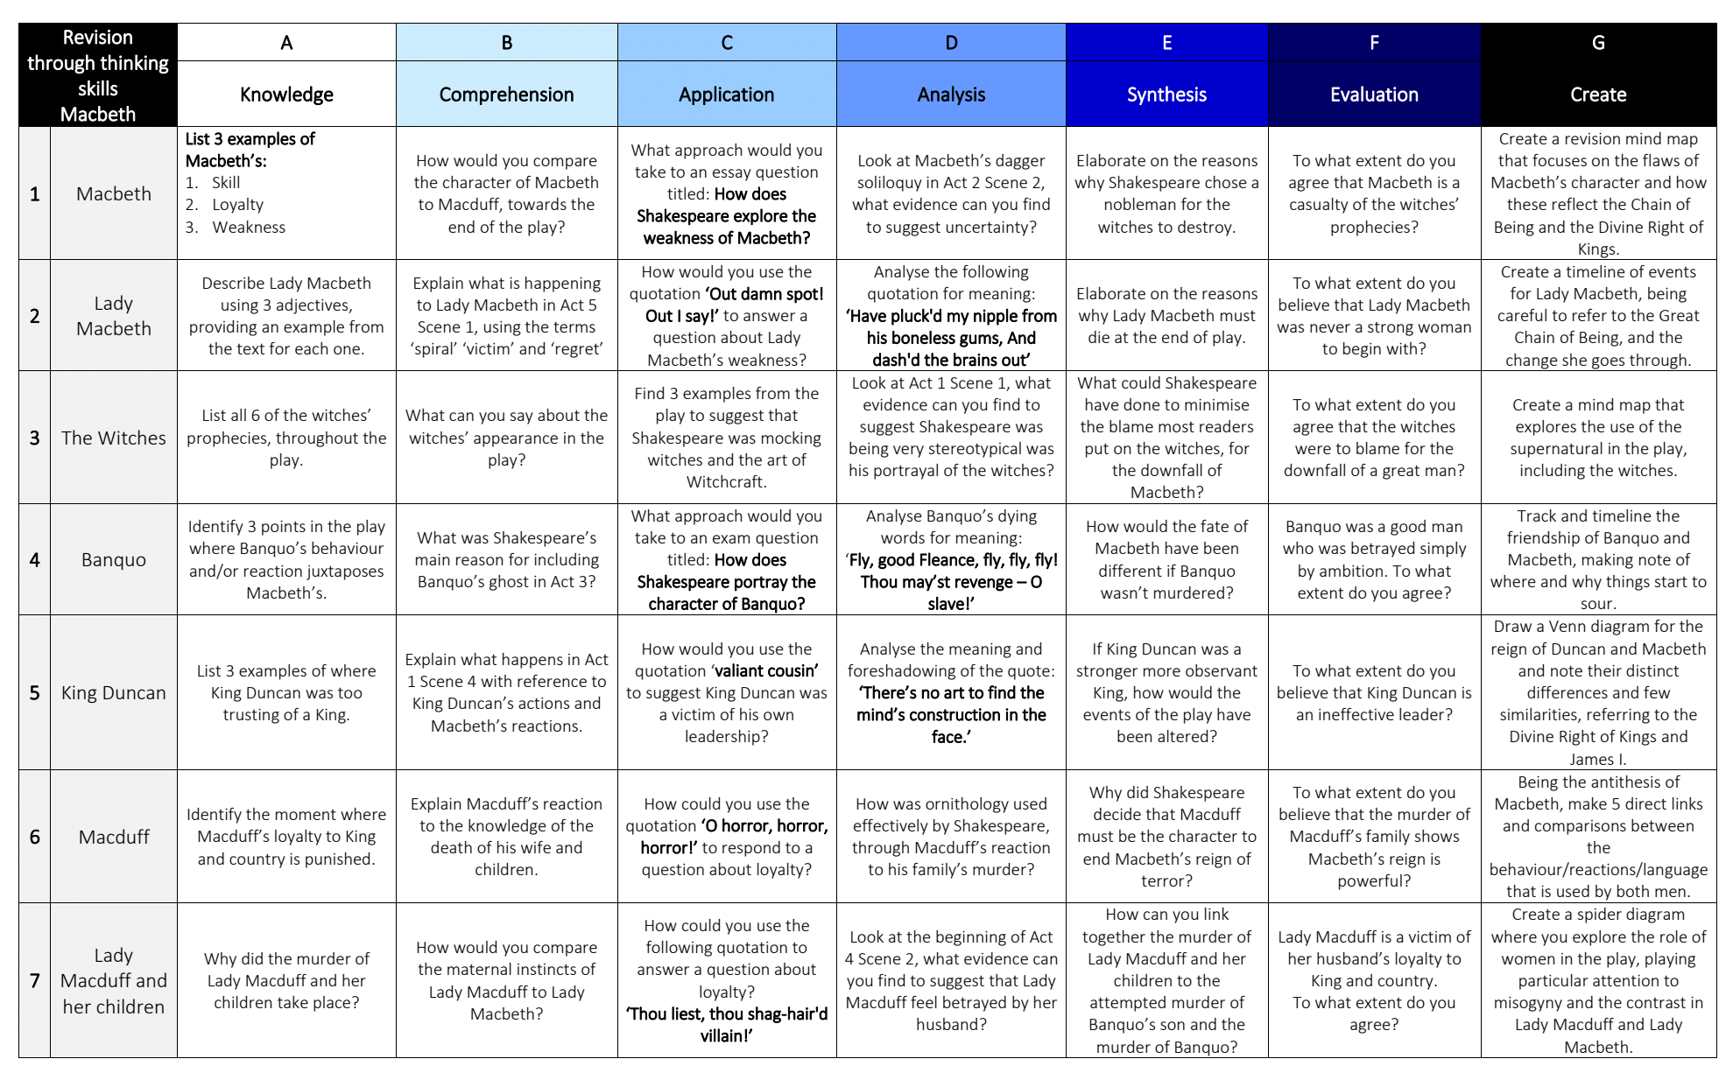

Slide 43
