Slide 1
Lesson 1 and 2
English Language, Paper 1 – Question 1 & 2 (new pro-forma)
November 2018 paper: ‘Sound of Thunder’ (T-Rex Paper)

Slide 2





YOUR TASK: Reviewing Language Paper 1
Retrieval
Knowledge
Acquisition
Application and Skills Development
Plenary/ Next Steps
Title: How do I approach English Language Paper 1, Question 1 and 2?
How many Language papers will I sit?
How many marks is each paper worth?
How is each paper structured?
What skill do I need to use when writing about Language / Structure for Q2 and 3?
What do I need to do for Q5?

Slide 3
YOUR TASK: Reviewing Language Paper 1
Retrieval
Knowledge
Acquisition
Application and Skills Development
Plenary/ Next Steps
Self- Assessment: Green pen your answers
I will sit 2 Language Papers (Paper 1 and Paper 2).
Each paper is worth 80 marks.
Each paper is structured into a Reading section (Q1-4) and a Writing section (Q5).
I need to use analysis when writing about Language / Structure for Q2 and 3?
For Q5, I need to write my own creative response, focusing on describe / narrate.

Slide 4

YOUR TASK: Information on English Language
Retrieval
Knowledge
Acquisition
Application and Skills Development
Plenary/ Next Steps
What is English Language?
Lots of the skills you need to answer you have already learnt through our English Literature work. Here are the paper breakdowns:
English Language, Paper 1:
You will get an extract from a fictional text.
Question 1: Select 4 correct answers (4 marks)
Question 2: Language analysis (8 marks)
Question 3: Structure (8 marks)
Question 4: Evaluation (20 marks)
Question 5: Descriptive/creative writing (40 marks)
English Language, Paper 2:
You will get two non-fiction sources.
Question 1: True or false (4 marks)
Question 2: Comparison between sources (8 marks)
Question 3: Language analysis (12 marks)
Question 4: Comparing attitudes (16 marks)
Question 5: Writing to persuade/argue (40 marks)

Slide 5
Paper 1 (1hr 45 mins) | What you have to do | Marks | Timings (15 mins for reading) | 25% Extra Time (2 hr, 12 mins) (20 mins for reading)
Q1 Select 4 | Select 4 details (Q.F. / pronoun) | 4 | 5 minutes | 5 minutes
Q2 Language | Analysis of Language (2 PEZALS) | 8 | 10 minutes | 13 minutes
Q3 Structure | Analysis of Structure (Track the extract, R/W) | 8 | 10 minutes | 13 minutes
Q4 Statement / Evaluate | Thesis – prove it 3-4 PEZALS – conclude | 20 | 20 mins | 25 mins
Q5 Writing Creatively (describe/ narrate) | Write a creative piece, focusing on description / narrative | 40 | 45 mins (5,35,5) // | 55 mins (10, 40, 5)

Slide 6
Paper 1 (1hr 45 mins) | What you have to do | Marks | Timings (15 mins for reading) | 25% Extra Time (2 hr, 12 mins) (20 mins for reading)
Q1 Select 4 | Select 4 details (Q.F. / pronoun) | 4 | 5 minutes | 5 minutes
Q2 Language | Analysis of Language (2 PEZALS) | 8 | 10 minutes | 13 minutes
Q3 Structure | Analysis of Structure (Track the extract, R/W) | 8 | 10 minutes | 13 minutes
Q4 Statement / Evaluate | Thesis – prove it 3-4 PEZALS – conclude | 20 | 20 mins | 25 mins
Q5 Writing Creatively (describe/ narrate) | Write a creative piece, focusing on description / narrative | 40 | 45 mins (5,35,5) // | 55 mins (10, 40, 5)

Slide 7

Paper 1,
Section A – Reading Time

Slide 8

YOUR TASK: Information on English Language
Timings: 15 minutes maximum
(20 extra time)
Retrieval
Knowledge
Acquisition
Application and Skills Development
Plenary/ Next Steps
How do I approach my reading time?
Note the source information on the front of the insert
Skim the Qs, highlight key words
Bracket key sections
Read the source (Tip: Answer Q1 immediately; you may find it helpful to highlight/ annotate ready for Q3 as you go!)
Let’s do this together now …

Slide 9
Paper 1,
Section A – Question 1

Slide 10
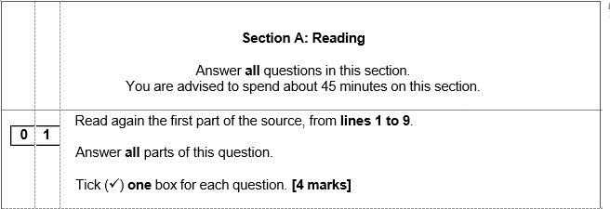
YOUR TASK: Information on English Language
Timings: 5 minutes maximum
Retrieval
Knowledge
Acquisition
Application and Skills Development
Plenary/ Next Steps
How do I approach Question 1?
Re-read lines 1-9
Take each question/option in turn
Put your finger on the moment that proves your selection to be true
Tick the correct answer
4 marks = done ☺

Slide 11

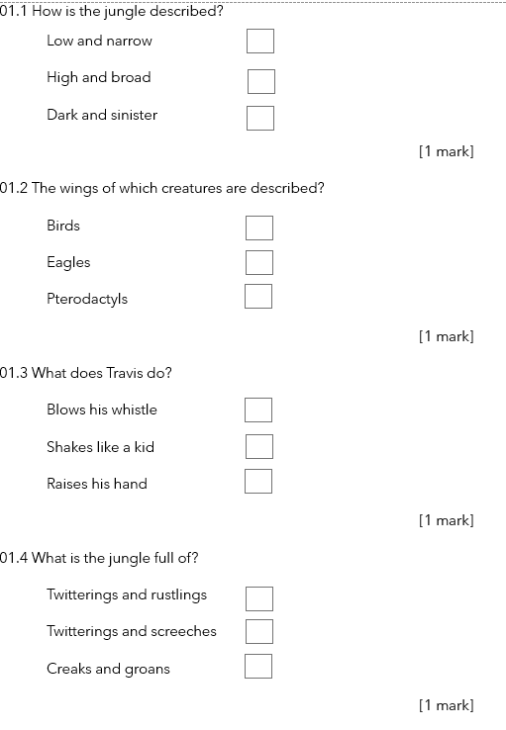
YOUR TASK: Information on English Language
Timings: 5 minutes maximum
Retrieval
Knowledge
Acquisition
Application and Skills Development
Plenary/ Next Steps
How do I approach Question 1?

Slide 12

YOUR TASK: Information on English Language
Timings: 5 minutes maximum
Retrieval
Knowledge
Acquisition
Application and Skills Development
Plenary/ Next Steps
Mark Question 1

Slide 13

EXIT TICKET
What do you need to remember when answering Question 1?
How will you specifically gain marks?
How will you make sure that you gain the highest level?

Slide 14
Paper 1,
Section A – Question 2

Slide 15

Question 2 of English Language Paper 1 asks you to analyse language in a short extract. In the grid below are a series of language and structural methods. Write down in each box whether the method is a language method or a structure method.
simile
analepsis
zooming in/out
change in tone
dialogue
personification
shift in focus
metaphor
tricolon
alliteration
verb
Introduction of new character
adjective
foreshadowing
sentences

Slide 16
Question 2 of English Language Paper 1 asks you to analyse language in a short extract. In the grid below are a series of language and structural methods. Write down in each box whether the method is a language method or a structure method.
Simile
Language
Analepsis
Structure
zooming in/out
Structure
change in tone
Structure
Dialogue
Structure
Personification
Language
shift in focus
Structure
Metaphor
Language
Tricolon
Language
Alliteration
Language
Verb
Language
Introduction of new character
Structure
Adjective
Language
Foreshadowing
Structure
Sentences
Language/Structure

Slide 17

TASK: Write out a definition for the following language techniques (methods).
Example:
1. Simile – Comparing one thing with another to make the description of something more vivid. Usually created with the use of the words ‘like’ or ‘as’ to compare.
2. Personification –
3. Metaphor -
4. Alliteration -
5. Hyperbole -
6. Adjective -
7. Verb -
8. List of three/triplet –
Extension: Write an example of each technique

Slide 18
TASK: Write out a definition for the following language techniques (methods).
DO NOW
Example:
1. Simile – Comparing one thing with another to make the description of something more vivid. Usually created with the use of the words ‘like’ or ‘as’ to compare.
2. Personification – giving human characteristics to something non-human
3. Metaphor - where one thing is said to represent another thing
4. Alliteration - the repetition of the same letter or sound in consecutive words
5. Hyperbole - exaggerated claims about something
6. Adjective - describing word
7. Verb - a doing word
8. List of three/triplet – a list of three adjectives
Extension: Write an example of each technique

Slide 19

YOUR TASK: Information on English Language
Timings: 10 minutes maximum
(13 extra time)
Retrieval
Knowledge
Acquisition
Application and Skills Development
Plenary/ Next Steps
How do I approach Question 2?
Question 2: 8 marks = 8-10 minutes
You will be given a smaller extract. Do not write outside these lines as it won't be marked. This question will always he phrased like this:
How does the writer use language here to describe the Tyrannosaurus Rex?
You could include the writer’s choice of:
words and phrases
language features and techniques (any similes, metaphors, personification that you can spot and write about the effect of)
sentence forms (only focus on sentence forms if you have something to say about them!)

Slide 20
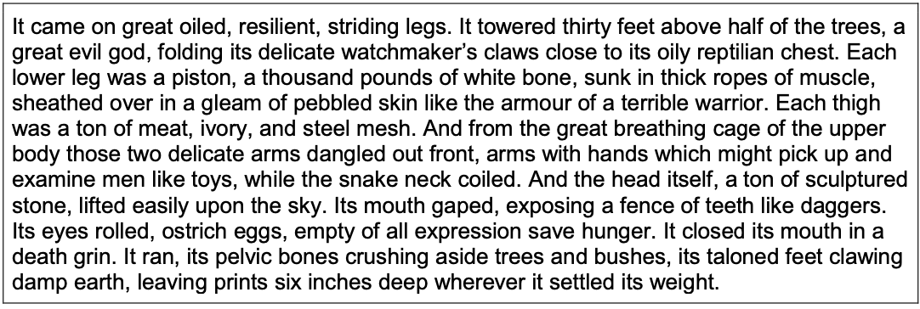


YOUR TASK: Information on English Language
Timings: 10 minutes maximum
(13 extra time)
Retrieval
Knowledge
Acquisition
Application and Skills Development
Plenary/ Next Steps
How do I approach Question 2?
Which words/phrases describe the T-Rex? What impression do you get of it? Highlight them. Can you tell me the word class of specific words?
Can you find any techniques (metaphor, simile, personification, any repeated reference to battles)?

Slide 21































YOUR TASK: Information on English Language
Timings: 10 minutes maximum
(13 extra time)
Retrieval
Knowledge
Acquisition
Application and Skills Development
Plenary/ Next Steps
How do I approach Question 2?
Adjectives Verbs Personification Battle imagery/semantic field
Metaphors (extended) Simile

Slide 22
Completing single word analysis
WORD: god (noun) Reason 1: mighty – creates a sense of terror Reason 2: impressive – not threatened by the humans Reason 3: cannot be defeated / immortal | WORD: armour (noun) Reason 1: Reason 2: Reason 3:
WORD: (word class) Reason1: Reason 2: Reason 3: | WORD: (word class) Reason1: Reason 2: Reason 3:

Slide 23
Completing single word analysis
Now see if you can take one box and link your ideas together in full sentences to create a small paragraph of single word analysis. Look at the example to help you. Notice how I have expanded on my ideas from the grid. See if you can do the same.
The writer refers to the Tyrannosaurus Rex as being like an ‘evil god’. Perhaps the writer chooses the ‘noun’ god to describe this mighty creature because it makes the T-Rex sound terrifying; it will show no mercy to the people who are running away from it. Gods are usually seen as impressive figures. It is clear the humans are not threatening the dinosaur. ‘God’ may also imply that it cannot be defeated; it is so strong it sounds almost immortal.

Slide 24




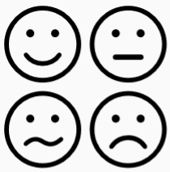
Q2 Practice: How does the writer use language here to describe the T-Rex?
Timings: 10 minutes maximum
(13 extra time)
POINT: How is the T-Rex presented at this point in the text? Be sure to use an adjective!
In the extract, the writer uses language to make the T-Rex sound …
EVIDENCE: What evidence do you have to support your point? Be sure to label the technique and explain the literal meaning of your evidence!
This becomes evident in the *language feature* “________” which conveys an impression of…
ZOOM: Select two word choices, label each one and explain the meanings created by the specific choices. Try to say two different things about each word choices.
In particular, the use of the word class (verb/adjective/verb) *word choice* “___” suggests that…
Moreover (or: On the other hand), the *word choice* “____” could imply that the T-Rex is …
ANALYSIS: Consider and explain the atmosphere created using three abstract nouns.
In doing so, the writer creates a sense of … which reflects …
LINK: Explain how the reader is encouraged to feel and what we are encouraged to question/consider.
As a result, a reader is encouraged to … as they…
Notes:
10 mins 1 paragraph using

Slide 25
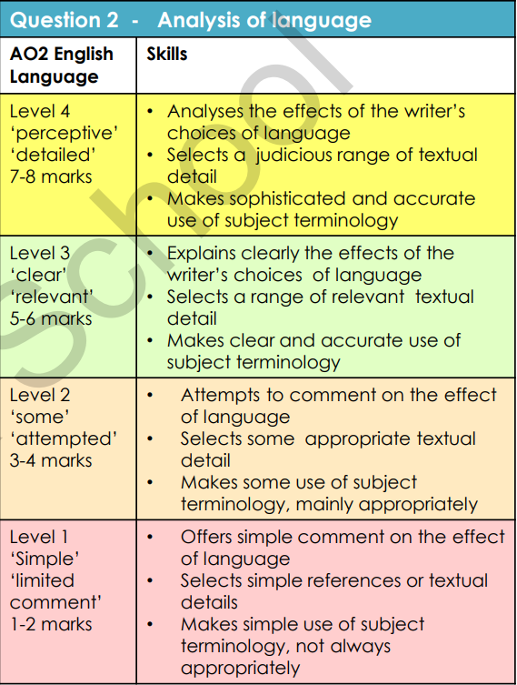

Be the examiner… what mark & why?
The Tyrannosaurus Rex ‘towered thirty feet’ above the trees, suggesting it is bigger and higher than everything else. The writer uses metaphors to describe it as a ‘great evil god’, so it sounds not only big but bad, and also a ‘terrible warrior’, suggesting it fights to get what it wants. | The writer says the Tyrannosaurus Rex ‘towered’ over the jungle. The verb ‘towered’ suggests great height, as if it is leaning over everything below it in a scary and threatening way. The creature is described metaphorically as a ‘great evil god’ to suggest its massive size, and powerful and wicked nature. This idea is continued with the image of a ‘terrible warrior’, implying the Tyrannosaurus Rex is a fighter to be feared, prepared to use its strength to inflict damage on its enemy
The writer employs an extended metaphor of power and strength to describe the Tyrannosaurus Rex. He says it ‘towered’ over the trees, the verb ‘towered’ suggesting that the huge creature is imposing itself on its jungle surroundingsfrom a great height, and intimidating everything beneath it. It is personified as a ‘great evil god’, implying the Tyrannosaurus Rex is an all-powerful being without mercy, and also a ‘terrible warrior’, an image that conveys the idea of an invincible fighting machine destroying everything in its wake. | The Tyrannosaurus Rex ‘towered thirty feet above half of the trees’, and the word ‘towered’ tells us it’s big. The writer says it is a ‘great evil god’ and a ‘terrible warrior’ so it sounds horrible.
What marks would you give and why?

Slide 26
Be the examiner…
The Tyrannosaurus Rex ‘towered thirty feet’ above the trees, suggesting it is bigger and higher than everything else. The writer uses metaphors to describe it as a ‘great evil god’, so it sounds not only big but bad, and also a ‘terrible warrior’, suggesting it fights to get what it wants. 3 – 4 marks | The writer says the Tyrannosaurus Rex ‘towered’ over the jungle. The verb ‘towered’ suggests great height, as if it is leaning over everything below it in a scary and threatening way. The creature is described metaphorically as a ‘great evil god’ to suggest its massive size, and powerful and wicked nature. This idea is continued with the image of a ‘terrible warrior’, implying the Tyrannosaurus Rex is a fighter to be feared, prepared to use its strength to inflict damage on its enemy. 5 – 6 marks
The writer employs an extended metaphor of power and strength to describe the Tyrannosaurus Rex. He says it ‘towered’ over the trees, the verb ‘towered’ suggesting that the huge creature is imposing itself on its jungle surroundings from a great height, and intimidating everything beneath it. It is personified as a ‘great evil god’, implying the Tyrannosaurus Rex is an all-powerful being without mercy, and also a ‘terrible warrior’, an image that conveys the idea of an invincible fighting machine destroying everything in its wake. 7 – 8 marks | The Tyrannosaurus Rex ‘towered thirty feet above half of the trees’, and the word ‘towered’ tells us it’s big. The writer says it is a ‘great evil god’ and a ‘terrible warrior’ so it sounds horrible. 1 – 2 marks
What marks would you give and why?

Slide 27
Q2 Peer Assessment
Use the success criteria to give your partner’s work a mark out of 8 for Q2.

Slide 28


YOUR TASK: Information on English Language
Timings: 10 minutes maximum
(13 extra time)
Retrieval
Knowledge
Acquisition
Application and Skills Development
Plenary/ Next Steps
EXIT TICKET
How do I approach Question 2?
To finish …
Write down your top tips to answer Question 2.
Paper 1:
Question 1
Question 2
Question 3
Question 4
Question 5

Slide 29
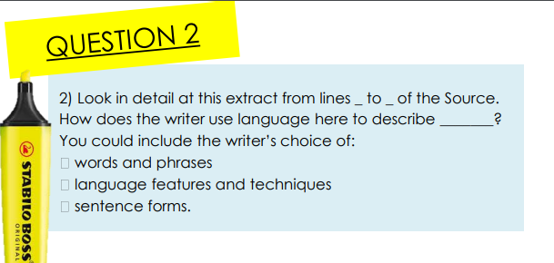
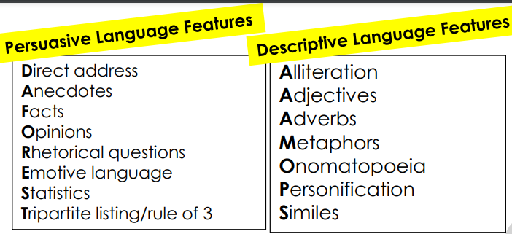
Question 2: Mark Scheme

Slide 30


AQA English Language – Paper 1, Question 2
Question 2 of English Language Paper 1 will ask you to analyse language. This means you have to consider WHY the writer has used certain words and phrases. What effect are they trying to achieve and how do particular words or phrases help them to achieve it? Remember, question 2 is worth 8 marks.
DON’T
just purely talk about punctuation and sentence forms. Whilst you can discuss these elements, you will find it easier to pick up marks by talking about the language used.
just summarise what the writer has said. You MUST use quotations and talk about them!
list lots of quotations at once. Write about one quotation before moving on to the next.
make a brief comment about your chosen quotations. Try and explore multiple ideas.
DO
include single word analysis and subject terminology.
read the extract carefully and pick your quotations wisely. Make sure you can say something about the words/phrases you pick out before you write about them!
think about why the writer has used a certain word or phrase. What do they want/need a reader to feel and how does their choice of language help them to achieve this?

Slide 31

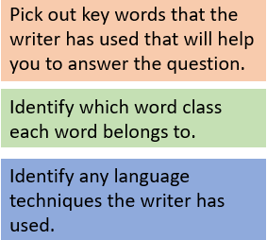
Q2: Practice questions:
Extract from ‘Twilight’ by Stephanie Meyer:
And then, as the room went black, I was suddenly hyperaware that Edward was sitting less than an inch from me. I was stunned by the unexpected electricity that flowed through me, amazed that it was possible to be more aware of him than I already was. A crazy impulse to reach over and touch him, to stroke his perfect face just once in the darkness, nearly overwhelmed me. I crossed my arms tightly across my chest, my hands balling into fists. I was losing my mind. The opening credits began, lighting the room by a token amount. My eyes, of their own accord, flickered to him. I smiled sheepishly as I realised his posture was identical to mine, fists clenched under his arms, right down to the eyes, peering sideways at me. He grinned back, his eyes somehow managing to smoulder, even in the dark. I looked away before I could start hyperventilating. It was absolutely ridiculous that I should feel dizzy.
How does the writer use language here to describe Bella’s feelings towards Edward?
You could include the writer’s choice of:
• words and phrases
• language features and techniques
• sentence forms. [8 marks]

Slide 32
Q2: Practice questions:
Extract from ‘A Christmas Carol’ by Charles Dickens:
Marley’s face. It was not in impenetrable shadow as the other objects in the yard were, but had a dismal light about it, like a bad lobster in a dark cellar. It was not angry or ferocious, but looked at Scrooge as Marley used to look: with ghostly spectacles turned up on its ghostly forehead. The hair was curiously stirred, as if by breath or hot-air; and, though the eyes were wide open, they were perfectly motionless. That, and its livid colour, made it horrible; but its horror seemed to be, in spite of the face and beyond its control, rather than a part of its on expression.
How does the writer use language here to describe Marley?
You could include the writer’s choice of:
• words and phrases
• language features and techniques
• sentence forms. [8 marks]

Slide 33
Lesson 3
English Language, Paper 1 – Question 3 (new pro-forma)
November 2018 paper: ‘Sound of Thunder’ (T-Rex Paper)

Slide 34
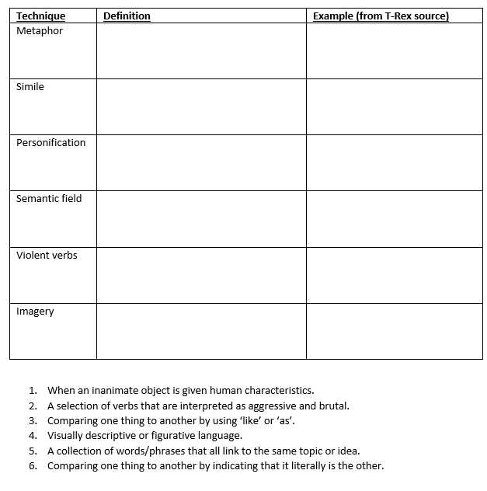
YOUR TASK: Knowledge Retrieval
Retrieval
Knowledge
Acquisition
Application and Skills Development
Plenary/ Next Steps
Title: How do I approach English Language Paper 1, Question 3?
Retrieval
Please complete the techniques retrieval sheet.
These are some of the techniques you could identify in the Language paper.

Slide 35
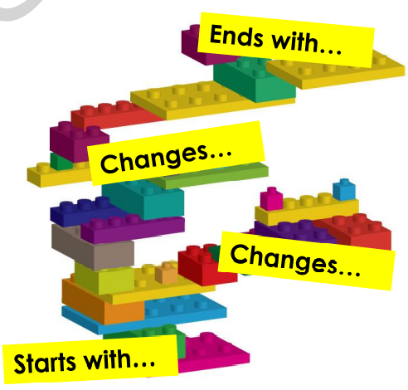
Paper 1:
Section A – Question 3

Slide 36
YOUR TASK: Knowledge Retrieval
Timings: 10 minutes maximum
(13 extra time)
Retrieval
Knowledge
Acquisition
Application and Skills Development
Plenary/ Next Steps
Title: How do I approach English Language Paper 1, Question 3?
What do we mean by structure?
Structure refers to the arrangement / sequencing of a text. When we consider, we need to think about the “journey of the piece”. What journey does the writer take the reader on? We need to remember that writers structure their texts deliberately to make the reader think and feel certain things.
When we look at structure in a text, we look at certain things:
What happens at the beginning of the extract and why?
What happens at the end of the extract and why?
Do the characters use speech/dialogue?
Shifts in person, time, tone, setting
Foreshadowing (hinting at something that will happen later)
Cyclical structure – does the text end in a similar way to how it started?

Slide 37
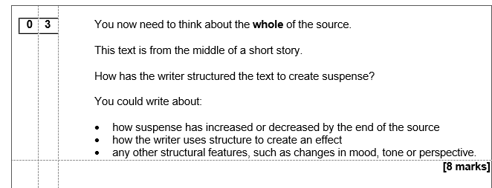
YOUR TASK: Understanding the Q
Timings: 10 minutes maximum
(13 extra time)
Retrieval
Knowledge
Acquisition
Application and Skills Development
Plenary/ Next Steps
Title: How do I approach English Language Paper 1, Question 3?

Slide 38
Timings: 10 minutes maximum
(13 extra time)
In pairs, re-read the source and discuss the table below:
Retrieval
Knowledge
Acquisition
Application and Skills Development
Plenary/ Next Steps
Does the extract do any of these things?
The characters speak to each other. (dialogue)​ | The extract begins in one location, but then changes to a different place (shift in setting).​ | The extract begins by taking place in the morning, but in the next paragraph changes to the afternoon (shift in time).​
The extract changes from being one tone to another. (shift in tone) | The extract begins by following one character, but then changes to a different character.​ (shift in character) | The extract hints at something that will happen later.​ (foreshadowing)
The extract ends in the same way that it begins.​ (cyclical structure) | The extract is broken up into small chunks of writing.​ (paragraphs) | The extract changes from hearing one character's thoughts to a different character's thoughts.​ (narrative perspective)

Slide 39

Q3: STRUCTURE - [8 marks/10 mins]
Timings: 10 minutes maximum
(13 extra time)
Re-read the extract and consider what happens and when.
When do moments of suspense occur / increase / decrease? This will form the main basis for your response!
Can you spot any other structural devices that contribute to the suspense created?
Analyse the effect on the reader in as much detail as possible.
Talk about a RANGE of devices (3 or more)
Use well chosen evidence (precise key-word quotations) to support each idea.

Slide 40
Q3: STRUCTURE – LET’S FEEDBACK
Timings: 10 minutes maximum
(13 extra time)
Re-read the extract and consider what happens and when.
When do moments of suspense occur / increase / decrease? This will form the main basis for your response!
Can you spot any other structural devices that contribute to the suspense created?
Analyse the effect on the reader in as much detail as possible.
Talk about a RANGE of devices (3 or more)
Use well chosen evidence (precise key-word quotations) to support each idea.

Slide 41
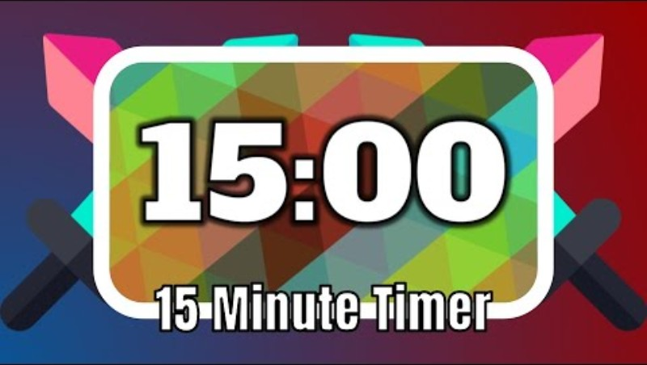
YOUR TASK: Question 3 - Writing about Structure
Timings: 10 minutes maximum
(13 extra time)
Retrieval
Knowledge
Acquisition
Application and Skills Development
Plenary/ Next Steps
How is suspense created overall? (mini thesis)
Throughout this extract, the writer creates a sense of suspense through …
Comment on the sense of suspense at the beginning? Present – why/why not?
At the beginning of the text, …
What happens about as the text progresses / by the end?
As the text progresses, the writer … / By the end of the text, …
Does the tone change at all? Where?
The tone of the text changes when …
Is there anything else interesting going on with the structure? Dialogue? Paragraphing?

Slide 42
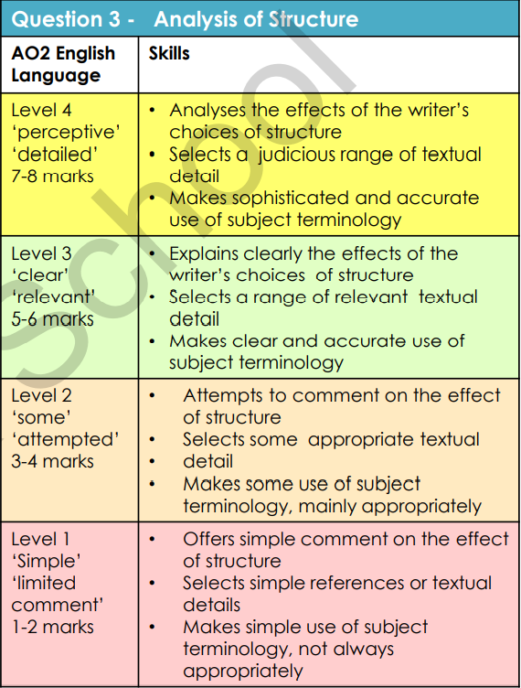
Q3 Peer Assessment
Use the success criteria to give your partner’s work a mark out of 8 for Q3

Slide 43
YOUR TASK: Retrieving Literature texts
Timings: 10 minutes maximum
Retrieval
Knowledge
Acquisition
Application and Skills Development
Plenary/ Next Steps
EXIT TICKET
Title: How do I approach English Language Paper 1, Question 3?
To finish off …
Write down 3 examples of structural techniques you could look for in the extract you get in your mock and what this technique means.
Paper 1:
Question 1
Question 2
Question 3
Question 4
Question 5

Slide 44
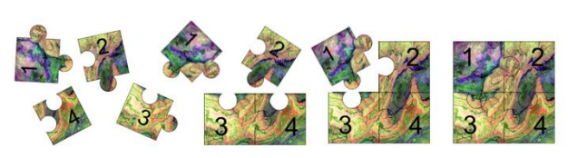
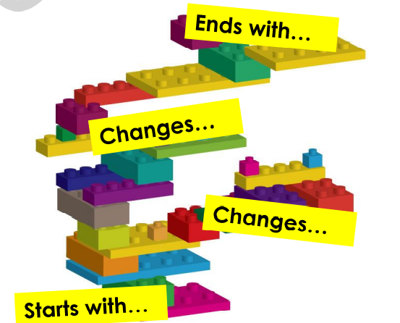
What does ‘structure’ really mean?
STRUCTURAL DEVICES TO LEARN
Zooming in from something big to something smaller
Shifting between different times
A gradual introduction of new characters at significant points
Moving from inside to the wider outside world
Following a cyclical shape; shifting focus through a series of points and ending up back at the beginning.
Combining external actions with internal thoughts
Shifting between different points of view
Moving from wider outside world to inside
Shifting between different places
Developing and reiterating; focusing on a dominant point of view by expanding and repeating it.
9

Slide 45

Another way of considering structure …
From AQA website
Whose views?
Who is telling the story? What perspective is it from?
What time is it?
How is time ordered in it? What sort of sequence do I see?
Where am I?
What’s the place, location, setting? How did I find out?
9
Who is here?
What character(s) have I met and how were they introduced?
What’s it made of?
What shapes, styles, patterns can I see in the sentences?

Slide 46
Lesson 4
English Language, Paper 1 – Question 4 (new pro-forma)
Key Skill: Evaluation
November 2018 paper: ‘Sound of Thunder’ (T-Rex Paper)

Slide 47
YOUR TASK: Reviewing Language Paper 1
Retrieval
Knowledge
Acquisition
Application and Skills Development
Plenary/ Next Steps
Title: Language Paper 1 Recall
How many marks is Section A worth?
How are the marks awarded across Q1-4?
How many marks is Section B worth?
How are the marks awarded for Q5?
What is meant by evaluation?

Slide 48
Paper 1,
Section A – Question 4

Slide 49
YOUR TASK: Retrieving Literature texts
Retrieval
Knowledge
Acquisition
Application and Skills Development
Plenary/ Next Steps
Title: How do I approach English Language Paper 1, Question 4?
Retrieval: Which structural technique is being described here?
Choose from:
Foreshadowing
Shift in tone
Shift in character
Dialogue
Narrative perspective
Paragraph
Shift in time
Cyclical structure
Shift in setting
The characters speak to each other. | The extract begins in one location, but then changes to a different place.​ | The extract begins by taking place in the morning, but in the next paragraph changes to the afternoon.​
The extract changes from being one tone to another. | The extract begins by following one character, but then changes to a different character.​ | The extract hints at something that will happen later.​
The extract ends in the same way that it begins.​ | The extract is broken up into small chunks of writing.​ | The extract changes from hearing one character's thoughts to a different character's thoughts.​

Slide 50
YOUR TASK: Information on Paper 1 Question 4
Timings: 25 minutes maximum
Retrieval
Knowledge
Acquisition
Application and Skills Development
Plenary/ Next Steps
Title: How do I approach English Language Paper 1, Question 4?
Paper 1, Queston 4 (20 marks – a lot of marks!)
This question tests your evaluation skills, but you can approach it in the same way you would look at a language analysis question.
You will be given a statement about the text. It is not a trick question - it is easier to agree with it than to disagree with it!
You can disagree with parts, but overall you want to find evidence that supports the question.
Sometimes there are two parts to the statement, so you will need to read it carefully.
20 marks = 20-25 minutes. Do not forget about or skip this question!

Slide 51
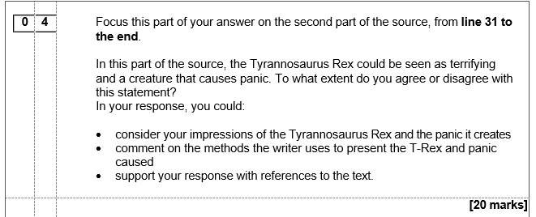
YOUR TASK: Paper 1 Question 4 – the question
Timings: 25 minutes maximum
Retrieval
Knowledge
Acquisition
Application and Skills Development
Plenary/ Next Steps
Title: How do I approach English Language Paper 1, Question 4?
Let's re-read the Source from yesterday.
Today, we will focus on Question 4 – methods / the statement.
As a class, let’s create a mind-map of as many methods as we can think of.

Slide 52
YOUR TASK: Paper 1 Question 4 – the question
Timings: 25 minutes maximum
Retrieval
Knowledge
Acquisition
Application and Skills Development
Plenary/ Next Steps
Title: How do I approach English Language Paper 1, Question 4?
Now, let’s now focus on the statement. There are two parts to this statement – the monster as terrifying, the monster as causing panic.
Look for evidence of the monster as something that creates terror and as something that creates panic – is there panic from line 31 onwards or does Eckles have a different reaction to begin with? Highlight and annotate.
Look for evidence that the monster is terrifying/ causes panic.

Slide 53
YOUR TASK: Putting it all together for your answer
Timings: 25 minutes maximum
Retrieval
Knowledge
Acquisition
Application and Skills Development
Plenary/ Next Steps
Title: How do I approach English Language Paper 1, Question 4?
Mini thesis – give your overall opinion:
For the most part, I agree that the monster is described as terrifying. However, I would contest that …
Get into it – outline your ideas, prove your point/ develop a case (PEZAL):
When Eckels first sees the T-Rex, he says '….', which suggests to me that he isn't panicked as he is/has ... He feels … I think that Eckels panic increases when … ' ….' This implies to us that … By the end of the extract, he is '…', conveying that he is ...
As the reader, we understand why he may feel panic because of the way the dinosaur is described as terrifying, like the student says. He is described as '…' and '…', which creates the impression that … It makes us think that …

Slide 54
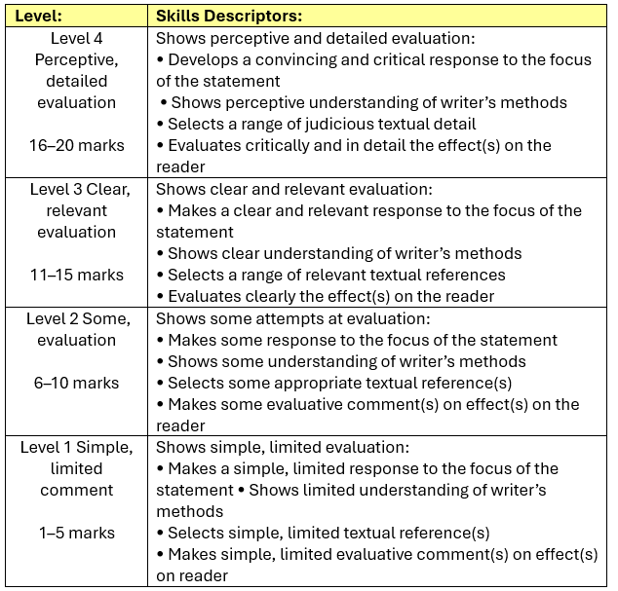
Question 4: Self assess your work, using the criteria below – what mark and why?

Slide 55
YOUR TASK: Top tips for Question 4
Timings: 25 minutes maximum
Retrieval
Knowledge
Acquisition
Application and Skills Development
Plenary/ Next Steps
EXIT TICKET
Write down your top tips to yourself to answer Question 4:
In Question 4, I should spend …
Paper 1:
Question 1
Question 2
Question 3
Question 4
Question 5

Slide 56
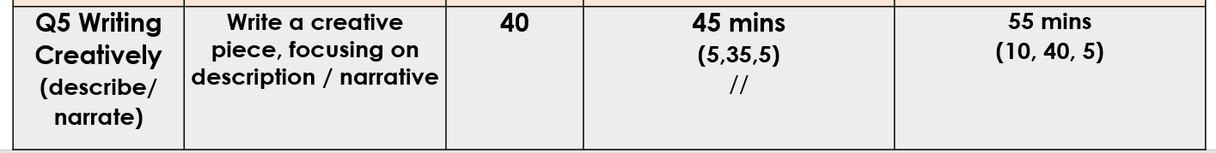
Lesson 5 and 6
Paper 1 – Question 5
Descriptive writing

Slide 57
Paper 1,
Section A – Question 5

Slide 58
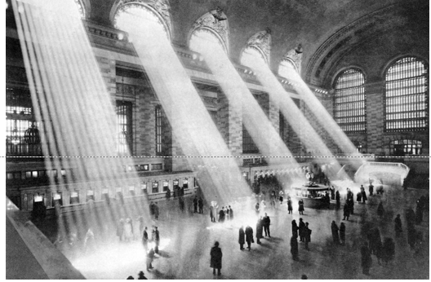
YOUR TASK: Reviewing Language Paper 1
Retrieval
Knowledge
Acquisition
Application and Skills Development
Plenary/ Next Steps
Title: How do I approach English Language Paper 1, Question 5
Look at the image. What ideas/ impressions/thoughts come to mind?
Jot down ideas around the outside of the image.

Slide 59
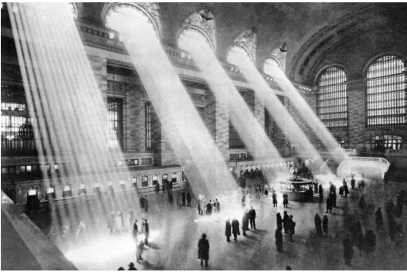
WAGOLL: what makes this opening successful?
You could start….
Light streamed through the upper windows of the station, five pillars that seemed to hold up the very roof itself. The throngs of commuters seemed to avoid the light as if it would burn them, some standing, others running, a few drifting aimlessly as they looked at their phones, entranced by something more important in their little virtual world. The air inside was …….

Slide 60
Write the next paragraph.
Light streamed through the upper windows of the station, five pillars that seemed to hold up the very roof itself. The throngs of commuters seemed to avoid the light as if it would burn them, some standing, others running, a few drifting aimlessly as they looked at their phones, entranced by something more important in their little virtual world. The air inside was …….

Slide 61

Self Assessment
AO5: Success Criteria
Content Tone and style is matched to the given genre, audience and purpose Effective vocabulary Range of suitable language techniques Organisation Range of suitable structural techniques Writing interests the reader Range of clear paragraphs with discourse markers
AO6: Success Criteria
Accurately punctuated sentences Wide range of punctuation marks Wide range of sentence types and lengths Grammatically correct Standard English Accurate spelling Sophisticated vocabulary
Give yourself an EBI from the list on the right.
Notes:
Image: http://www.freestockphotos.biz/stockphoto/16633 & https://pixabay.com/en/pencil-eraser-rubber-red-write-307508/

Slide 62
YOUR TASK: Reviewing Language Paper 1
Retrieval
Knowledge
Acquisition
Application and Skills Development
Plenary/ Next Steps
Title: Language Paper 1 Question 5 Recall
Tell me how you approach Question 5!!

Slide 63
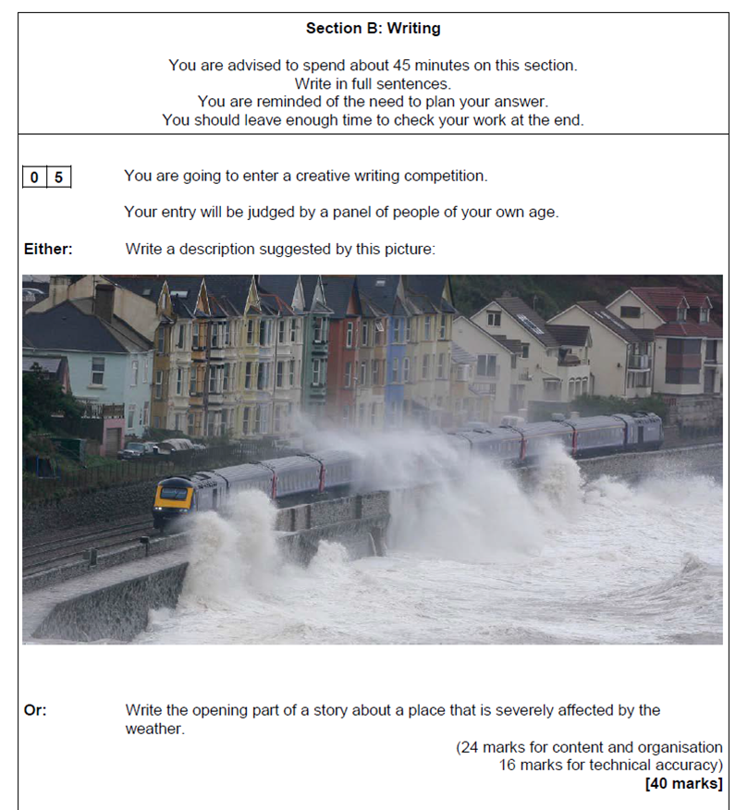
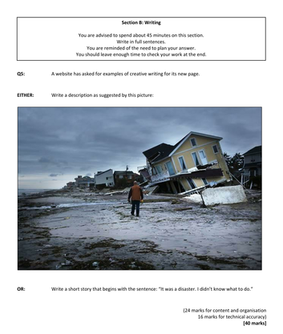
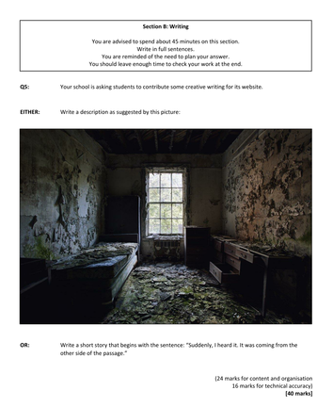
YOUR TASK: Information on Paper 1 Question 5
Timings: 45/55 minutes maximum
Retrieval
Knowledge
Acquisition
Application and Skills Development
Plenary/ Next Steps
Title: How do I approach English Language Paper 1, Question 5?
Paper 1 Question 5 is worth 40 marks.
24 marks – content and organisation
16 marks – technical accuracy
This means you should be spending about 40-45 minutes on it. It is a writing question, which means you are being assessed on your writing skills.

Slide 64
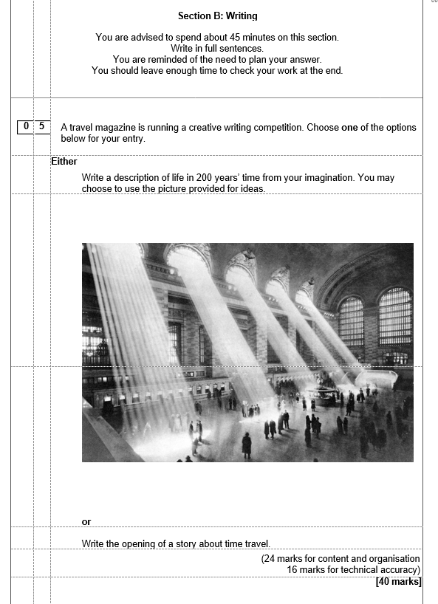
YOUR TASK: Information on Paper 1 Question 5
Timings: 45/55 minutes maximum
Retrieval
Knowledge
Acquisition
Application and Skills Development
Plenary/ Next Steps
Title: How do I approach English Language Paper 1, Question 5?
You will be given an option.
Write a description suggested by the picture / using your imagination.
Or
Write the opening of a story following a prompt.

Slide 65
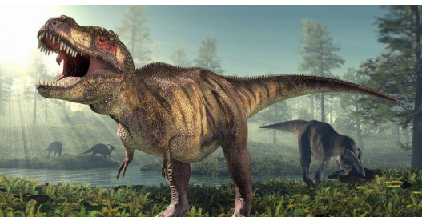
Method Recall: Find, highlight and label the language and structural devices in the description. Choose from the devices in red and explain what each device means when you label them. One has been done for you.
Simile – Comparing one thing to another using the words ‘like’ or ‘as’.
The stench, like rotting garbage, was the first indication that the peace was about to be broken. Next came the sound of long, heavy strides through the trees, an ominous rumbling that threatened perilous danger. A low growl. A glimpse of pebbled, leathery flesh amongst the ferns, unusually bright but perfectly camouflaged amongst the plants that seemed to sway uneasily.
Whatever had disturbed the jungle had seemed to cause it to fall completely silent, yet as more time passed, life went on and the continuous, high pitched sounds of insects, singing together in a chorus, resumed once more.
Without warning, the T-Rex burst through the foliage, smashing what stood in its way, jaws lined with sharp daggers clamping down on another dinosaur, its next meal. It held on, slicing easily through meat as its prey thrashed and flailed, both dinosaurs locked in a chaotic and violent dance that only one would survive.
SMILE
METAPHOR
SHIFT IN FOCUS
ZOOM IN
PERSONIFICATION
CHANGE IN TONE

Slide 66
Method Recall: Find, highlight and label the language and structural devices in the description. Choose from the devices in red and explain what each device means when you label them. One has been done for you.
Simile – Comparing one thing to another using the words ‘like’ or ‘as’.
The stench, like rotting garbage, was the first indication that the peace was about to be broken. Next came the sound of long, heavy strides through the trees, an ominous rumbling that threatened perilous danger. A low growl. A glimpse of pebbled, leathery flesh amongst the ferns, unusually bright but perfectly camouflaged amongst the plants that seemed to sway uneasily.
Whatever had disturbed the jungle had seemed to cause it to fall completely silent, yet as more time passed, life went on and the continuous, high pitched sounds of insects, singing together in a chorus, resumed once more.
Without warning, the T-Rex burst through the foliage, smashing what stood in its way, jaws lined with sharp daggers clamping down on another dinosaur, its next meal. It held on, slicing easily through meat as its prey thrashed and flailed, both dinosaurs locked in a chaotic and violent dance that only one would survive.
SMILE
METAPHOR
SHIFT IN FOCUS
ZOOM IN
PERSONIFICATION
CHANGE IN TONE

Slide 67

YOUR TASK: Paper 1 Question 5 Method
Timings: 45/55 minutes maximum
Retrieval
Knowledge
Acquisition
Application and Skills Development
Plenary/ Next Steps
Title: How do I approach English Language Paper 1, Question 5?
My advice would be to split your image into 4 sections or choose 4 “boxes”.
Write one paragraph on each section.
You are using the image as a springboard, but you are allowed to describe other things too – just no drama, murders, machine guns etc. Unless the image suits it!

Slide 68
YOUR TASK: What will you be marked on?
Timings: 45/55 minutes maximum
Retrieval
Knowledge
Acquisition
Application and Skills Development
Plenary/ Next Steps
Title: How do I approach English Language Paper 1, Question 5?
Things you will be marked on for this question:
Sentence structure (do your sentences make sense?)
Spelling
Impressive vocabulary
Language techniques (similes, metaphors etc)
How engaging your writing is
Punctuation
Paragraphs

Slide 69
YOUR TASK: Practising Paper 1 Question 5
Timings: 45/55 minutes maximum
Retrieval
Knowledge
Acquisition
Application and Skills Development
Plenary/ Next Steps
I have identified all the nouns in this image. You need to write these down and add an adjective to describe each noun. Try to think of impressive vocabulary.
Tree
Leaf
Trunk
Waterfall
Cliff
Rock - smooth
Stone
Water
Lake
Fish

Slide 70
YOUR TASK: Practising Paper 1 Question 5
Timings: 45/55 minutes maximum
Retrieval
Knowledge
Acquisition
Application and Skills Development
Plenary/ Next Steps
Next, write down any verbs and adverbs that you can think of for these nouns.
Tree
Leaf
Trunk
Waterfall - crashed
Cliff
Rock - smooth
Stone
Water - rushed
Lake
Fish

Slide 71
YOUR TASK: Practising Paper 1 Question 5
Timings: 45/55 minutes maximum
Retrieval
Knowledge
Acquisition
Application and Skills Development
Plenary/ Next Steps
Split the image in four parts to guide your sentences. When you write, avoid using second person completely - 'you could see …'. Ideally, use third person perspective but it is okay to use first person too.
Now, we will focus on piecing this together. You should now have a selection of verbs, adjectives, adverbs and nouns. Through doing this, you will have subconsciously thought about the 5 senses too! Think about your vocabulary.
Write a minimum of two sentences for each quarter (you would need to write more than this in the exam). A good way to write in third person is to imagine that you are a camera lens, describing what the lens can see.
A torrent of water crashed from the powerful waterfall …

Slide 72
YOUR TASK: Top tips for Question 5
Timings: 45/55 minutes maximum
Retrieval
Knowledge
Acquisition
Application and Skills Development
Plenary/ Next Steps
EXIT TICKET
Title: How do I approach English Language Paper 1, Question 5?
Write down your top tips to yourself to answer Question 5:
In Question 5, I should spend …
I should include …
Paper 1:
Question 1
Question 2
Question 3
Question 4
Question 5

Slide 73

YOUR TASK: Reviewing Language Paper 1
Retrieval
Knowledge
Acquisition
Application and Skills Development
Plenary/ Next Steps
Title: How do I approach English Language Paper 1, Question 5
Look at the image. What ideas/ impressions/ thoughts come to mind?
Jot down ideas around the outside of the image.

Slide 74
YOUR TASK: Practising Paper 1 Question 5
Timings: 45/55 minutes maximum
Retrieval
Knowledge
Acquisition
Application and Skills Development
Plenary/ Next Steps
Know the 5 Steps to answering Q5!
The Process – A Reminder: 5 min plan – 35 min write – 5 min check (or 10-40-5)
Look at the image/ question. Decide which one you will answer (TIP: You must describe anyway to hit the highest marks – and something needs to happen (a shift), so there will be a narrative element anyway). (Tip 2: If it helps, think about your “character” and “drop” them into this moment).
Jot down thoughts/ideas/ possibilities around the image. (Tip: If you are stuck for ideas, use the “boxing” method. These will then become your key 3-5 moments of focus).
On your writing paper, jot down your plan.
For the plan, jot down your 4-5 BIG IDEAS (essentially, the what (plot). Then, next to each idea, jot down the devices you will be sure to include (the how). (Tip: It might be helpful to think about it as: Setting/Exposition (drop), Zoom in, Shift, Zoom out, Conclude (cyclical?).
Write. Check.

Slide 75
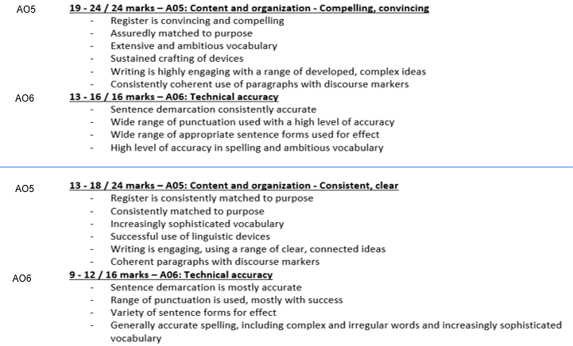
YOUR TASK: Practising Paper 1 Question 5
Timings: 45/55 minutes maximum
Retrieval
Knowledge
Acquisition
Application and Skills Development
Plenary/ Next Steps
Peer Assessment: The Mark Scheme – what mark would you award your peer and why?

Slide 76
EXIT TICKET
Write down three things you will remember to do for Question 5

Slide 77


POWERFUL KNOWLEDGE
DO
DON’T
Take your time. Think about what you can describe. You will need to add description, even if you are writing a story.
Use a variety of punctuation. Demonstrate that you can use more than just full stops. Make sure punctuation is used accurately. –
Keep things believable. Fast paced stories that race through a complicated plot find it harder to pick up marks.
Use a variety of sentence lengths and structures. Stories that only include short sentences begin to sound like a list.
Proof read! Remember, 16 marks are dedicated towards your spelling, punctuation and grammar.
Make changes to the picture if you want to. You do not have to stick to it exactly.
Rely on clichés. Lots of students will be writing about tears falling down cheeks and feeling shivers down spines. You want to make your writing stand out.
Rush through your plot. A common mistake students make is trying to cram lots into their stories in a short amount of time. A rushed plot means there will be very little detail.
Try and think of an overcomplicated plot. Keep things believable! The best and most sophisticated answers are usually where not a lot happens at all!
Overuse particular structural features like paragraphing for effect. If you do that, you’ll lose the effect you were hoping to create in the first place.

Slide 78
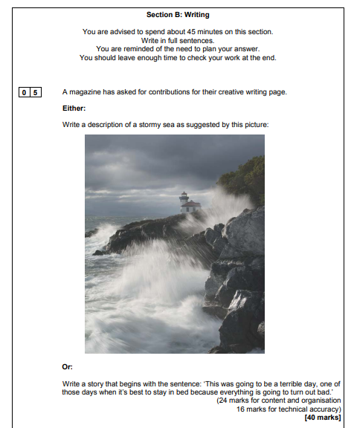
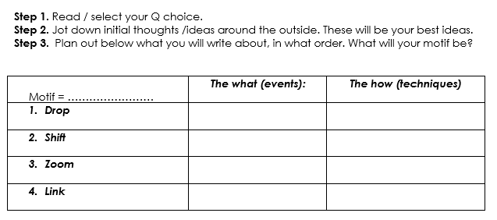
YOUR TASK: Further Practice
Timings: 45/55 minutes maximum
Retrieval
Knowledge
Acquisition
Application and Skills Development
Plenary/ Next Steps
N.B. You may refer to your imagination for the first option. You only need to write the opening of the story for the second option.

